Slide 1
BLE-Guardian: Protecting the Privacy of BLE Users
Kassem Fawaz*, Kyu-Han Kim†, Kang G. Shin*
*Computer Science and Engineering, University of Michigan
†Hewlett Packard Labs

Slide 2
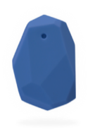
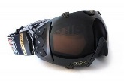
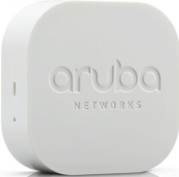
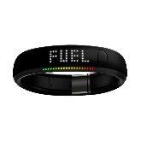
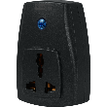
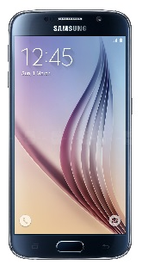
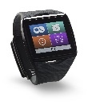
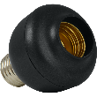
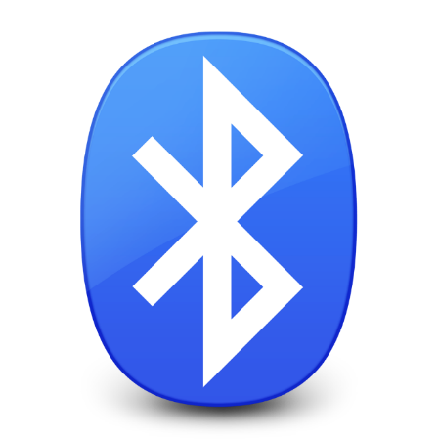
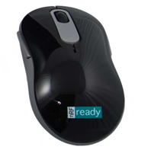
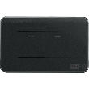

What is Bluetooth Low Energy?
Attractive communication technology
  Short range
  Low energy footprint
  Supported by most hosts
Currently:
  74K unique products with BLE support
2013:
  1.2 billion BLE products shipped
2020:
  2.7 billion BLE products expected
Notes:
Bluetooth.org lists 74K unique products with 4.0 support¹
http://www.arubanetworks.com/assets/ds/DS_LocationServices.pdf
(PCs, smartphones, tablets, etc.) and some APs (Aruba¹)

Slide 3
BLE Primer
Standby: Low Power Mode. Receiver and transmitter switched ‘off’
Advertising: Used by low power ‘Server’. Only transmitter required.
Scanning: Used by ‘Client’. Receiver listens to advertising channels.
Initiating: ‘Server’ sends connection request
Connection: After scanning, ‘Client’ responds to ‘Server’ advertisement
Scanning
Advertising
Standby
Initiating
Connection
Notes:
Say we got the slides from Jeremey

Slide 4


BLE Advertisements
3 dedicated advertising channels:
  2402 MHz (37), 2426 MHz (38), 2480 MHz (39)
Type | Description | Frequency
ADV_DIRECT_IND | Connect to a particular device only | 3.75 ms, but only for 1.28 seconds
ADV_IND | General presence known + connections | 20ms – 10.24s
Advertisement
Listen
$$r∈[0,10]$$
$$adv$$
Notes:
They enable the whole process

Slide 5
BLE Security and Privacy
Pairing & bonding
  Prevent unauthorized access to device or secured services
Address randomization
  Prevent user tracking
Direct Advertisements
  Prevent user tracking and profiling
Notes:
They enable the whole process

Slide 6

BLE Privacy & Security Effectiveness
Passively scan for BLE advertisements
Collect:
<Timestamp, BT Address, advertisement content, RSSI>
Site | Participants | Period
Hewlett Packard Labs | 1 | 40 days
Ann Arbor | 13 | 2 months
Phone LAB/ SUNY Buffalo | 86 | 2 months
Notes:
Must fill x and y after checking the traces

Slide 7
BLE Privacy & Security Effectiveness
Indirect Advertisements
  Detected 214 different unique types of devices
Address Randomization
Name | Description
ihere | key finder
DEXCOMRX | Glucose monitor
Frances’s Band ea:9d | smartband
Otbeat | heart rate monitor
JS00002074 | digital pen
Device | Days observed
One | 37
Flex | 37
Zip | 37
Forerunner 920 | 36
Basis Peak | 25
Address
00:17:E9:CB:F3:61
00:17:E9:CB:F5:01
Revealing Names
Consistent Addresses
Poor Randomization
Notes:
Devices are verbose
This is a short list
Put a table and highlight columns with takeaways

Slide 8
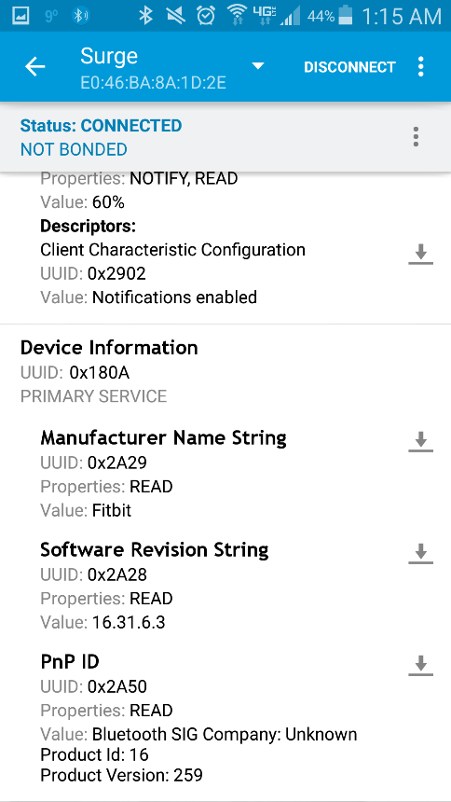
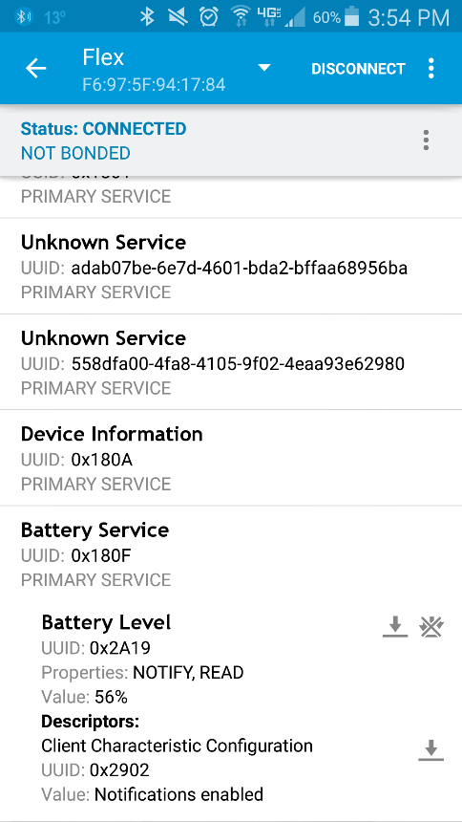
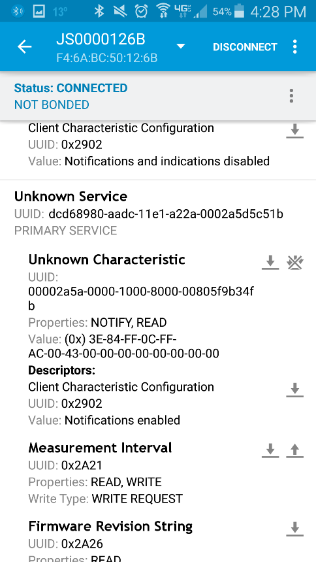
BLE Privacy & Security Effectiveness
Device Pairing
Advertise and accept connections
Battery level
Unique identifiers
Notes:
Screenshots obtained from Nordic app

Slide 9
It all starts with the advertisements…
Tracking User
Consistent addresses, poor randomization, unique device names and identifiers
Notes:
“threat model” slide
Health situation (glucose monitor), user’s lifestyle (fitness trackers), preferences (brands of devices), and personal interests (toys, cameras, Pet activity trackers, etc.)
Fingerprinting a house physical security system or security cameras, inferring user behavior from sensory values

Slide 10
It all starts with the advertisements…
Tracking User
Profiling User
  Health situation, user’s lifestyle, behavior, preferences, and personal interests
Notes:
“threat model” slide
Health situation (glucose monitor), user’s lifestyle (fitness trackers), preferences (brands of devices), and personal interests (toys, cameras, Pet activity trackers, etc.)
Fingerprinting a house physical security system or security cameras, inferring user behavior from sensory values

Slide 11
It all starts with the advertisements…
Tracking User
Profiling User
Harming User
  Fingerprinting of and unauthorized access for sensitive systems and devices
Notes:
“threat model” slide
Health situation (glucose monitor), user’s lifestyle (fitness trackers), preferences (brands of devices), and personal interests (toys, cameras, Pet activity trackers, etc.)
Fingerprinting a house physical security system or security cameras, inferring user behavior from sensory values

Slide 12
Research Questions
Can we effectively fend off the threats to BLE-equipped devices
  in a device-agnostic manner,
  (2) using COTS (Commercial-Off-The-Shelf) hardware only, and
  (3) with as little user intervention as possible?
Notes:
Health – VP example
Focus life critical systems
Vehicle
Physical security system
Industrial systems
Spice up this slide
For example, some wearable
devices might reveal a health situation (e.g., glucose monitor).
Other devices1 might reveal information about the
user’s lifestyle (fitness trackers, treadmill), preferences
(brands of wearable devices, and personal

Slide 13
BLE-Guardian

Slide 14
BLE-Guardian
Ubertooth One
  Programmable BT radio
  Open source firmware
  Rx/Tx on each BT channel
User-level app
  Control BLE-Guardian
  Update firmware seamlessly
Notes:
Address deployment – multiple protections

Slide 15
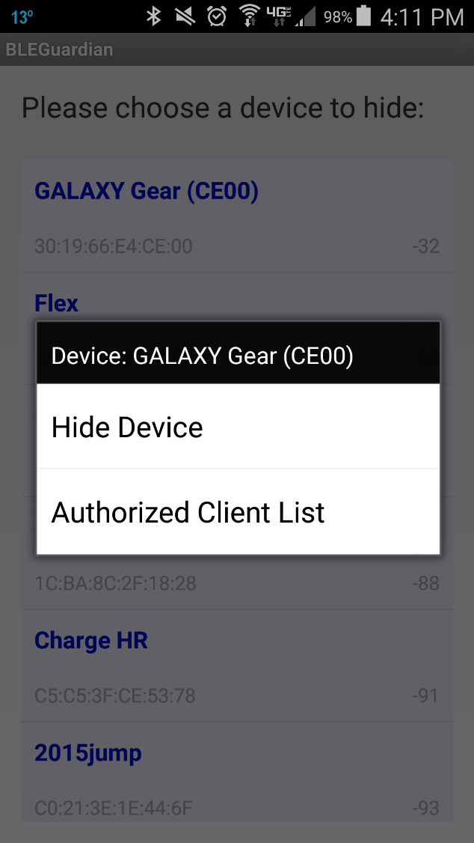
High-level Description
BLE-Guardian running
Owner chooses target BLE device
Device Hiding Module
User Alert
New client
Authorized client
Attacker detected
Access denied
Access Control Module
Client Authorization
Access granted
Whitelist Client
Connection Enabling

Slide 16






Device Hiding
Jam BLE device advertisements to hide its existence
Need to learn device advertising Sequence
  Otherwise jamming will be ineffective or inefficient
Advertisement
Listen
$$…$$
$$r∈[0,10]$$
$$37$$
$$38$$
$$39$$
$$adv$$
Notes:
We need all 15 permutations

Slide 17
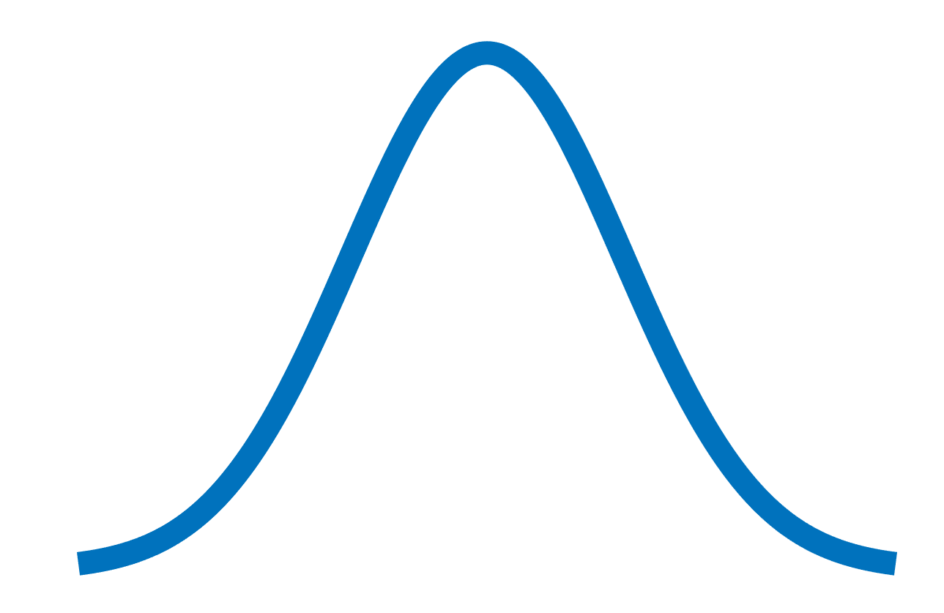



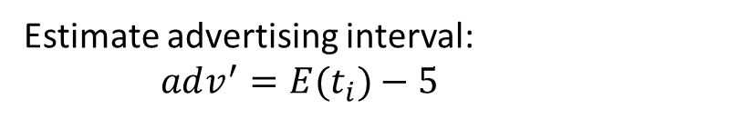





Device Hiding
Advertisement session
$$t_{1}$$
$$t_{2}$$
$$t_{3}$$
$$t_{4}$$
Estimate advertising interval:
$adv^{′}=E(t_{i})−5$
$$T_{N}$$
$$T_{N}+adv’$$
Max delay
Monitoring interval
$$T_{N}+adv^{′}−e$$
$$T_{N}+adv^{′}+e+10$$

Slide 18
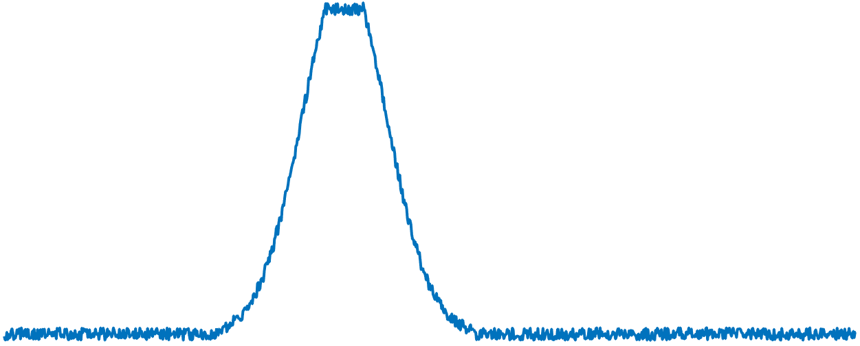
Device Hiding
jamming
Monitoring interval
Detect RSSI (received signal strength indication) increase
Apply jamming and follow advertising sequence
Notes:
Now, let’s take a look at this monitoring interval

Slide 19
At this point, the target BLE device is hidden.
  How to enable access to it?

Slide 20
Access Control
Authorization:
Bluetooth classic as an OOB channel.
Bt_addr, UUID
jamming
adv
Attempt connection
Connection
request
Send pairing request
User
completes pairing
Client authorized by user

Slide 21
Access Control
Connection Enabling:
Connection parameters to distinguish legitimate connection request.
Connection
parameters
jamming
adv
Reduced Adv.
Connection request
Legitimate connection
jamming
adv
data
data

Slide 22
Evaluation

Slide 23
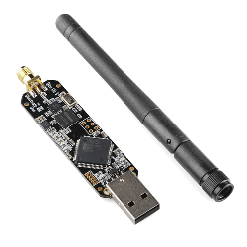
Evaluation
Cut-off Distance
Cut-off distance
d
Attacker
BLE device
BLE-Guardian

Slide 24
Evaluation
Cut-off Distance
Adversary has to be within 1 m of BLE device to read its advertisements

Slide 25
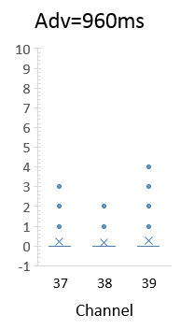
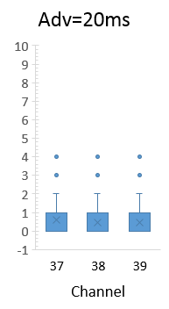
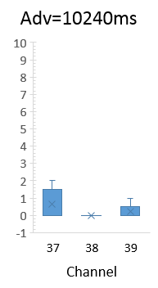
Evaluation
Impact on Advertising Channels
Protect single device at advertising intervals:
  20ms, 960ms, and 10.24 sec
Two devices advertising at 20 ms
15 other devices
  With varying advertising frequencies
unnecessary jams
The number of unnecessary jamming instance is minimal

Slide 26
Evaluation
Energy Overhead
BLE-device and authorized clients
  No overhead
Smartphone as a gateway
  Idle power: 1370mW
  Overhead: less than 16%
Notes:
*overhead does not include powering the ubertooth radio

Slide 27
Conclusion
BLE-Guardian
  Privacy protection for BLE device users
  Device agnostic and relies on COTS hardware
  Low overhead on advertisement channels
Future work
  Explore other M2M protocols such Zigbee
  Implement without needing external hardware (need firmware access)

Slide 28
Thank You
kmfawaz@umich.edu
kassemfawaz.com

