Slide 1
Continuous Authentication for Voice Assistants
Huan Feng¹, Kassem Fawaz², Kang G. Shin³
¹ Facebook Inc.
² University of Wisconsin
³ University of Michigan

Slide 2

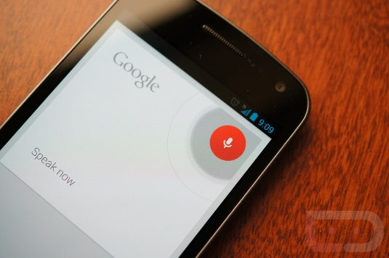
Voice – An Emerging Interaction Surface
While driving, cooking, exercising …
Voice assistants and voice-activated devices

Slide 3

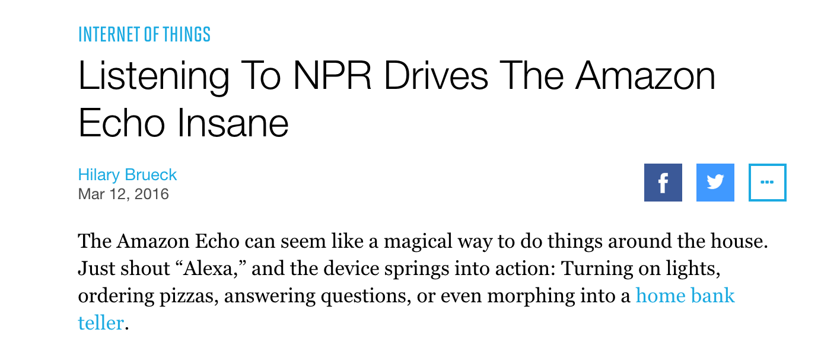
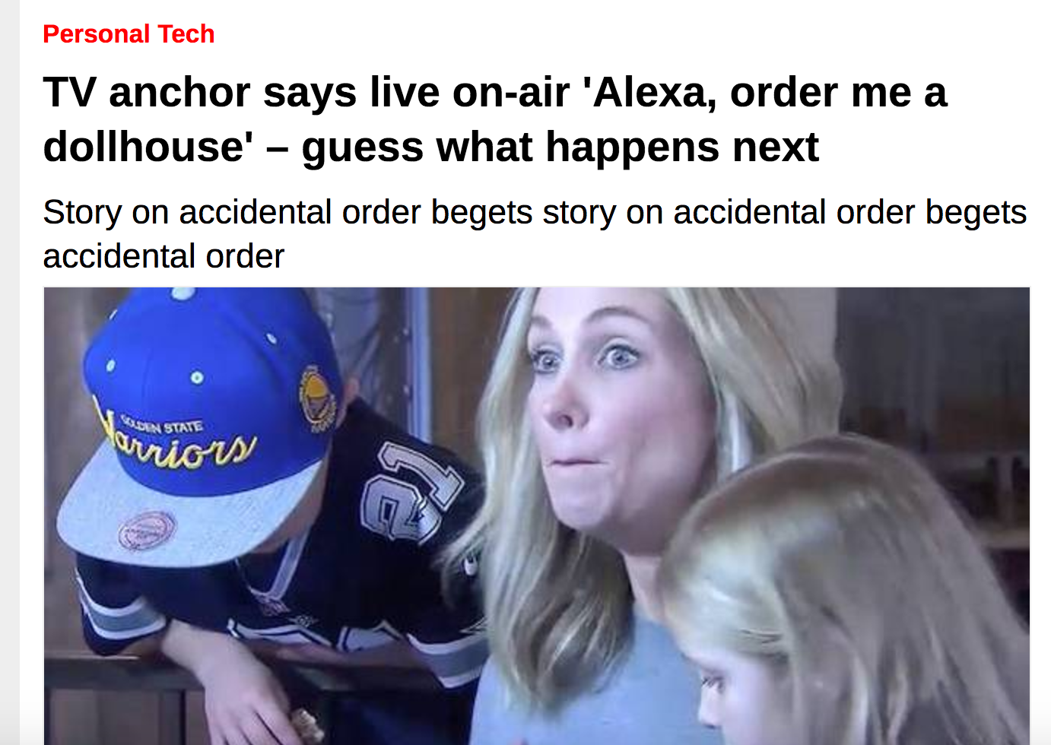
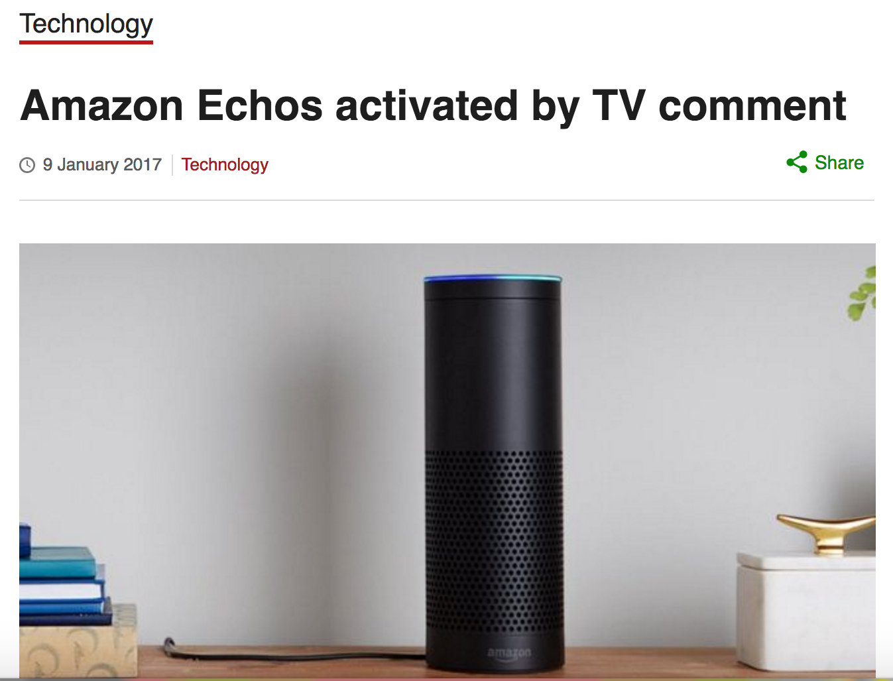
Voice-enabled Devices Listen to Everything

Slide 4
Voice Is an Open Channel
with repercussions …
Mangled voice attack
[Vaidya et al. ‘15, Carlini et al. ’16]
Malicious apps issuing voice commands
[ Ben Itzhak '14]
Command injection from inaudible signals
[Kasmi et al. ’15, Zhang et al. ‘17]

Slide 5


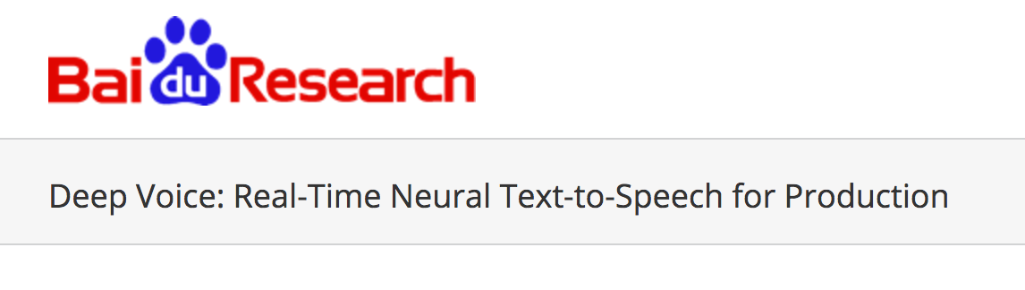
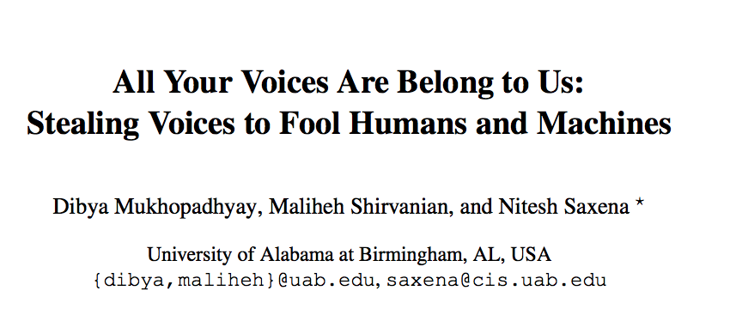
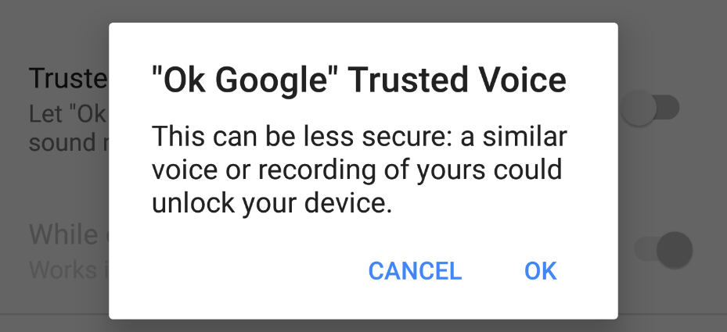
Why Not Voice Biometrics?

Slide 6
How to solve the problem?
VAuth: Continuous Voice Authentication

Slide 7
VAuth – Continuous Voice Authentication
accelerometer
Real-time matching engine
Match
speech
Mismatch

Slide 8
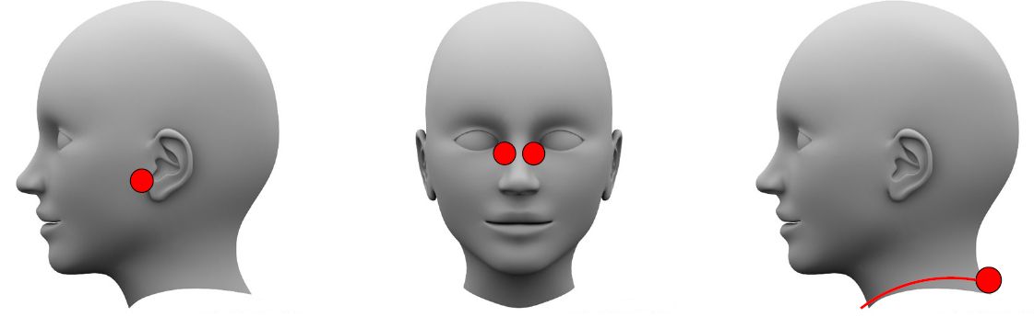
VAuth Deployability
VAuth requires wearing a security-assisting device
  Embed VAuth in existing wearable products
(a) Earbuds
(b) Eyeglasses
(c) Necklace

Slide 9
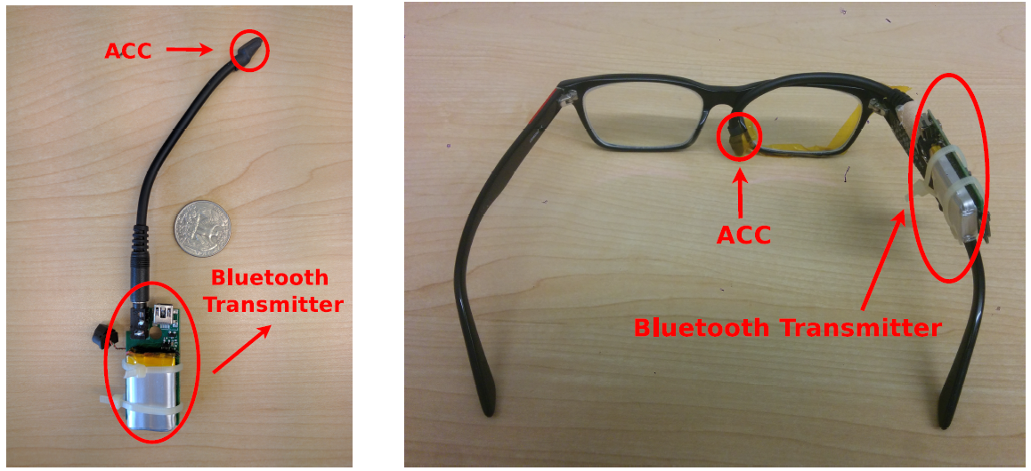
VAuth Prototype
  Smaller than a coin
  Sensitive (11k Hz)
  Analog-to-digital conversion
  Secure Bluetooth transmission
(a) Wireless
(b) Eyeglasses

Slide 10
Matching Algorithm
Do the accelerometer and microphone signals match?

Slide 11
Matching Algorithm
Segment Identification
Per-Segment Analysis
Matching Decision
  Detect energy bumps in accelerometer signal
  Compare glottal pattern for each segment
  Decide whether the two signals match

Slide 12
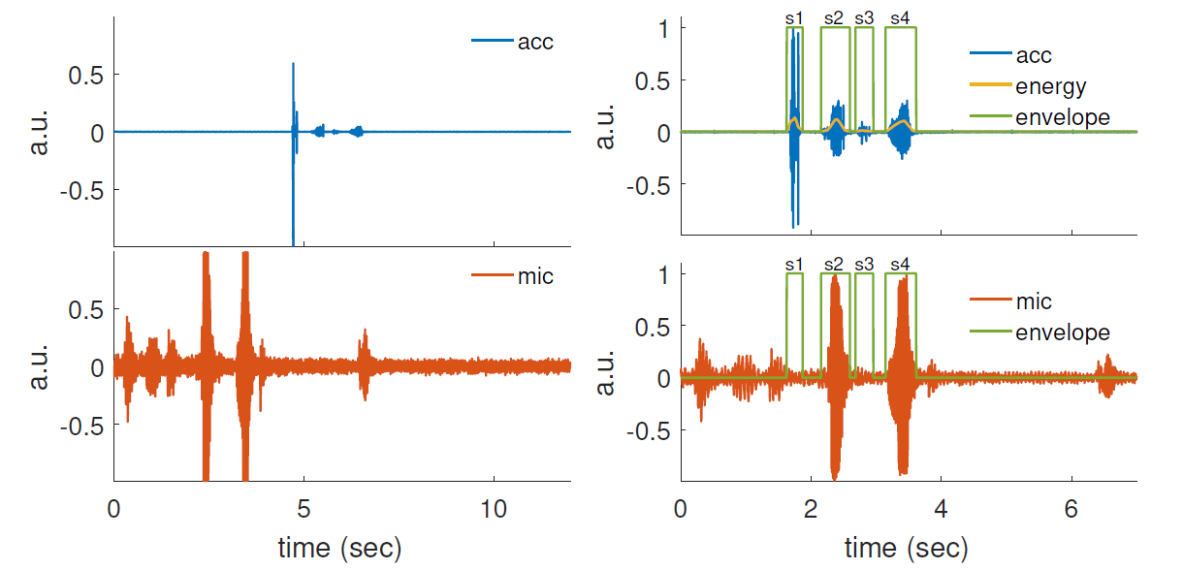
Segment Identification
4. Rise in energy levels
2. Reduce abrupt movement
1. Raw signals
3. Align signals
5. Acc energy envelope
Notes:
Two words, male speaker, cup, luck

Slide 13
Per-segment Analysis
Identify glottal cycles - periodic patterns in speech
Keep matching segments
Average fundamental frequency$∈[80Hz, 333Hz]$
Average fundamental frequency ∈[80𝐻𝑧, 333𝐻𝑧]
Average relative distance $<25\%$
Average relative distance <25%
Maximum cross correlation $∈[0.25, 1]$
Maximum cross correlation ∈[0.25, 1]

Slide 14
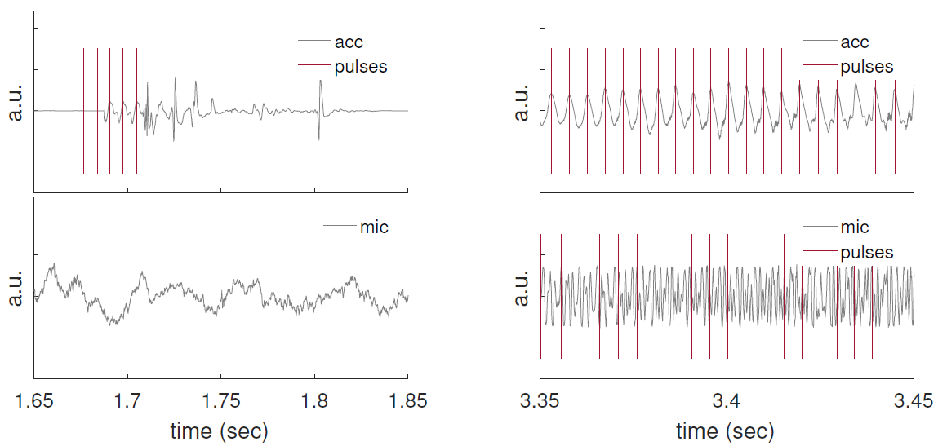
Per-segment Analysis
Non–matching segment s3
Matching segment s4

Slide 15
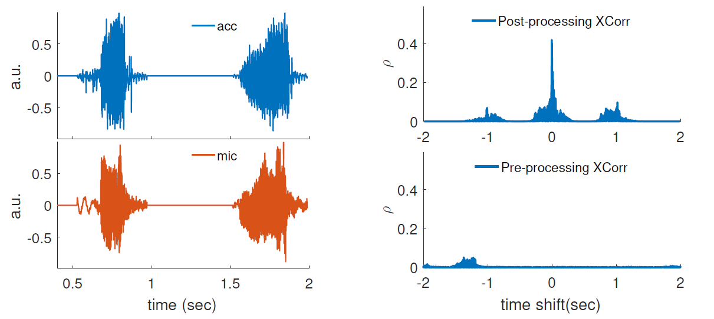
Matching Decision
Input: surviving segments of acc and mic signals
SVM-based classifier trained on 44 English Phonemes of one speaker
Output: boolean decision (matching/non-matching)
Decision
execute
block
Matching
Not matching

Slide 16
Evaluation

Slide 17
User Study
Matching Accuracy (True Positives) & False Positives
18 users issuing 30 commands under 6 scenarios
  Three positions (eyeglasses, earbuds, necklace)
  Two mobility patterns (still and jogging)
Tested with five different languages
  English (18 users), Arabic, Korean, Persian, Chinese (1 user each)

Slide 18
User Study
English Commands
Scenario | Movement | TP(%) – 10th percentile | FP(%) 90th percentile
Earbud | Still | 100 | 0.26
 | jogging | 91.33 | 0.33
Eyeglasses | Still | 96.66 | 0.26
 | jogging | 96.66 | 0.34
Necklace | Still | 81.66 | 0.15
 | jogging | 93.33 | 0.15
  Takeaways:
  False positive cases resulted in non-intelligible commands
  Low energy signals contributed to low TP rate in one case
  Results are consistent across the four other languages

Slide 19
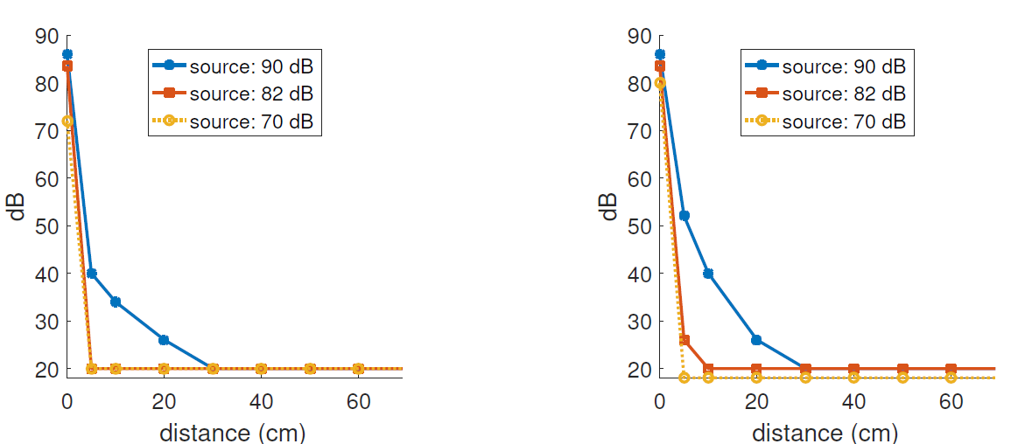
Acoustic Injection Attack
Cut-off distance beyond which acc does not pick up signals over the air
Cut-off Distance of 30 cm
Exposed Accelerometer
Covered Accelerometer
Notes:
Acoustic Injection Attack (high-power sound)

Slide 20
Delay & Energy
Tested on real wireless prototype
Delay
  Match: 300ms – 830ms, average: 364ms
  Mismatch: 230ms – 760ms, average 319ms
  Long commands ~30 words: less than 1 second
Energy
  Idle (6mA), Active (31mA) -> most on BT transmission
  Standalone wearable (500mAh, 1 week)

Slide 21
Conclusion
Voice is an open channel
Unauthorized access to voice-activated devices
Challenge:
Continuous authentication mechanism for voice that does not rely on signature
Solution: VAuth
Couple the voice channel with physical assurance from on-body vibrations
Average: accuracy = 97%, false positive rate = 0.1% , matching delay < 1 sec.

Slide 22
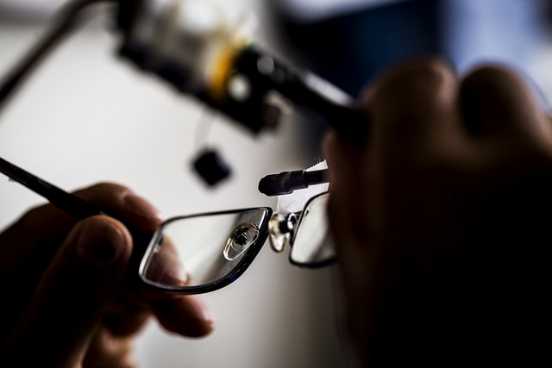
Conclusion
Voice is an open channel
  Unauthorized access to voice-activated devices
Challenge:
  Continuous authentication mechanism for voice that does not rely on signature
Solution: VAuth
  Couple the voice channel with physical assurance from on-body vibrations
  Average accuracy = 97%, false positive rate = 0.1% , matching delay < 1 sec.
Kassem Fawaz, kfawaz@wisc.edu, kassemfawaz.com

Slide 23
Backup slides

Slide 24
Usability Survey
Amazon Mechanical Turk Survey
952 US respondents
Two-level Survey:
  Are voice assistants secure?
  Would you use VAuth?
    In eyeglasses?
    In necklace?
    In earbud?
    Other scenario?

Slide 25
Phoneme-level Analysis
The basic unit of English speech
  44 phonemes (20 vowels and 24 consonants)
  Two speakers (one male and one female)
  Match each acc sample against all mic samples
Microphone | Accelerometer | True Positive (%) | False Positive (%)
consonants | consonants | 90 | 0.2
consonants | vowels | - | 1.0
vowels | consonants | - | 0.2
vowels | vowels | 100 | 1.7
all | all | 94 | 0.7
  A lower-bound of whole-command matching

