Slide 1
Anatomization and Protection of Mobile Apps’ Location Privacy Threats
Kassem Fawaz, Huan Feng, and Kang G. Shin
Computer Science & Engineering
The University of Michigan

Slide 2
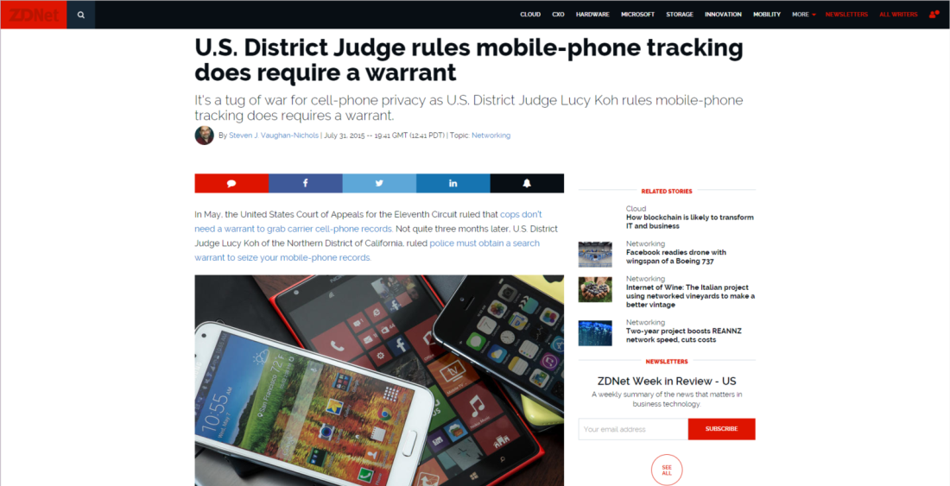
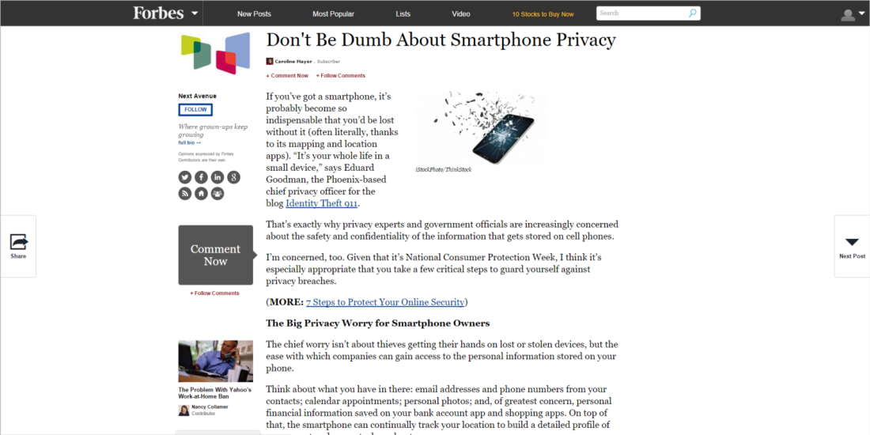
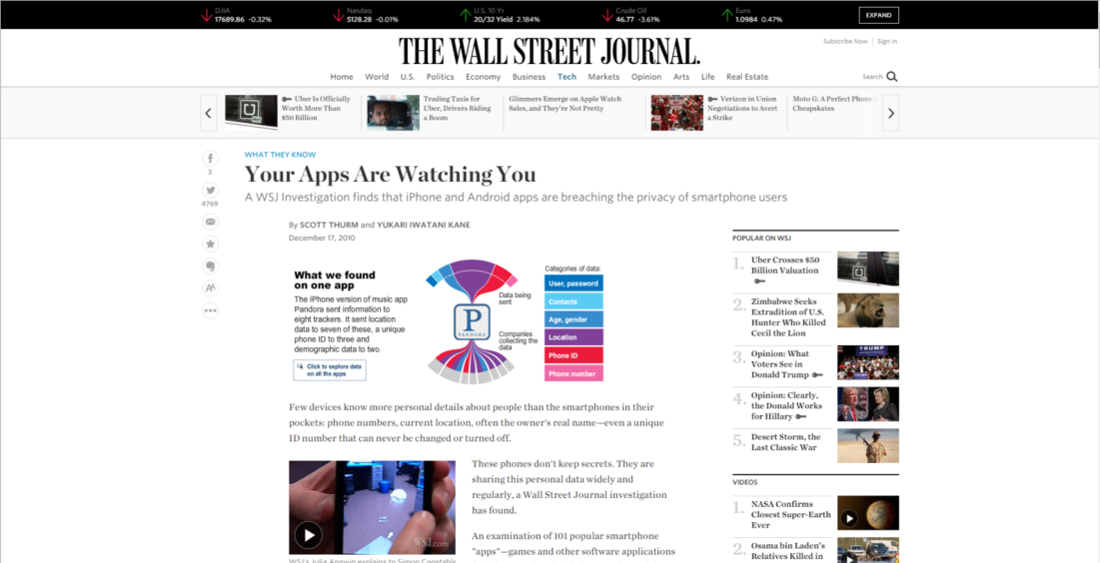
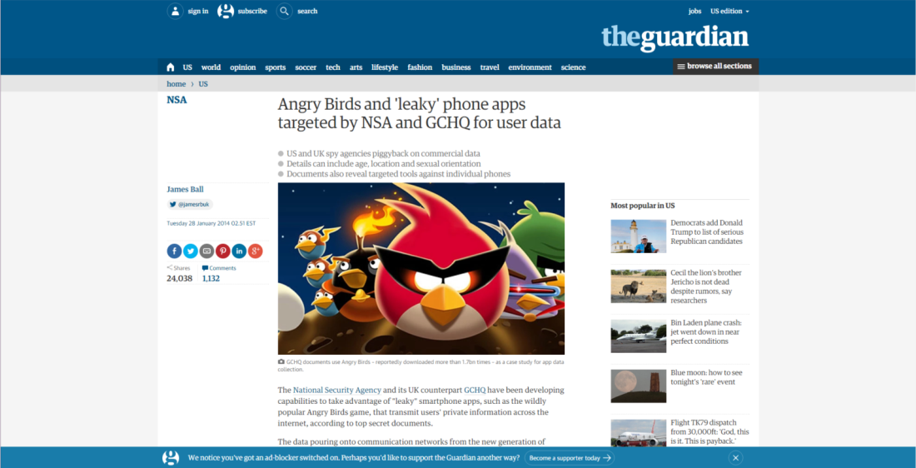
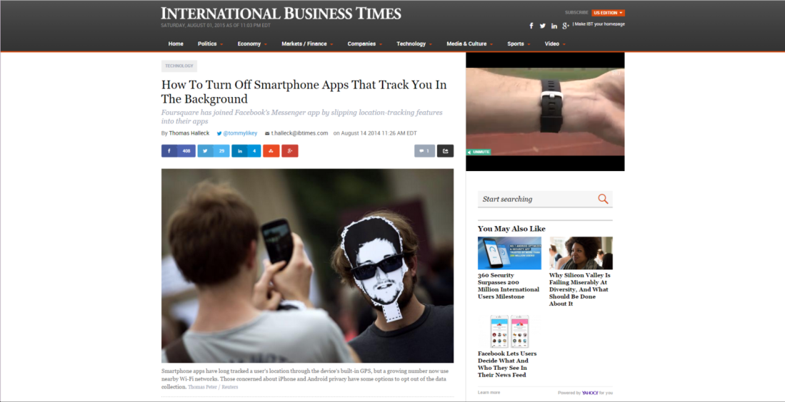
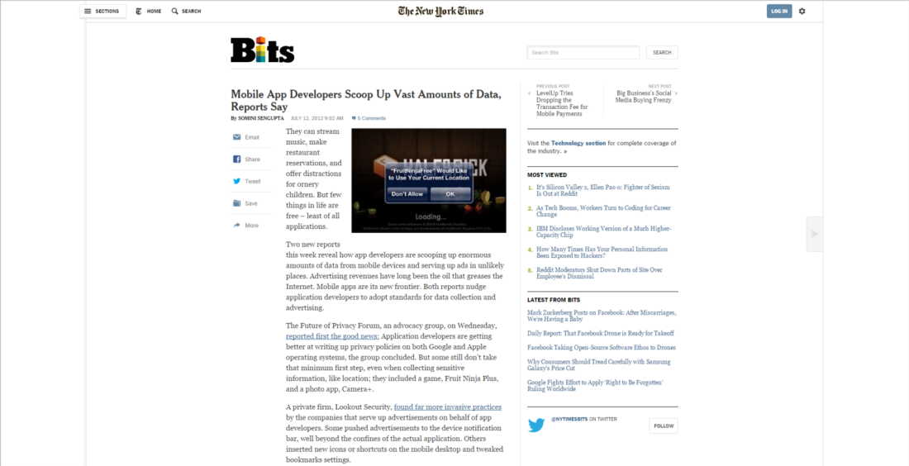
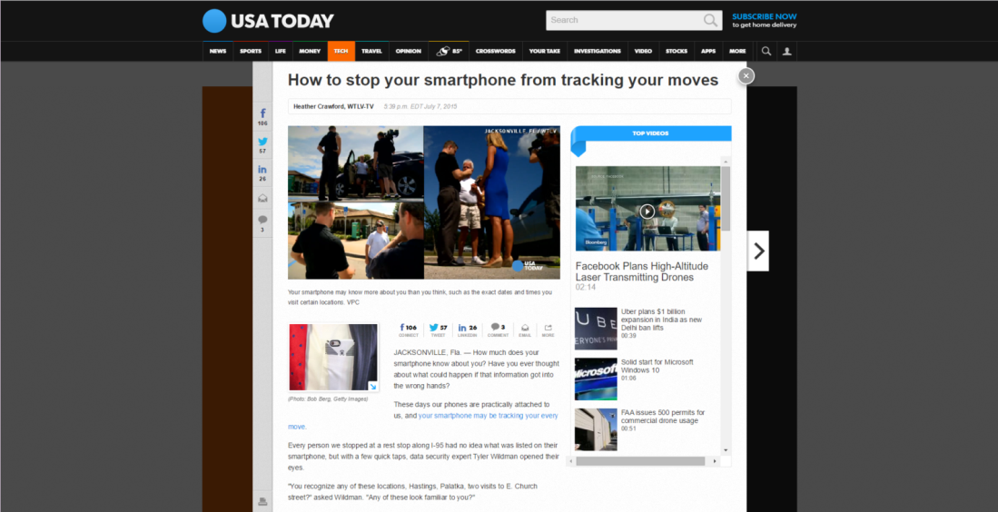
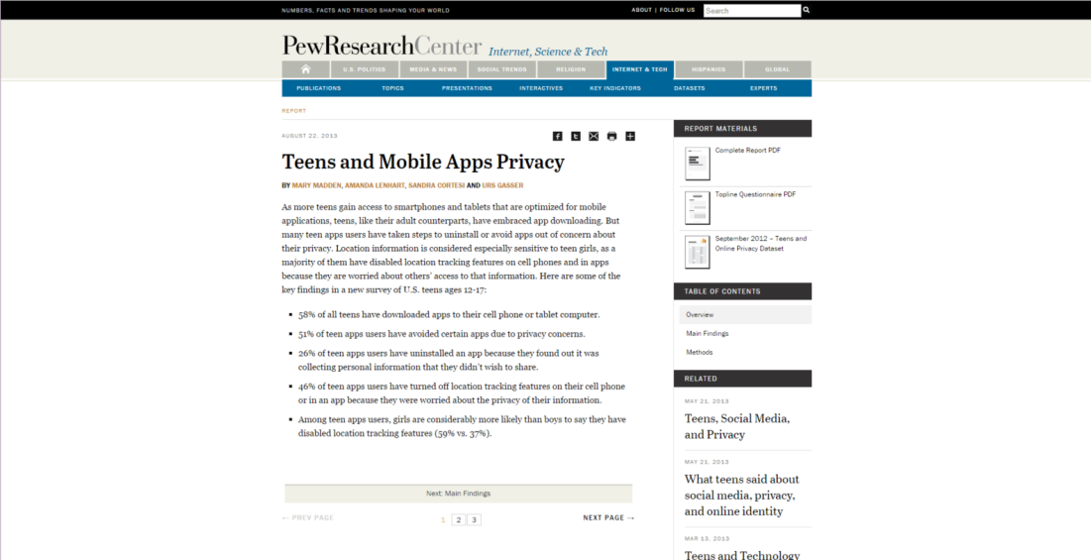
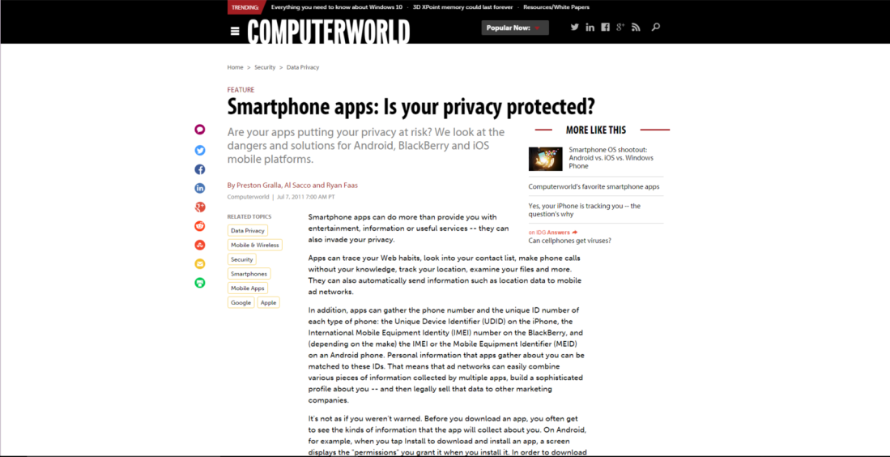
Apps’ Location Privacy
  What can we do about it?
2
Notes:
General slide that we don’t have from before – no text, newspapers and articles kinda thing to emphasize location privacy

Slide 3
Apps’ Location Privacy
More than a decade of research
Lots of location privacy protection mechanisms
  E.g., LP-Guardian, MockDroid, Caché, Koi, etc.
Few implementations/deployments:
  Some have not been implemented with real-world apps
  Others very difficult to deploy (require custom ROMS, etc.)
We are left with what OSes provide us
Notes:
Need a better slide here

Slide 4
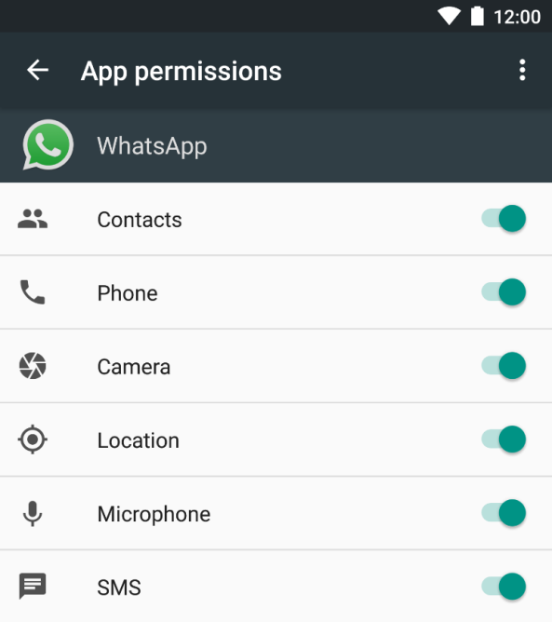
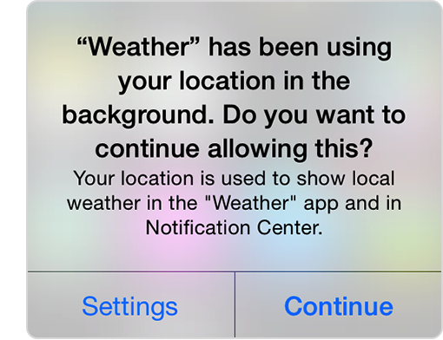
Mobile OS Location Controls
Install time permissions
Per-app location switch
Background location access
http://arstechnica.com/gadgets/2015/05/android-m-dev-preview-launches-permission-controls-fingerprint-api-and-more/
https://support.apple.com/library/content/dam/edam/applecare/images/en_US/applecare/location_background.png
Notes:
http://arstechnica.com/gadgets/2015/05/android-m-dev-preview-launches-permission-controls-fingerprint-api-and-more/
https://support.apple.com/library/content/dam/edam/applecare/images/en_US/applecare/location_background.png
https://support.apple.com/library/content/dam/edam/applecare/images/en_US/applecare/location_sharing.png

Slide 5
Apps’ Location Privacy
Are OS-based controls effective in protecting the user’s location privacy?
If not, how can they be improved, in user-level, without modifying any app or the OS?

Slide 6
This Talk
Measurement
Collect app-tagged location traces
Anatomy
Quantify location privacy threat for apps
LP-Doctor
Leverage OS controls to balance utility and privacy
Study location access and usage patterns of different apps
Easy to install and use
Analyze effectiveness of OS controls
Measurement and LP-Doctor are based on Android, but conclusions apply to other platforms

Slide 7

Measurement
https://thisisprable.files.wordpress.com/2014/05/tape-measure1.jpg

Slide 8
Measurement
App runs in:
Foreground
Cached
Background
Location granularity & frequency
Location granularity & frequency
Location granularity & frequency
< x, y, e, t₁>
Location-access pattern = F(app)
→ offline analysis
< x, y, e, t₃>
<app, x, y, e, t₁>
<app, x, y, e, t₂>
<app, x, y, e, t₃>
.
App–tagged location traces
App-usage pattern = F(user)
→ user-level collection
Notes:
Distributing instrumented android is not practical

Slide 9
Location-Access Patterns
Location permissions | # apps | Foreground (%) | Cached (%) | Background (%) | None (%) | Coarse Granularity enough (%)
Coarse | 210 | 71 | 6 | 1 | 22 | 100
Fine | 955 | 74 | 14 | 4 | 12 | 48
All | 1165 | 74 | 12 | 3 | 14 | 66
Apps abuse the location permissions
Minority of the apps continuously access location
Focus on foreground location access
Notes:
Manual analysis of each app’s location based functionality to reveal the needed granularity

Slide 10
App-Usage Patterns
App Usage Patterns Analysis
  List of app sessions:
Three datasets:
com.whatsapp,1395247179636,America/New_York,75,placeID:1,placeID:1
 | RTCL | PhoneLab | LiveLab
Participants | 25 | 95 | 30
Period | 1 week - 10 months | 1 week - 4 months | 1 year
Location | Ann Arbor, MI | Buffalo, NY | Houston, TX
Notes:
App usage datasets

Slide 11
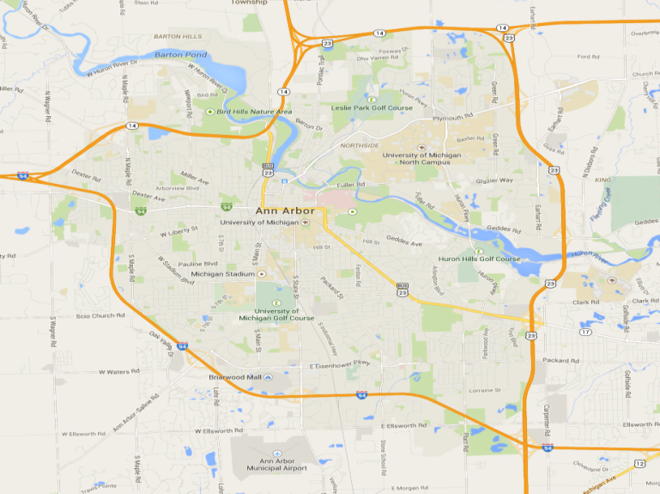
Location-Access Model
App session maps to a place the user visited
  98% of app sessions started and ended at the same place
Model app as a histogram
  Map place to number
  of visits
  Sample of user’s mobility
92 visits
50 visits
92 visits
40 visits
25 visits
Notes:
Fix the circles In the histogram

Slide 12
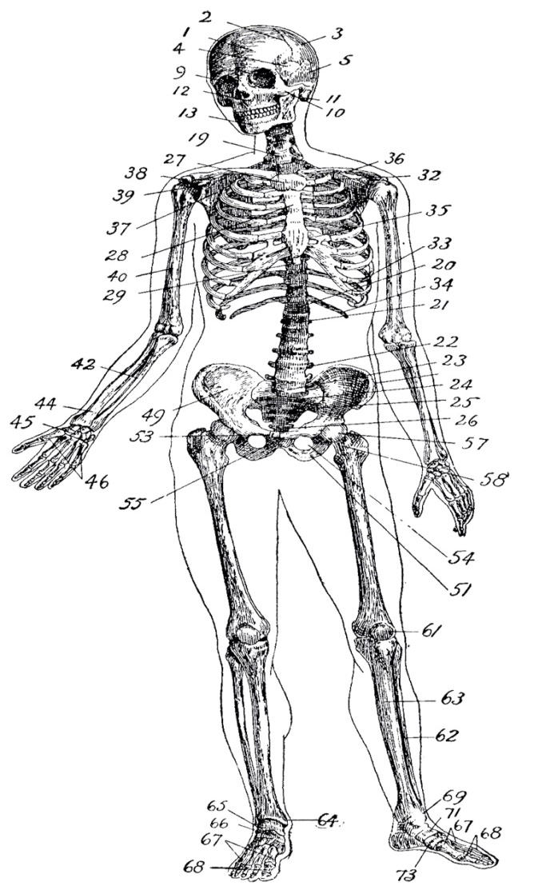
Anatomy
http://thegraphicsfairy.com/wp-content/uploads/2013/09/Vintage-Anatomy-Skeleton-Images-GraphicsFairy.jpg

Slide 13
Location Privacy Metrics
Capture and quantify the user’s original mobility pattern with the app’s histogram
Probability of user visiting place
# of visits app observed user at place
Notes:
Examples on each metric and more details here make it little bit more deep

Slide 14
Location Privacy Metrics
Four privacy metrics:
  PoI_{total}: Portion of user’s identified significant places
    The closer to 1, the more places are identified
  PoI_{sens}: Portion of identified rarely visited places
    Represent “deviant” behaviors which are more sensitive
  Prof_{cont}: KL divergence between histogram and mobility pattern
    Distance between app’s observation and user’s mobility profile
  Prof_{bin}: χ² test with significance level of 0.05
    Whether the histogram (sample) is a good fit of the mobility pattern
Notes:
Examples on each metric and more details here make it little bit more deep

Slide 15
Threat Anatomy
Metric | Insight
PoI_{total} | For each user: 20% of apps, each, identified most PoIs Most apps identified users’ top two PoIs
PoI_{sens} | For each user: 20% of apps identified most sensitive PoIs A&A libraries identified more of the sensitive PoIs
Prof_{cont} | No correlation between app usage frequency and privacy threats A&A posing significantly more threats Value mostly larger than 0 histograms are not uniform samples of user’s mobility

Slide 16
Threat Anatomy
Metric | Insight
PoI_{total} | For each user: 20% of apps, each, identified most PoIs Most apps identified users’ top two PoIs
PoI_{sens} | For each user: 20% of apps identified most sensitive PoIs A&A libraries identified more of the sensitive PoIs
Prof_{cont} | No correlation between app usage frequency and privacy threats A&A posing significantly more threats Value mostly larger than 0 histograms are not uniform samples of user’s mobility

Slide 17
Threat Anatomy
Metric | Insight
PoI_{total} | For each user: 20% of apps, each, identified most PoIs Most apps identified users’ top two PoIs
PoI_{sens} | For each user: 20% of apps identified most sensitive PoIs A&A libraries identified more of the sensitive PoIs
Prof_{cont} | No correlation between app usage frequency and privacy threats A&A posing significantly more threats Value mostly larger than 0 histograms are not uniform samples of user’s mobility

Slide 18
Threat Anatomy
Metric | Insight
PoI_{total} | For each user: 20% of apps, each, identified most PoIs Most apps identified users’ top two PoIs
PoI_{sens} | For each user: 20% of apps identified most sensitive PoIs A&A libraries identified more of the sensitive PoIs
Prof_{cont} | No correlation between app usage frequency and privacy threats A&A posing significantly more threats Value mostly larger than 0 histograms are not uniform samples of user’s mobility

Slide 19
Are OS-Controls Effective?
Android location permissions
  Fail as a notification and choice mechanism
    App-usage behavior is independent from app’s location permissions
Background location blocking
  Limits tracking (less than 10 minutes a day) but not profiling
Per-app permissions
  Need to block location access of 10% of apps to neutralize each A&A library
  Take-it or leave-it situation
    Users can’t control when and where an app can access location

Slide 20

LP-Doctor
http://site.ambercity.com/images/mabis/legacy-sprague-lc-rappaport-type-stethoscope-adult-black-10-420-020-lr.jpg

Slide 21
LP-Doctor: WHY?
Per-session location access control is needed
  Existing OSes don’t provide an easy interface
  User can’t decide on threat level, especially for A&A libraries
Our Solution: LP-Doctor – a user-level tool that:
  Leverages and complements existing OS-controls
  Is easy to install and use

Slide 22
Threat Model
What’s in?
  Honest-but-curious adversaries
    Service providers or Advertisement and Analytics (A&A) agencies
    Access location only through location APIs
    Foreground location access
What’s out?
  Background location access
    Some platforms are providing controls like iOS
  Operating systems and cellular operators
    Users have no choice but to trust them
  Security issues

Slide 23
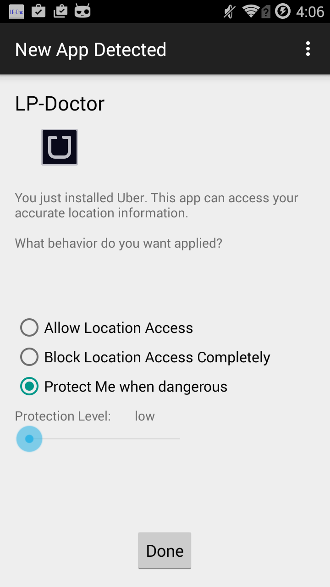
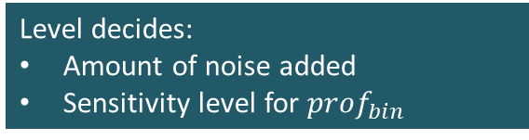
LP-Doctor
What happens when the user installs an app?
Apply protection before each session
Level decides:
Amount of noise added
Sensitivity level for ${prof}_{bin}$

Slide 24
LP-Doctor
What happens when the user runs an app?
Intercept app launch event
Fetch policy
Threat analyzer
Anonymization actuation
Display notification
Instruct app to launch
Instrument the CyanogenMod app launcher
Pause app execution
Divert execution to LP-Doctor

Slide 25
LP-Doctor
What happens when the user runs an app?
Intercept app launch event
Fetch policy
Threat analyzer
Anonymization actuation
Display notification
Instruct app to launch
Compute ${prof}_{cont}$ for before ($m_{bef}$) and after histogram ($m_{aft}$)
Compute 〖𝑝𝑟𝑜𝑓〗_𝑐𝑜𝑛𝑡 for before (𝑚_𝑏𝑒𝑓) and after histogram (𝑚_𝑎𝑓𝑡)
$$m_{bef }> m_{aft}$$
𝑚_(𝑏𝑒𝑓 )> 𝑚_𝑎𝑓𝑡
Compute ${prof}_{bin}$
Compute 〖𝑝𝑟𝑜𝑓〗_𝑏𝑖𝑛
Release location
$${prof}_{bin}=1?$$
〖𝑝𝑟𝑜𝑓〗_𝑏𝑖𝑛=1?
Protect location
Release location
Yes
No
Yes
No
Notes:
Prof bin based on alpha

Slide 26
LP-Doctor
What happens when the user runs an app?
Intercept app launch event
Fetch policy
Threat analyzer
Anonymization actuation
Display notification
Instruct app to launch
Compute obfuscated location
  Add 2-D Laplacian noise that achieves indistinguishability
Engage Android’s mock location provider
Apply same obfuscated location for future sessions of the same app from the place
  Reduces information leaks

Slide 27
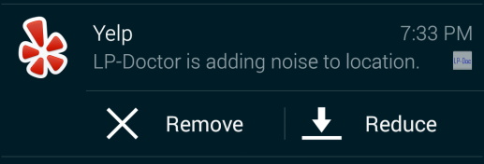
LP-Doctor
What happens when the user runs an app?
Intercept app launch event
Fetch policy
Threat analyzer
Anonymization actuation
Display notification
Instruct app to launch
Remove noise
Reduce noise →
user adjusts privacy – QoS trade-off
Notes:
Lp-doctor can remember the user’s decision in certain location

Slide 28
LP-Doctor
What happens when the user runs an app?
Intercept app launch event
Fetch policy
Threat analyzer
Anonymization actuation
Display notification
Instruct app to launch
Resume app launch
Delay less than 25 ms
End of app session:
  Update app histogram
  Disengage mock location provider

Slide 29
User Study
Recruited 227 participants from Amazon Mechanical Turk
Used LP-Doctor with Yelp (N = 120) and Facebook (N = 122)
Enable mock locations on Android
Reinstall Facebook or Yelp
Search for restaurant using Yelp
Check-in from a nearby place using Facebook
One time effort
Installation menu
Notifications &
Impact on QoS

Slide 30
User Study
Installation Menu
Notification
Appears only once for each 5 installed apps
Appears for 12% of sessions on average
Notes:
Asked the participants to uninstall and reinstall fb and yelp
Rated 1 or 2 on a scale

Slide 31


User Study
LP-Doctor adds noise automatically for 12% of the sessions on average of each app
Yelp
Facebook
Notes:
Do we need to explain the procedure?

Slide 32
User Study
Post study questions
Comfortable with fake location?
Comfortable with fake location?
Install LP-Doctor or similar tool?

Slide 33
Conclusion
Location privacy is a serious problem
  Existing research proposals are impractical
Are OS-controls enough?
  Measured threats from > 400 apps as used by > 100 users
  Found that OS-controls are ineffective and inefficient
We propose LP-Doctor that is practical and effective
Future work:
  Test LP-Doctor in the wild to study deployment challenges

Slide 34
Thank You!
Questions?
Kassem Fawaz
kmfawaz@umich.edu
github.com/kmfawaz/LP-Doctor

