Slide 1
Privacy vs. Reward in Indoor Location-Based Services
Kassem Fawaz†, Kyu-Han Kim* and Kang G. Shin†
† Computer Science & Engineering, The University of Michigan
* Hewlett Packard Labs

Slide 2
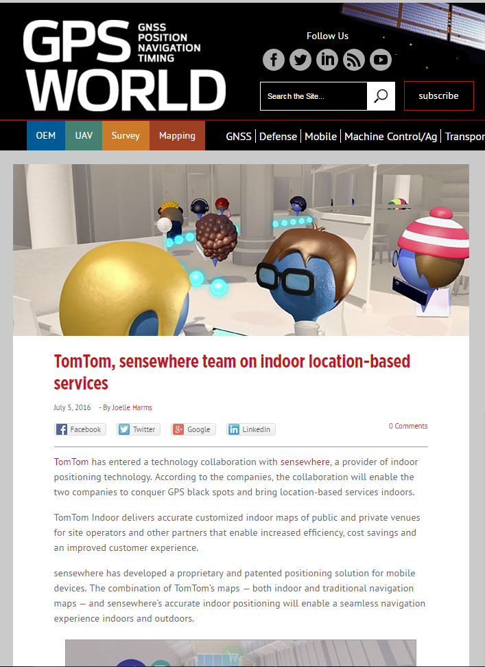
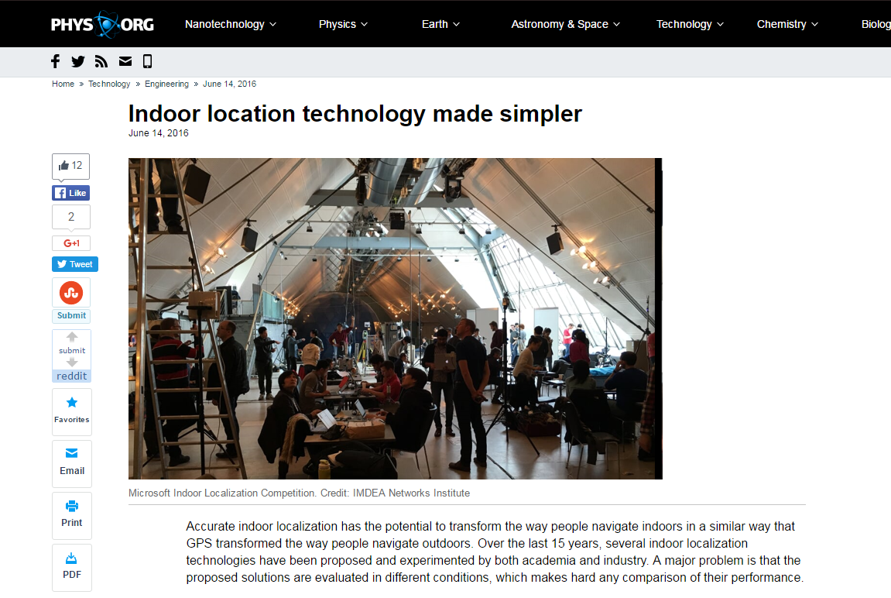
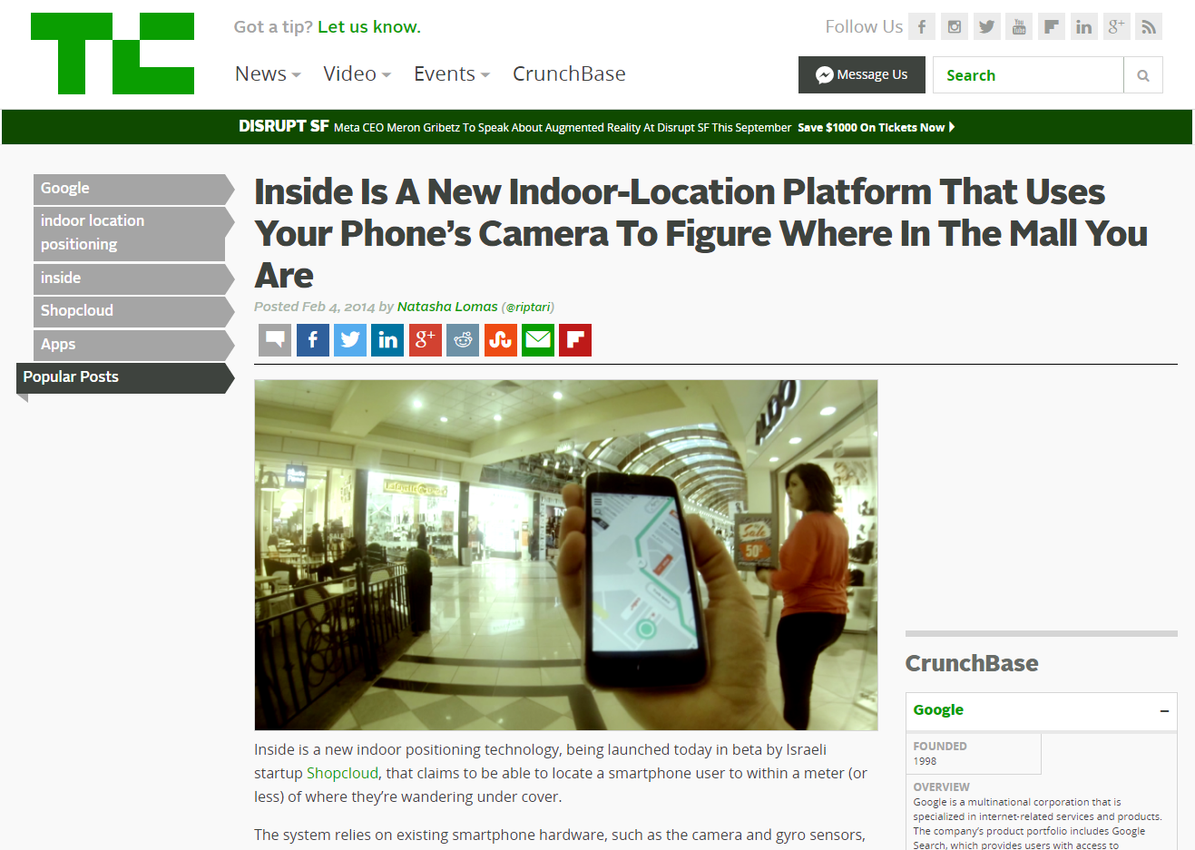
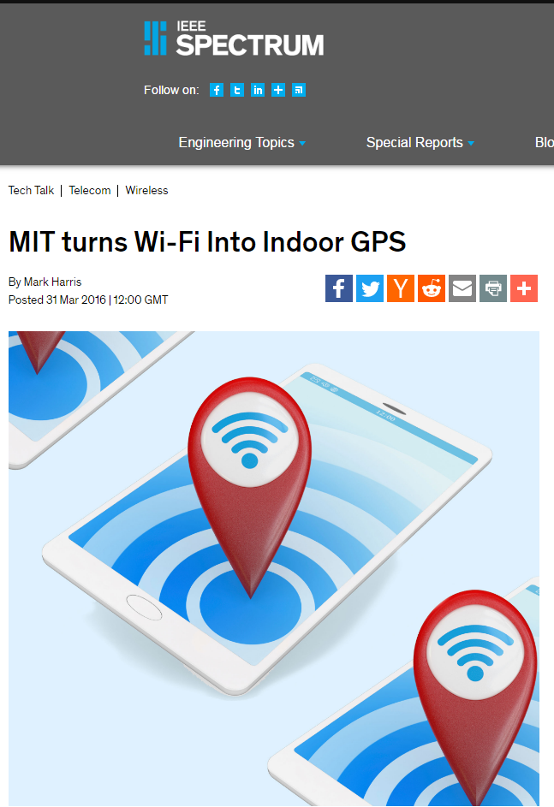
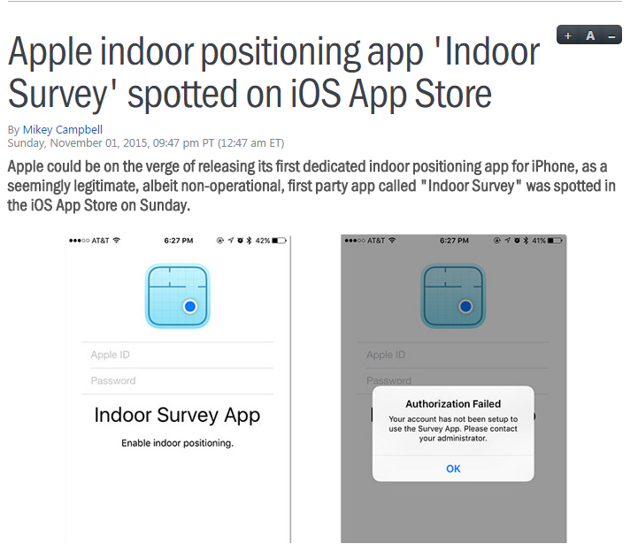
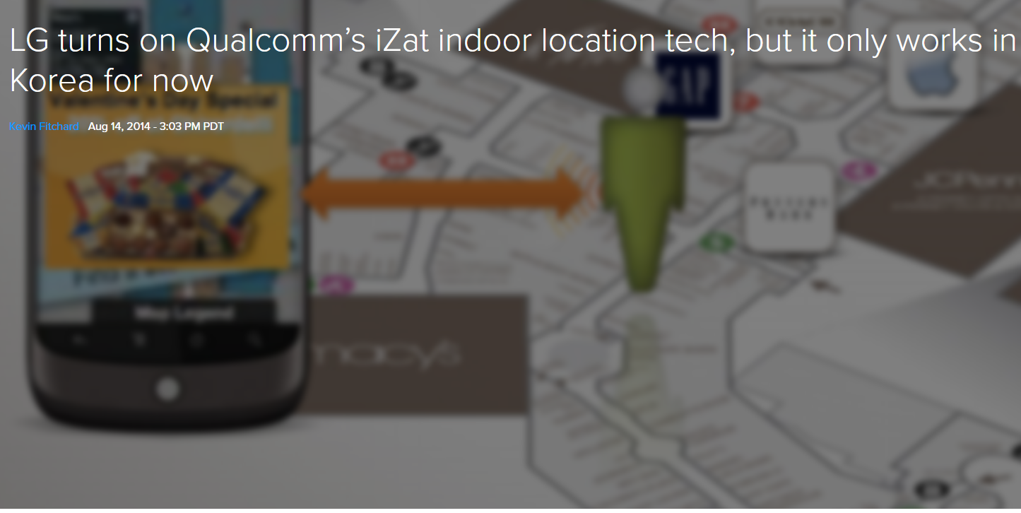
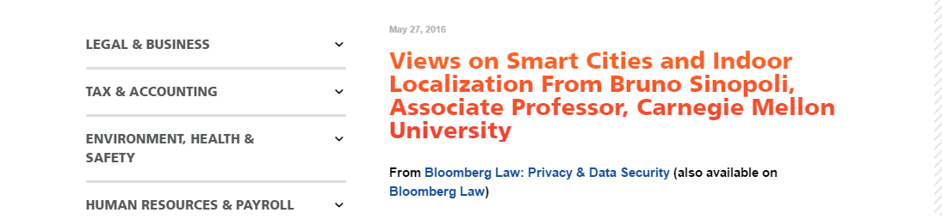
Indoor Localization
-New trend in localization technologies
  How do users feel about them?

Slide 3
The Survey
Shoppers’ perceptions about indoor localization

Slide 4
Demographics
Two shopper groups -- Walmart: N=100, Nordstrom N=104
Gender
Age
Education
Male: 50%
Female: 50%
15-29: 42%
30-44: 43%
High School: 29%
College: 50%

Slide 5
The Survey
-Disclaimer
We are always looking for ways to improve our customers’ experience. We gather publicly broadcasted information your smartphone or other WiFi enabled device sends out when it is attempting to connect to a WiFi network in and around this store. This provides us with anonymous, aggregate reports that give us a better sense of customer foot traffic. We do not gather such things as your name, email address, phone number, your device's browsing activity or text, email or voice messages.

Slide 6
Sharing Preferences
Response | % Respondents | Category
Reject tracking | 61% | Privacy-oriented
Track part of mobility | 24% | Neutral
Allow full tracking | 15% | Service-oriented

Slide 7
The Survey
-Takeaways
Utilize a technology that provides rewards in exchange of non-private sharing
  Can we provide a fair transaction between user and service provider?
Accept tracking if data shared with 3rd parties
Share some mobility in exchange for rewards

Slide 8
PR-LBS
Privacy vs. Rewards for Indoor Location-Based Services

Slide 9
Existing Approaches
Self Regulation
Location Obfuscation
Private Location Release
Disclaimers
  No reward vs. privacy tradeoff
Anonymous location collection
  User can still be tracked
PHY/MAC parameters manipulation
  Full privacy w/o any reward for customers and service providers
Bidding architectures and theoretical approaches
  Inapplicable
  Impractical

Slide 10
PR-LBS
-Deployment Modes
Infrastructure Mode
Device Mode

Slide 11
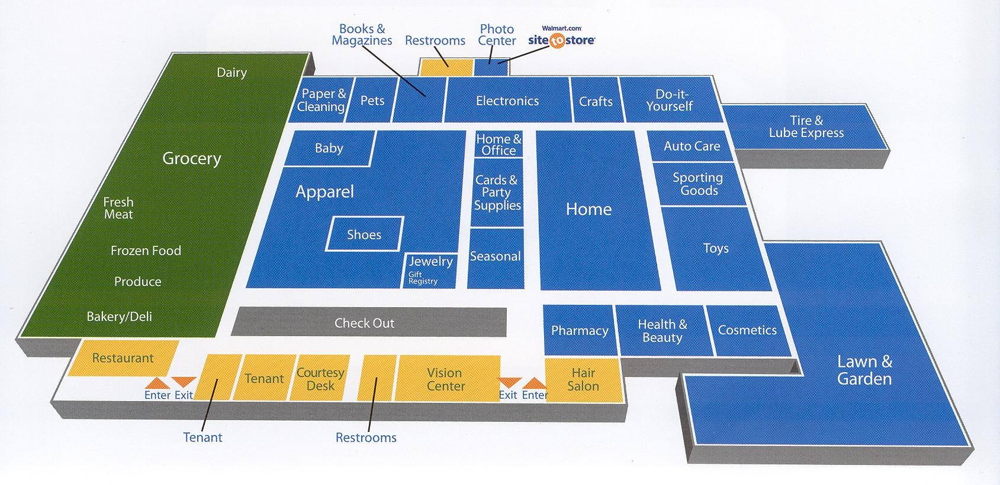
PR-LBS
-Mobility Model
User’s mobility is a sequence of zones
User transition from one zone to the other:
  Exchange between user and service provider

Slide 12
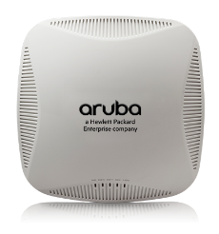

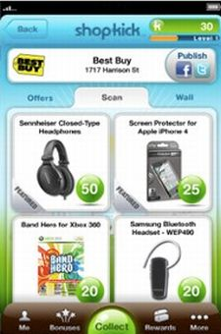
PR-LBS
-Location Service Exchange
PR-LBS performs an action
Service provider responds with service
Repeated Play Model [de Farias and Megiddo, 2006]
  Abstract user — service provider interactions
  Perform a set of actions to maximize user’s utility
zone id
service

Slide 13
PR-LBS
-Location – Service Exchange
What happens at each exchange?
Utilize information disclosure metric to measure change of adversary’s belief
Who are the experts?
Leverage user-app interactions to measure time spent using the app
Expert | Advice
First | Hides zone all time
Second | Release zone according to privacy mechanism
Third | Release zone all time

Slide 14
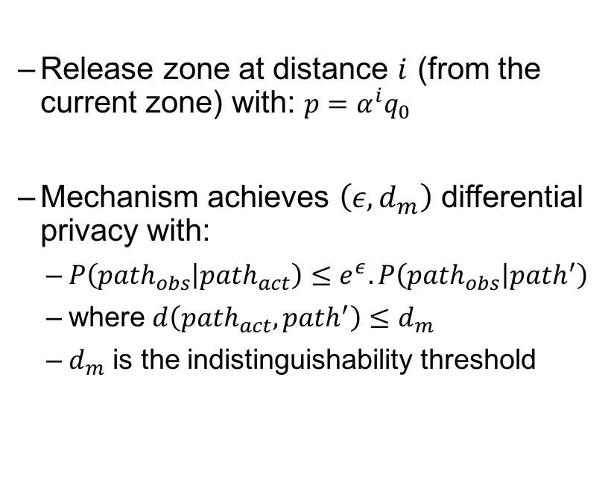
PR-LBS
-Second Expert
Differential Privacy Mechanism
Release zone at distance $i$ (from the current zone) with: $p=α^{i}q_{0}$
Mechanism achieves $\left(ε,d_{m}\right)$ differential privacy with:
  $P\left({path}_{obs} | {path}_{act}\right)≤e^{ε}.P\left({path}_{obs} | path^{′}\right)$
  where $d\left({path}_{act},path^{′}\right)≤d_{m}$
  $d_{m}$ is the indistinguishability threshold

Slide 15

PR-LBS
-Second Expert
What if PR-LBS does not know the topology?
  Achieves $\left(ε,d_{m}\right)$ differential privacy with: $q≤\frac{e^{\frac{ε}{dm}}}{\left|Z\right|−1+e^{\frac{ε}{dm}}}$
What if PR-LBS can not change the released zone?
Current zone
Release actual
q
Release random
1-q
Current zone
Release
q
Hide
1-q

Slide 16
PR-LBS
-Location – Service Exchange

Slide 17
PR-LBS
-Utility Estimation
Challenge: how extract utility value from privacy cost and received reward?
User defines privacy/reward trade-off:
Utilize a fuzzy inference system
  Translate the privacy profile to a numeric function: utility = f(cost, service)
 | No service | Some service | Full Service
No Privacy | 0 | 0 | 1
Some Privacy | 0 | 0 | 1
Full Privacy | 1 | 1 | 2

Slide 18
PR-LBS
-Location – Service Exchange

Slide 19
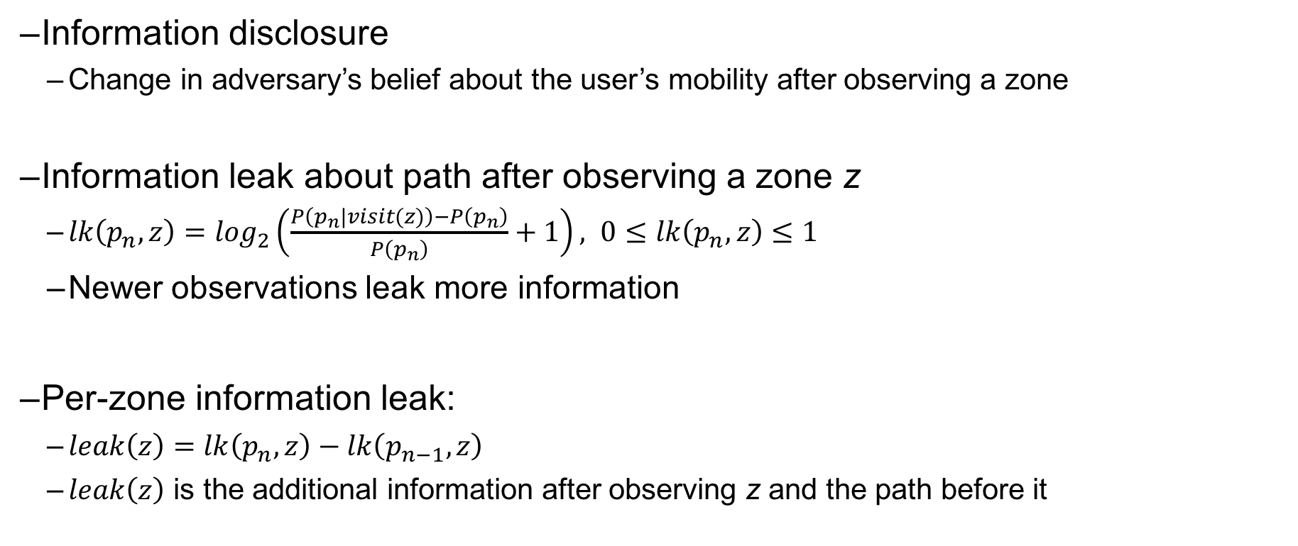
PR-LBS
-Privacy Cost
Information disclosure
  Change in adversary’s belief about the user’s mobility after observing a zone
Information leak about path after observing a zone z
  $lk\left(p_{n},z\right)=\log_{2}\left(\frac{P\left(p_{n}|visit(z)\right)−P\left(p_{n}\right)}{P\left(p_{n}\right)}+1\right), 0≤lk\left(p_{n},z\right)≤1$
  Newer observations leak more information
Per-zone information leak:
  $leak\left(z\right)=lk\left(p_{n},z\right)−lk\left(p_{n−1},z\right)$
  $leak\left(z\right)$ is the additional information after observing z and the path before it

Slide 20
PR-LBS
Privacy Cost
Four zones: A, B, C, and D. After 10 sessions:
11th session:
Set of paths of length 4
Set of paths of length 3
Set of paths of length 2
Set of paths of length 1
Path | #obs. | Prob.
A-B-C-D | 2 | 2/10
A-C-B-D | 3 | 3/10
A-D-B-A | 1 | 1/10
B-D-C-B | 1 | 1/10
B-D-C-A | 1 | 1/10
Φ | 2 | 2/10
Path | #obs. | Prob.
A-B-C | 2 | 2/10
A-C-B | 3 | 3/10
A-D-B | 1 | 1/10
B-D-C | 2 | 2/10
Φ | 2 | 2/10
Path | #obs. | Prob.
A-B | 2 | 2/10
A-C | 3 | 3/10
A-D | 1 | 1/10
B-D | 2 | 2/10
Φ | 2 | 2/10
Path | #obs. | Prob.
A | 6 | 6/10
B | 2 | 2/10
Φ | 2 | 2/10
Obs. zone | path | P(p_{n}) | P(p_{n}|z) | lk(p_{n},z) | leak(z)
D | <B,D> | 2/10 | 3/11 | $$\log_{2}{(\frac{\frac{3}{11}−\frac{2}{10}}{\frac{2}{10}}+1)}=\log_{2}{({15}/{11})}$$ | $$0$$
C | <B,D,C> | 2/10 | 3/11 | $$\log_{2}{(\frac{\frac{3}{11}−\frac{2}{10}}{\frac{2}{10}}+1)}=\log_{2}{({15}/{11})}$$ | $$0$$
A | <B,D,C,A> | 1/10 | 2/11 | $$\log_{2}{(\frac{\frac{2}{11}−\frac{1}{10}}{\frac{1}{10}}+1)}=\log_{2}{({40}/{22})}$$ | $\log_{2}{(\frac{40}{22})}$-$\log_{2}\left(\frac{15}{11}\right)=\log_{2}{(\frac{4}{3})}$
B | <B> | 2/10 | 3/11 | $$\log_{2}{(\frac{\frac{3}{11}−\frac{2}{10}}{\frac{2}{10}}+1)}=\log_{2}{({15}/{11})}$$ | $$\log_{2}{(\frac{15}{11})}$$

Slide 21
PR-LBS
-Location – Service Exchange

Slide 22

PR-LBS
-Service Estimator
Must be practical to measure and not require constant user feedback
Leverage user interactions with the service provider’s app
Service quality metric = $\frac{time spent running the app in foreground}{total time since last action}$

Slide 23
Implementation & Evaluation

Slide 24
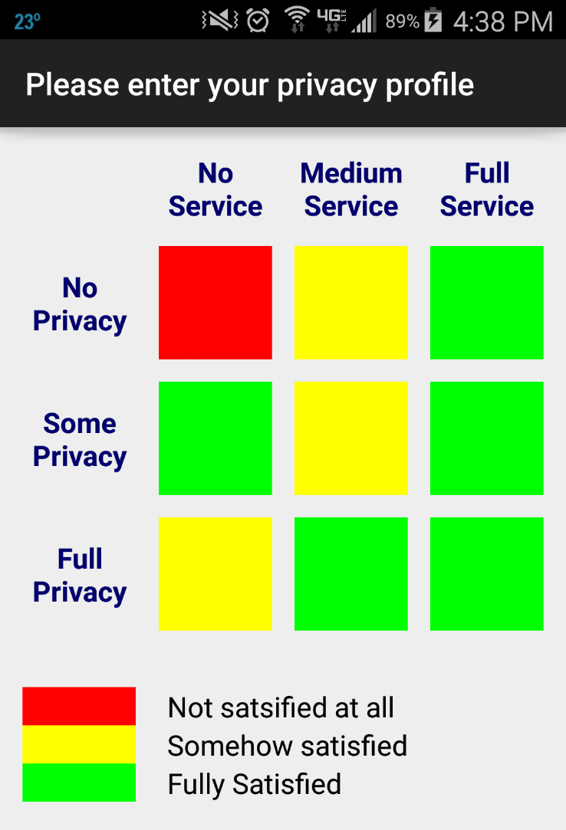
Implementation
Flow Diagram
Instrumeted Android to change content of BLE advertisement messages delivered to apps
Any location obfuscation method fits as an actuator
PR-LBS acts as a control knob for actuators
User Interface

Slide 25
App-based Evaluation
Energy Overhead
Limited energy overhead, mostly because of BLE scanning
(performed by SP app anyway)

Slide 26
Trace-Based Evaluation
-Datasets
Dataset | Location | Duration (days) | # zones | # users
HOPE 2008 | Hotel | 3 | 21 | 1273
HOPE 2010 | Hotel | 3 | 26 | 1119
State Fair | Fair | 5 | 32 | 19
Orlando | Theme Park | 61 | 44 | 41
NCSU | Campus | 80 | 49 | 35
KAIST | Campus | 78 | 44 | 92
Walmart | Retailer | - | 29 | 93
Nordstrom | Retailer | - | 34 | 76
CRAWDAD
Online survey

Slide 27
Trace-Based Evaluation
-User Satisfaction
Interpolate the satisfaction level of each participant
PR-LBS touches the sweet spot of each respondent’s privacy-rewards trade-off

Slide 28
Trace-Based Evaluation
-User Privacy Protection
Privacy-Oriented Users
Service-Oriented Users
PR-LBS curbs location sharing even for service-oriented individuals to protect their privacy

Slide 29
Trace-Based Evaluation
-Service Provider Metrics
Metric | Description
first | Portion of paths with correctly identified starting zones.
last | Portion of paths with correctly identified ending zones.
dwellarea | Portion of zones with accurate estimate of percentage time spent over all the users.
transitions | Portion of correctly identified zone transitions.
retention | Portion of zones with accurate estimate of retention (number of customers in a zone at a one time).
dwelltime | The portion of the zones in the area with accurate estimate of the dwell time. The dwell time of a zone is the average time spent at the zone.

Slide 30
Trace-Based Evaluation
-Service Provider Utility
PR-LBS maintains utility for the service provider’s aggregate metrics

Slide 31
Conclusion
Indoor localization technologies are gaining popularity
Users have privacy concerns
  Hindering the wide deployment of indoor location services
PR-LBS:
  Balances privacy and rewards in indoor environment
  Is easy to deploy and usable
Future work:
  a field study of PR-LBS’s device-based prototype

Slide 32
Thank you
kmfawaz@umich.edu

