Slide 1
Location Privacy Protection in the Mobile Era and Beyond
Kassem Fawaz
Oral Defense, April 21st 2017
Chair: Prof. Kang G. Shin

Slide 2
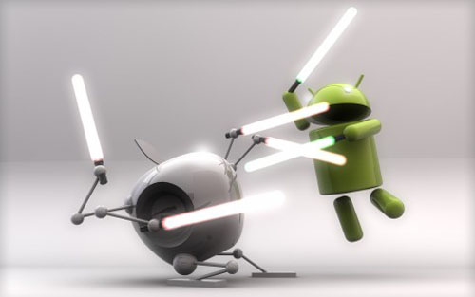
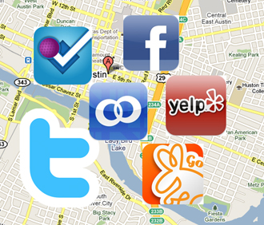
Location-aware Apps
Location-aware mobile devices
Location-Based Services
All Adults
Cell phone owners (90%)
74% of smartphone users utilize location-based services
Smartphone owners (58%)
http://www.popsugar.com/tech/Which-Location-Based-Service-Do-You-Like-Best-7829817
Pew Research, 2014

Slide 3
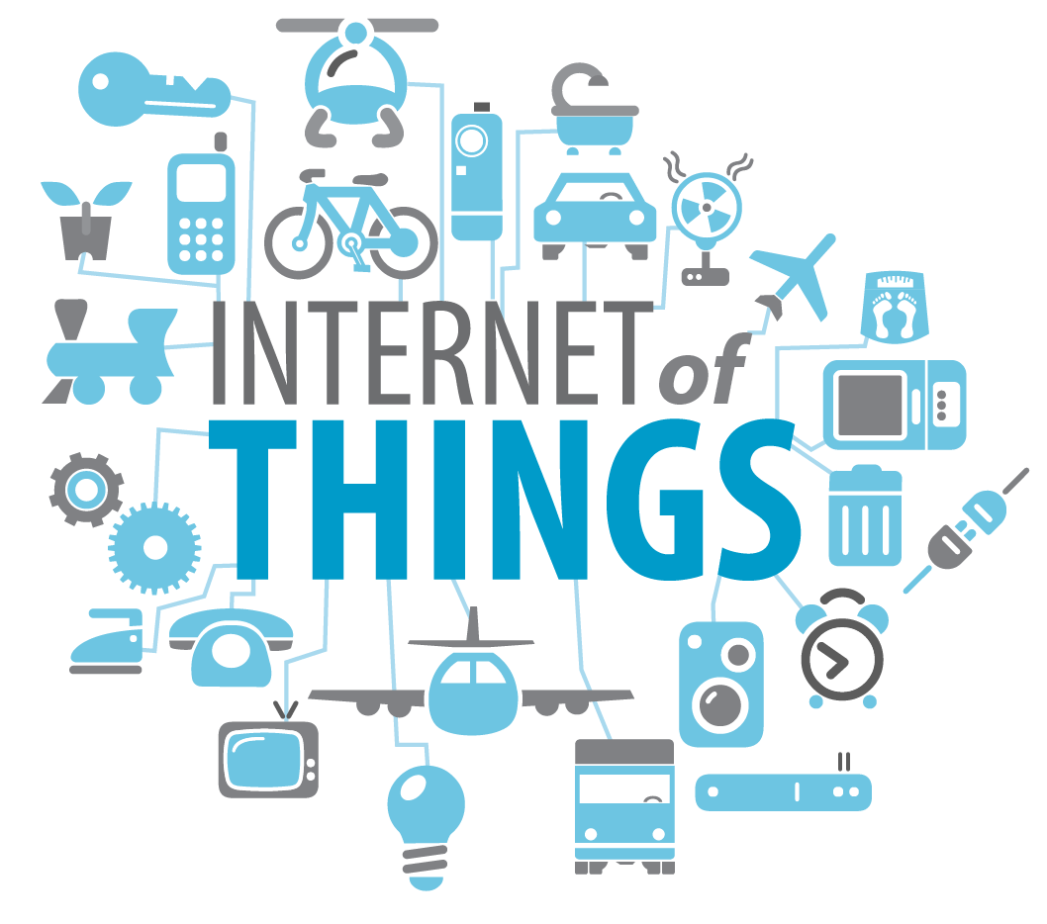
The Internet of Things
Things (items) with digital presence
  Consumers facing:
    Cameras, wearables, health trackers, appliances …
  Not consumer facing:
    RFID tags, inventory, ...
By 2020:
  6-9 billion connected things
  $3.02 trillion in economic value

Slide 4
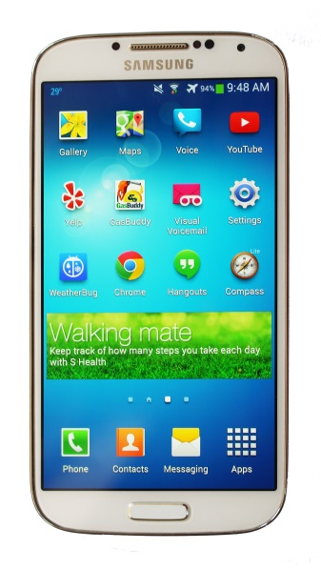










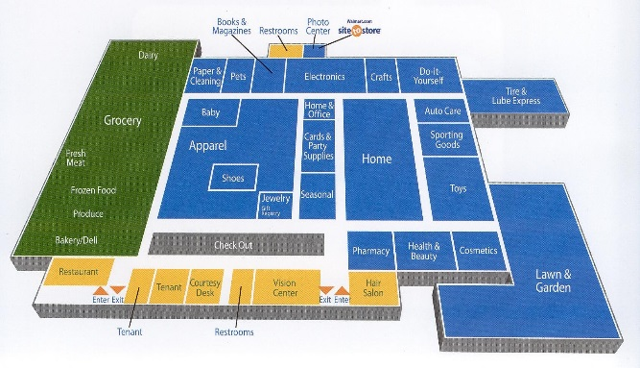
Location Privacy Scenarios
Service Provider
Localization Infrastructure
Location
Location-aware apps
Service
RSSI
Location Access Controls
OS level
Android Location Services
Location-aware Apps
Indoor environment
Wearable IoT devices

Slide 5
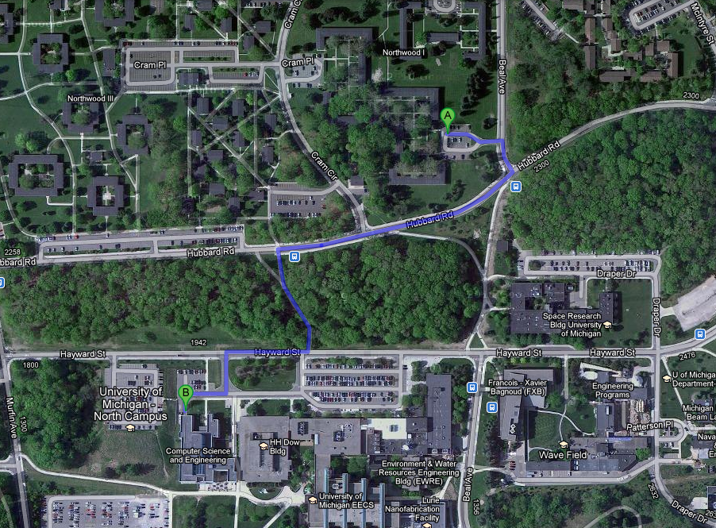
Location Privacy Threats
User tracking:
Track user in real time
User profiling:
Infer user characteristics
  Occupation (CS grad. Student)
User fingerprinting:
Infer user identity
  Home: NW1, Work: CSE
home
t₁, l₁
t₂, l₂
t₃, l₃
t₄, l₄
work
t₅, l₅
North Campus, Ann Arbor, MI

Slide 6
Location Privacy Concerns
Mobile users are more aware of this risk
Concerned about location access
Need more location access control
Teen app users turned off location tracking feature
Location aware apps pose privacy threats
Feed apps inaccurate location

Slide 7
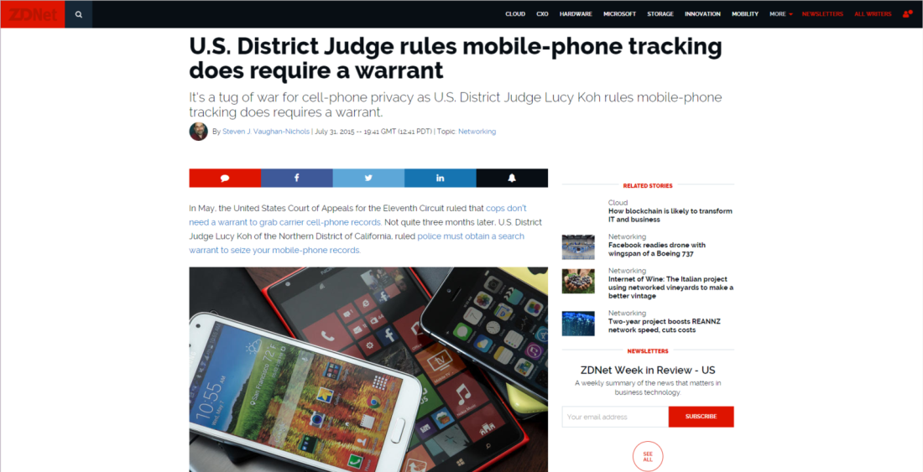
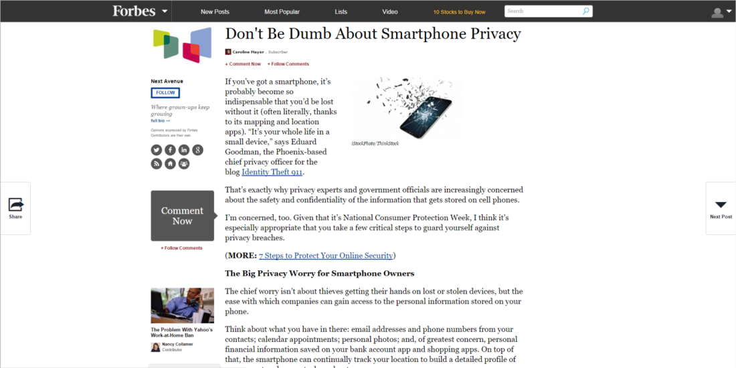
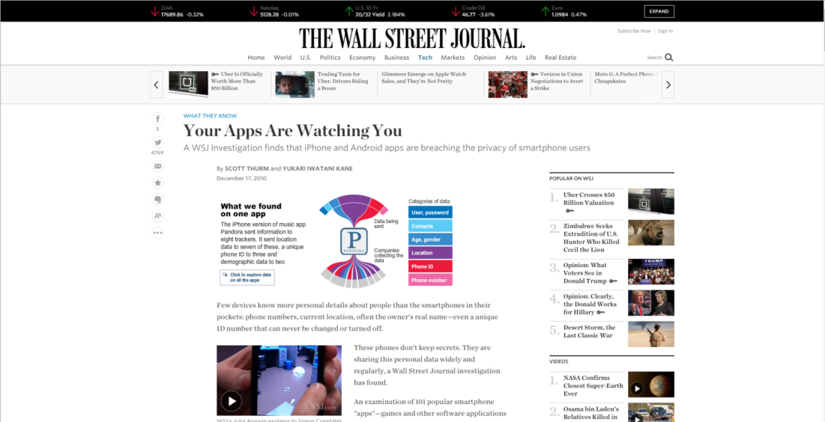
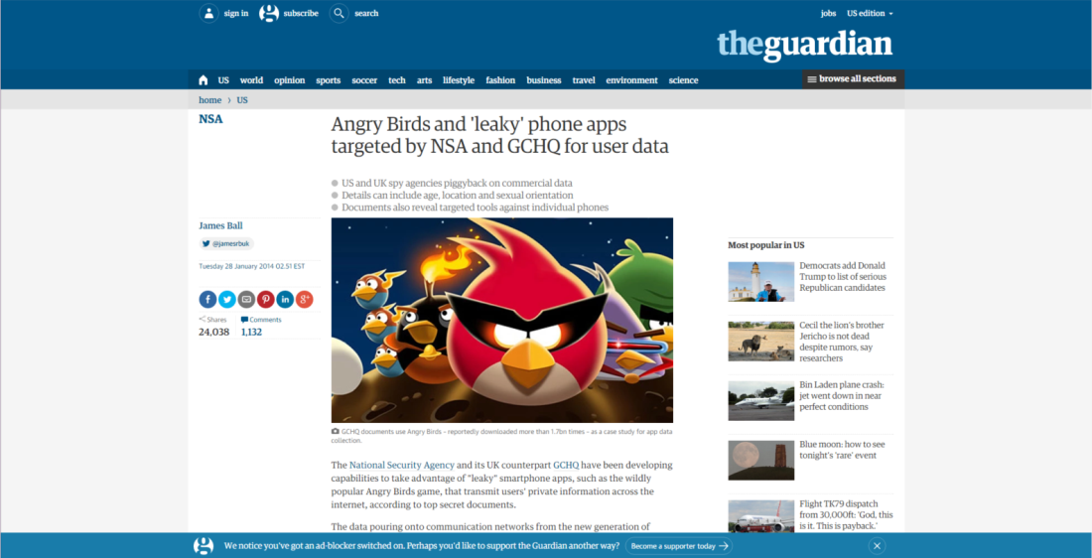
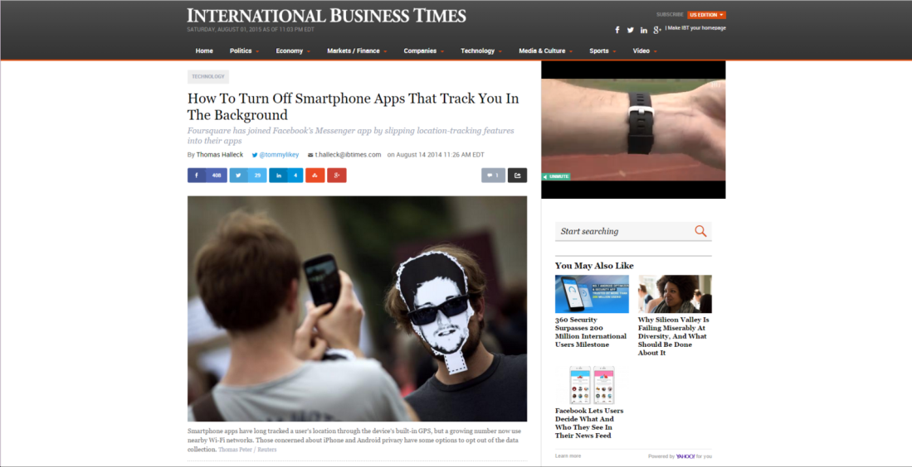
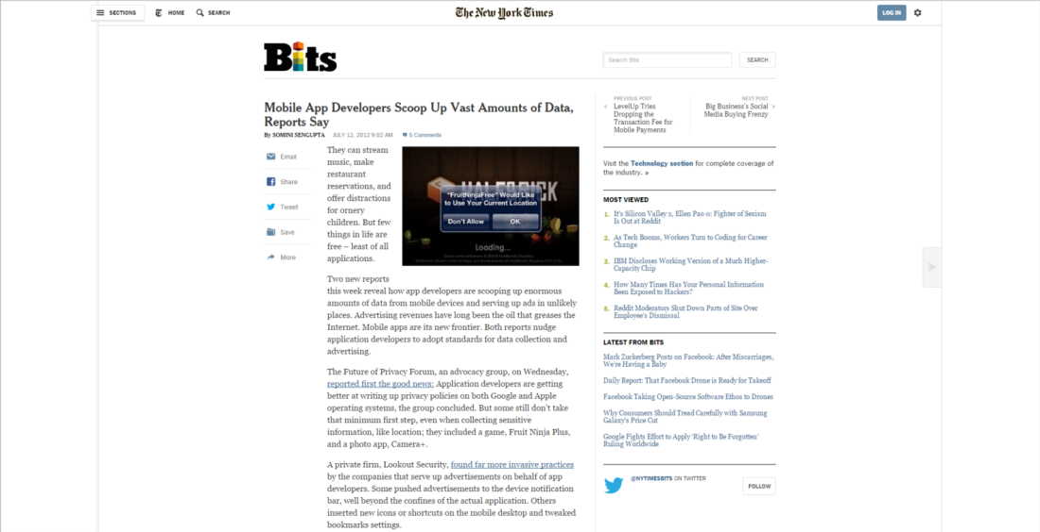
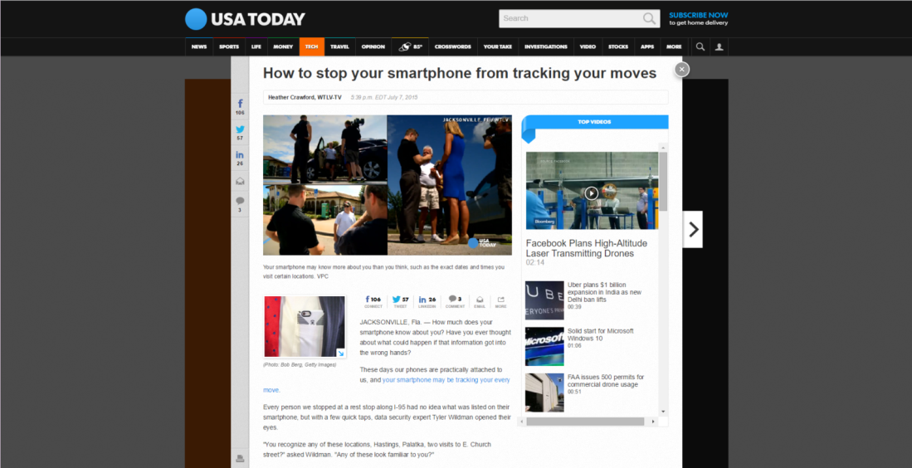
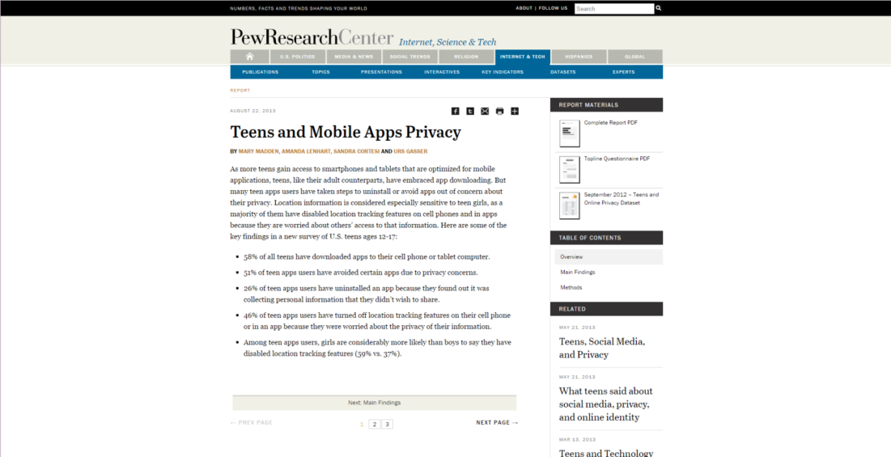
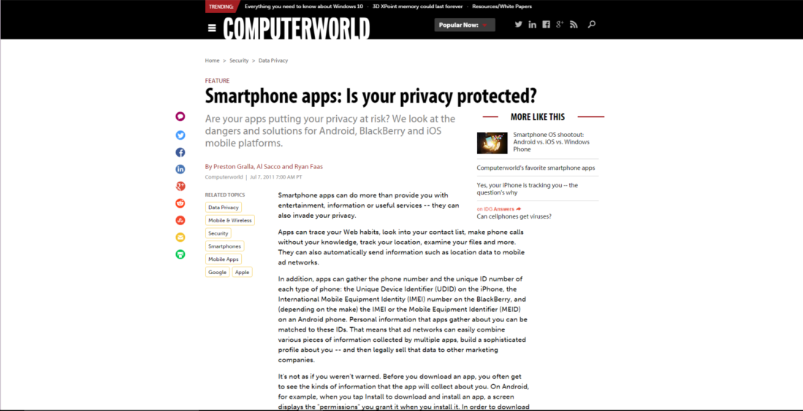
Location Privacy Concerns
  What can we do about it?
7

Slide 8
State of the Art
Deployability
  Compatibility with Localization Ecosystem
    Offline traces only
  Practicality
    Require major modifications to APIs, apps, and devices
Privacy Criteria
  Focus on tracking only
Privacy – Utility Trade-off
  Only the two extremes of the spectrum
  OS controls deficiencies

Slide 9
Thesis Statement
We bring usable, practical, and theoretically sound location privacy protection mechanisms for mobile users in the different scenarios of location-aware smartphone apps, indoor location-based services, and for the Internet of Things manifested by the prevalent BLE-equipped devices.

Slide 10
Thesis Contributions
System | Target Ecosystem | Tracking Protection | Fingerprinting Protection | Profiling Protection
LP-Guardian [ACM CCS ‘14] | Smartphone Apps | ✔ | ✔ | ✔
LP-Doctor [USENIX Sec’15] | Smartphone Apps | — | ✔ | ✔
PR-LBS [PETS ‘16] | Indoor Localization | ✔ | ✔ | ✔
BLE-Guardian [USENIX Sec’16] | BLE-equipped Devices | ✔ | ✔ | ✔

Slide 11
LP-Guardian
cv
cv
Service Provider
Localization Infrastructure
Location
Location-aware apps
Service
RSSI
Location Access Controls
OS level
Android Location Services
Location-aware Apps
Indoor environment
Wearable IoT devices

Slide 12
Threat Model
What’s in?
  Honest-but-curious adversaries
    Service providers or Advertisement and Analytics (A&A) agencies
    Access location only through apps
    Can link location updates of the same user
What’s out?
  Navigation apps
  Operating systems and cellular operators
  Security issues

Slide 13
Overview of LP-Guardian
App Requests Location
A&A library/background app requested location
Coarsen location to city-level
Core foreground app requested location
E.g., AccuWeather
Fingerprinting
protection
Profiling protection
E.g., Yelp, facebook
Synthetic Route
E.g., Runkeeper
Hide
Coarsen location

Slide 14
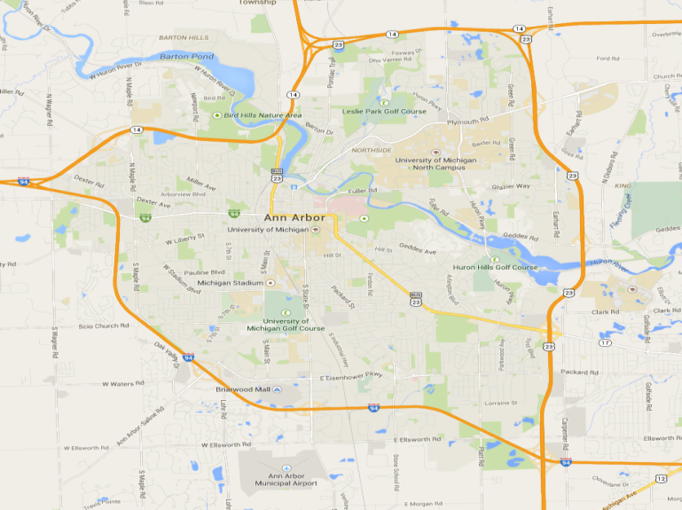
Fingerprinting Threat
App session maps to a place the user visited
  98% of app sessions started and ended at the same place
Model app as a histogram
  Map place to number of visits
92 visits
50 visits
92 visits
40 visits
25 visits

Slide 15
Profiling Metric
  Profiling metric p_{min}:
  Minimum probability in every bin the profiles the adversary has to attain
  The user is indistinguishable among a set of people, where everyone has a probability p_{min} of visiting the places the user visits
The lower p_{min,} the higher the privacy guarantees
  A larger set of people will visit the places the user visits, with low probability

Slide 16
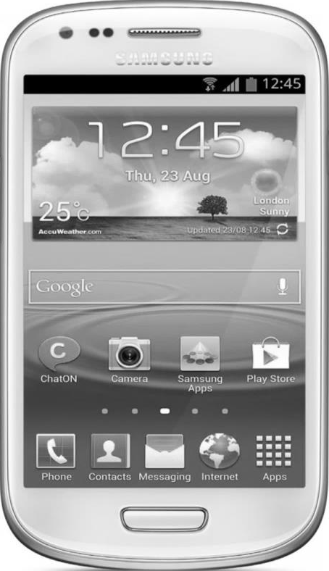

Implementation
Rely on a platform-level instrumentation
  Instrument the location object
  Communicate with LP-Guardian through binder
User level
LP-Guardian
User level
User level
Location updates
4
2
3
New location
New location
Location updates
OS level
1
1
OS level
OS level
LMS
GMS
LMS
GMS
LMS
GMS

Slide 17
Privacy Evaluation
P_{min}= 0.05: relaxed scenario
P_{min} = 0.0005: constrained scenario
QoS: percentage of sessions where LP-Guardian releases actual location

Slide 18
Privacy Evaluation
Tracking threat: time tracked per day
  90% of time, user is tracked less than 10 minutes a day

Slide 19
Summary
A comprehensive app-aware location privacy protection mechanism for Android
Practical:
  Operates solely on the mobile device and is app-compatible
Effective:
  Provides a theoretical location-privacy guarantee
Efficient:
  Provides only the needed level of protection

Slide 20
LP-Doctor
cv
Service Provider
Localization Infrastructure
Location
Location-aware apps
Service
RSSI
cv
Location Access Controls
OS level
Android Location Services
Location-aware Apps
Indoor environment
Wearable IoT devices

Slide 21
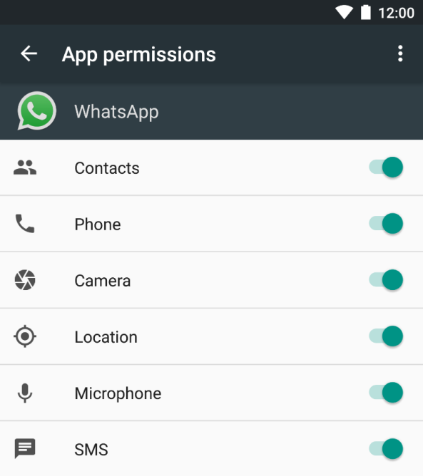
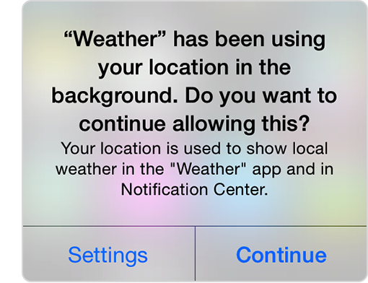
Mobile OS Location Controls
Install time permissions
Per-app location switch
Background location access

Slide 22
Research Questions
Are OS-based controls effective in protecting the user’s location privacy?
If not, how can they be improved, in user-level, without modifying any app or the OS?

Slide 23
Location Privacy Metrics
  Prof_{cont}: KL divergence between histogram and mobility pattern
  Prof_{bin}: χ² test with significance level of 0.05
Low privacy threat
High privacy threat
Probability of user visiting place
# of visits app observed user at place

Slide 24
Are OS-Controls Effective?
Apps
30% low threat
Allow location access
Prevent location access
70% high threat
Allow location access
Prevent location access
Optimal case
Utility loss
Privacy loss
Utility loss
Users can’t control location access on per-session basis
  Existing OSes don’t provide an easy interface
  User can’t decide on threat level

Slide 25
Apps’ Location Privacy
Are OS-based controls effective in protecting the user’s location privacy?
If not, how can they be improved, in user-level, without modifying any app or the OS?

Slide 26
LP-Doctor
Provides per-session location access control
Runs at the user-level
Is easy to install and use

Slide 27
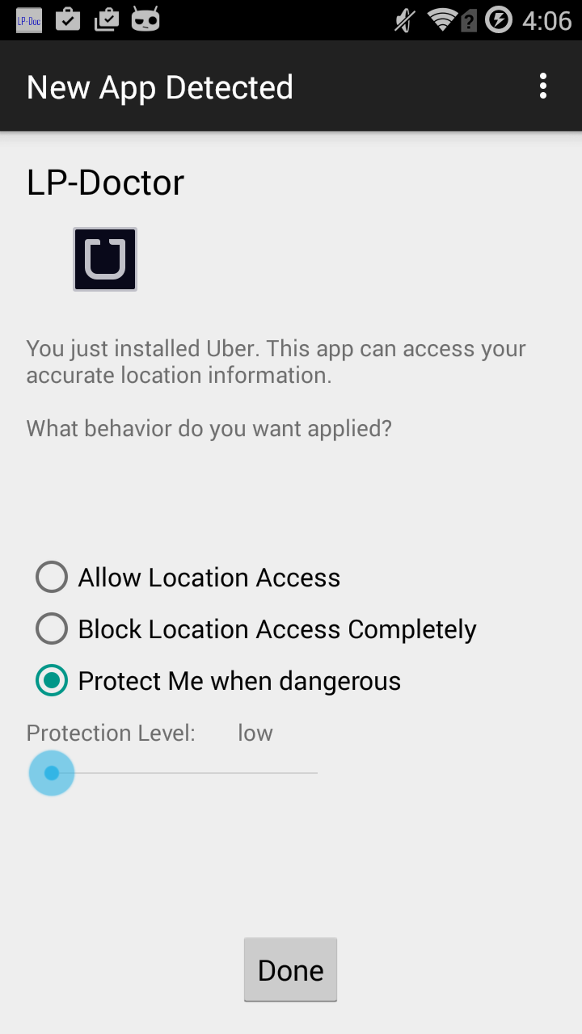
LP-Doctor
What happens when the user installs an app?
Probability of user visiting place
# of visits app observed user at place

Slide 28
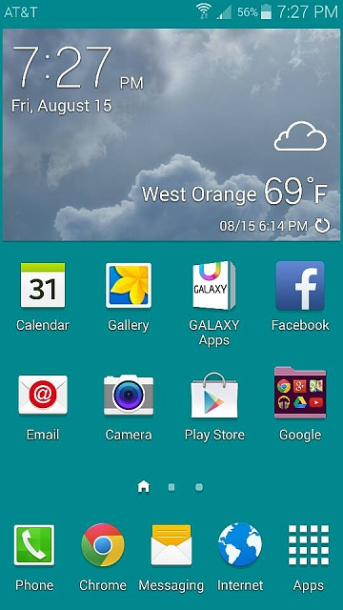

LP-Doctor
What happens when the user runs an app?
LP-Doctor
Intercept app launch event
Fetch policy
Threat analyzer
Anonymization actuation
Display notification
Instruct app to launch
Pack LP-Doctor as an app launcher

Slide 29
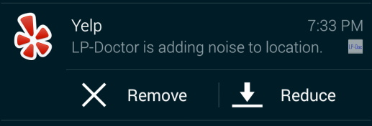
LP-Doctor
What happens when the user runs an app?
Intercept app launch event
Fetch policy
Threat analyzer
Anonymization actuation
Display notification
Instruct app to launch
Remove noise
Reduce noise →
user adjusts privacy – QoS trade-off

Slide 30
LP-Doctor
What happens when the user runs an app?
Intercept app launch event
Fetch policy
Threat analyzer
Anonymization actuation
Display notification
Instruct app to launch
Resume app launch
Delay less than 25 ms
End of app session:
  Update app histogram
  Disengage mock location provider

Slide 31


User Study
Recruited 227 participants from Amazon Mechanical Turk
Used LP-Doctor with Yelp (N = 120) and Facebook (N = 122)
Yelp
Facebook

Slide 32
Summary
Location privacy is a serious problem
  Existing research proposals are impractical
  OS-controls are ineffective and inefficient
LP-Doctor
  Practical and effective privacy protection mechanism
Future work:
  Test LP-Doctor in the wild to study deployment challenges

Slide 33
PR-LBS
cv
cv
Service Provider
Localization Infrastructure
Location
Location-aware apps
Service
RSSI
Location Access Controls
OS level
Android Location Services
Location-aware Apps
Indoor environment
Wearable IoT devices

Slide 34
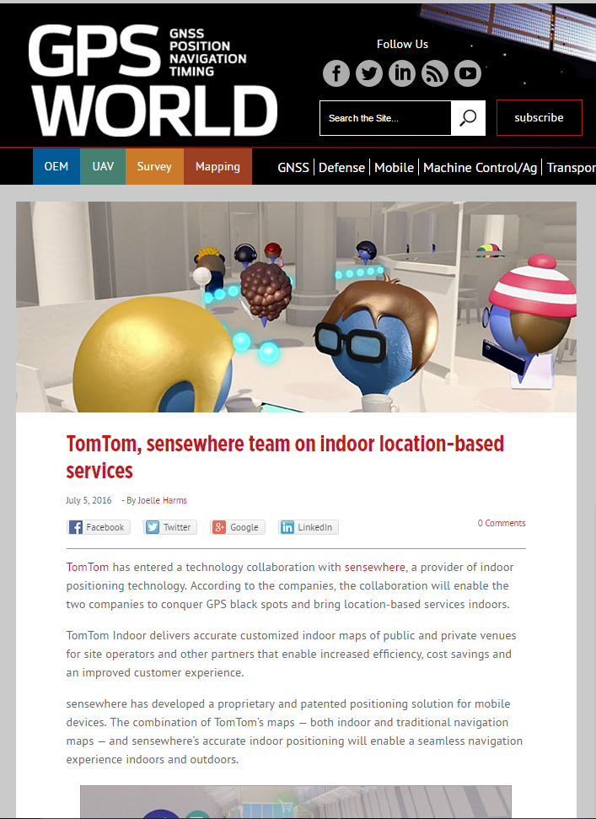
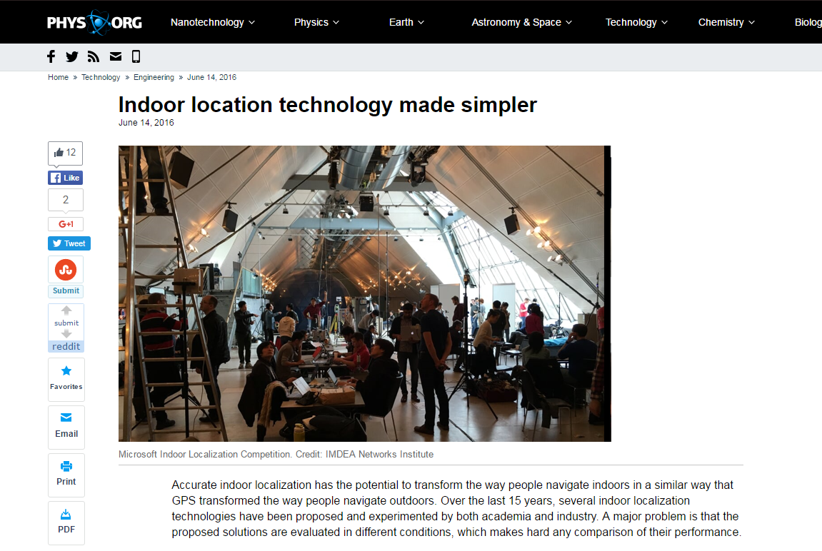
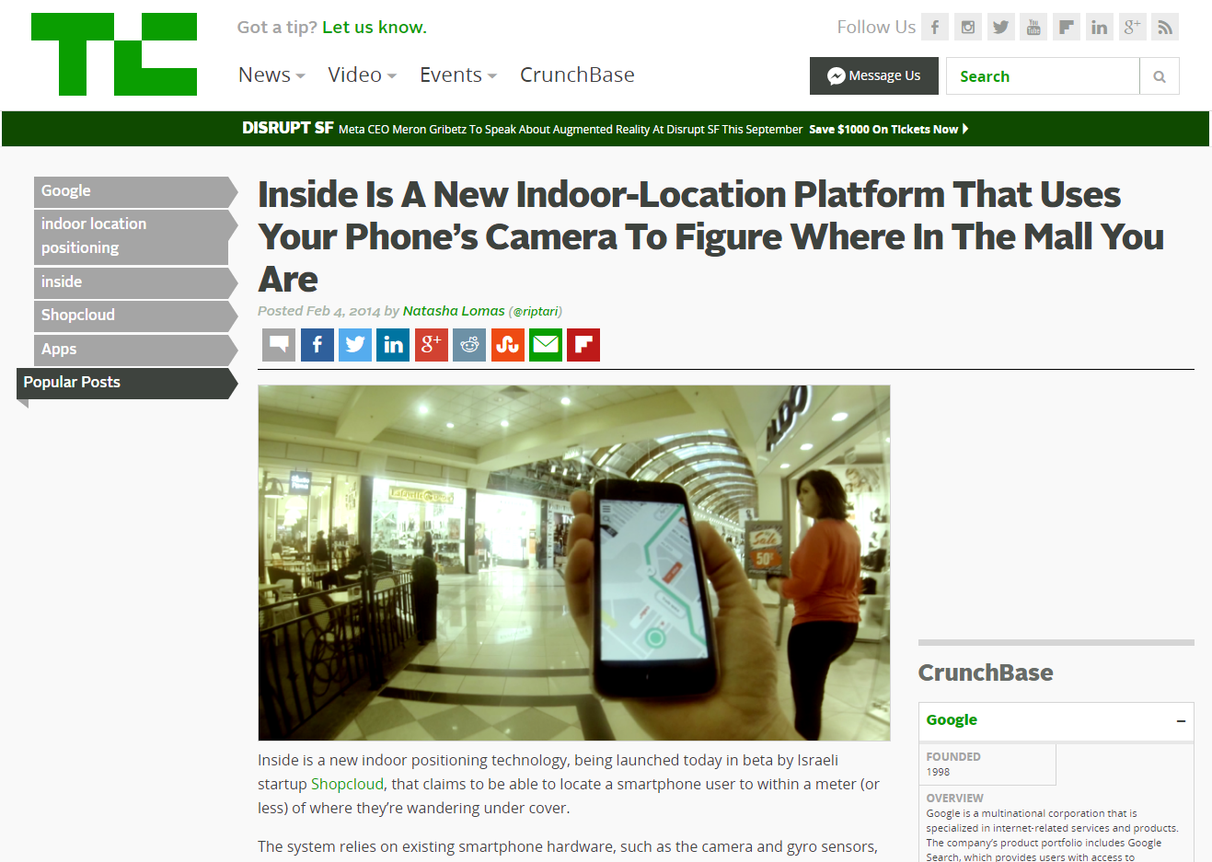
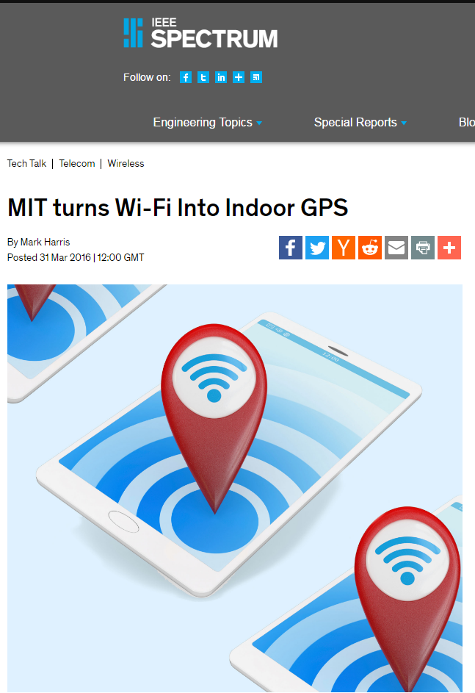
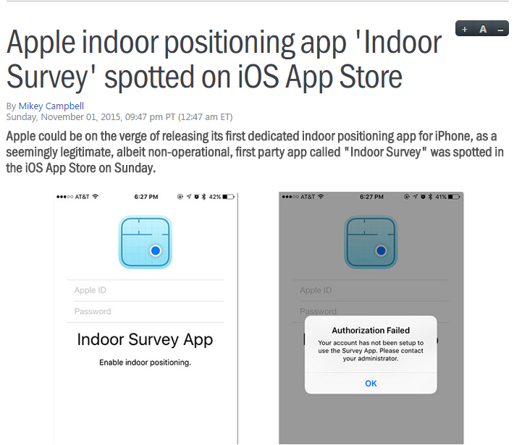
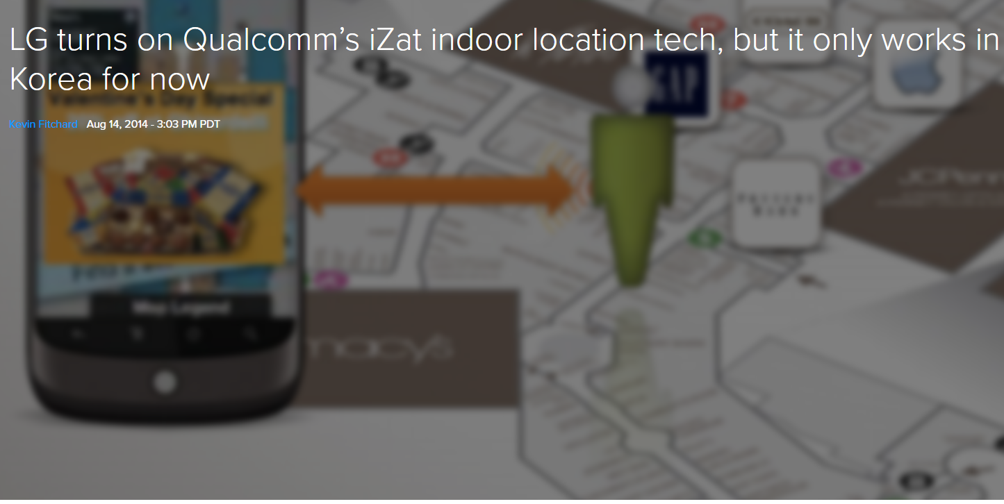
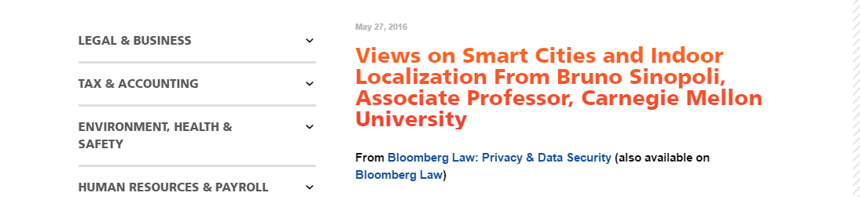
Indoor Localization
  How do users feel about them?

Slide 35
The Survey
We are always looking for ways to improve our customers’ experience. We gather publicly broadcasted information your smartphone or other WiFi enabled device sends out when it is attempting to connect to a WiFi network in and around this store. This provides us with anonymous, aggregate reports that give us a better sense of customer foot traffic. We do not gather such things as your name, email address, phone number, your device's browsing activity or text, email or voice messages.

Slide 36
Sharing Preferences
Response | % Respondents | Category
Reject tracking | 61% | Privacy-oriented
Track part of mobility | 24% | Neutral
Allow full tracking | 15% | Service-oriented

Slide 37
The Survey Takeaways
Utilize a technology that provides rewards in exchange of non-private sharing
  Can we provide a fair transaction between user and service provider?
Accept tracking if data shared with 3rd parties
Share some mobility in exchange for rewards

Slide 38
PR-LBS
Privacy vs. Rewards for Indoor Location-Based Services

Slide 39
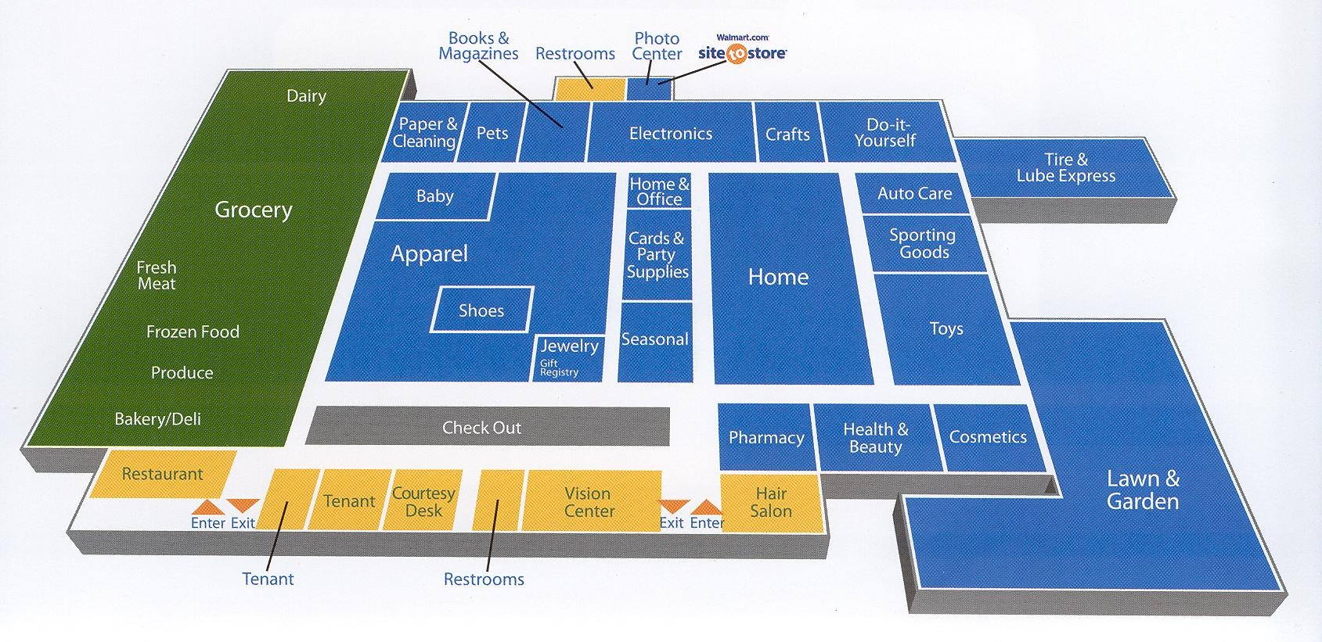
Mobility Model
User’s mobility is a sequence of zones
User transition from one zone to the other:
  Exchange between user and service provider
  PR-LBS performs an action
  Service provider responds
  with service

Slide 40
Location-Service Exchange
What happens at each exchange?
Utilize information disclosure metric to measure change of adversary’s belief
Who are the experts?
Leverage user-app interactions to measure time spent using the app
Expert | Advice
First | Hides zone all time
Second | Release zone according to privacy mechanism
Third | Release zone all time

Slide 41
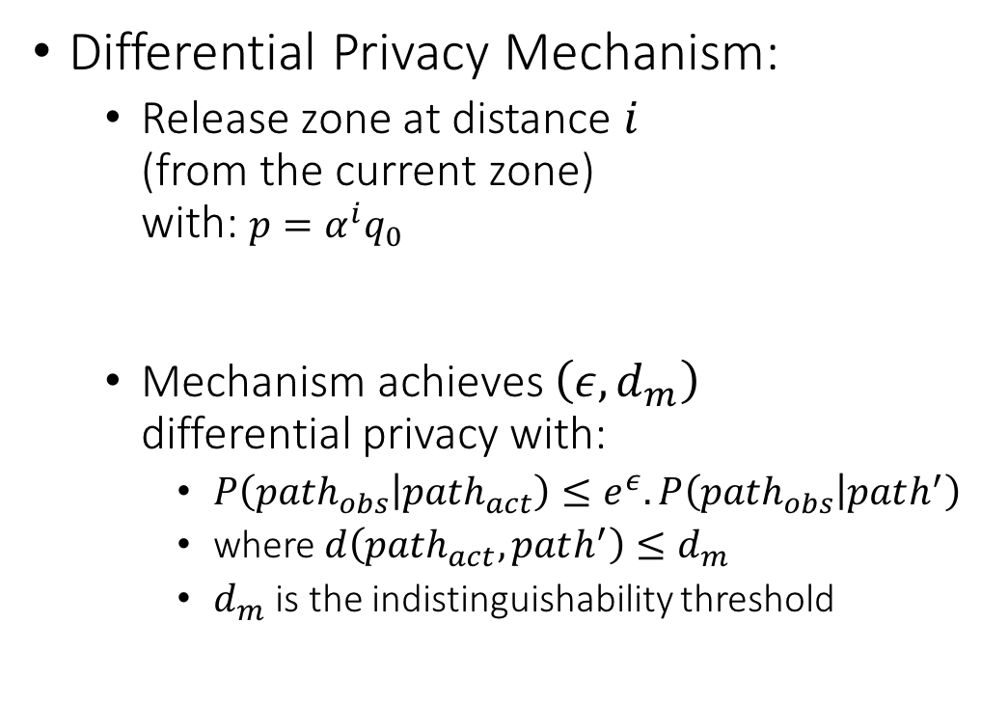
Second Expert
Differential Privacy Mechanism:
  Release zone at distance $i$
  (from the current zone)
  with: $p=α^{i}q_{0}$
  Mechanism achieves $\left(ε,d_{m}\right)$
  differential privacy with:
    $P\left({path}_{obs} | {path}_{act}\right)≤e^{ε}.P\left({path}_{obs} | path^{′}\right)$
    where $d\left({path}_{act},path^{′}\right)≤d_{m}$
    $d_{m}$ is the indistinguishability threshold

Slide 42
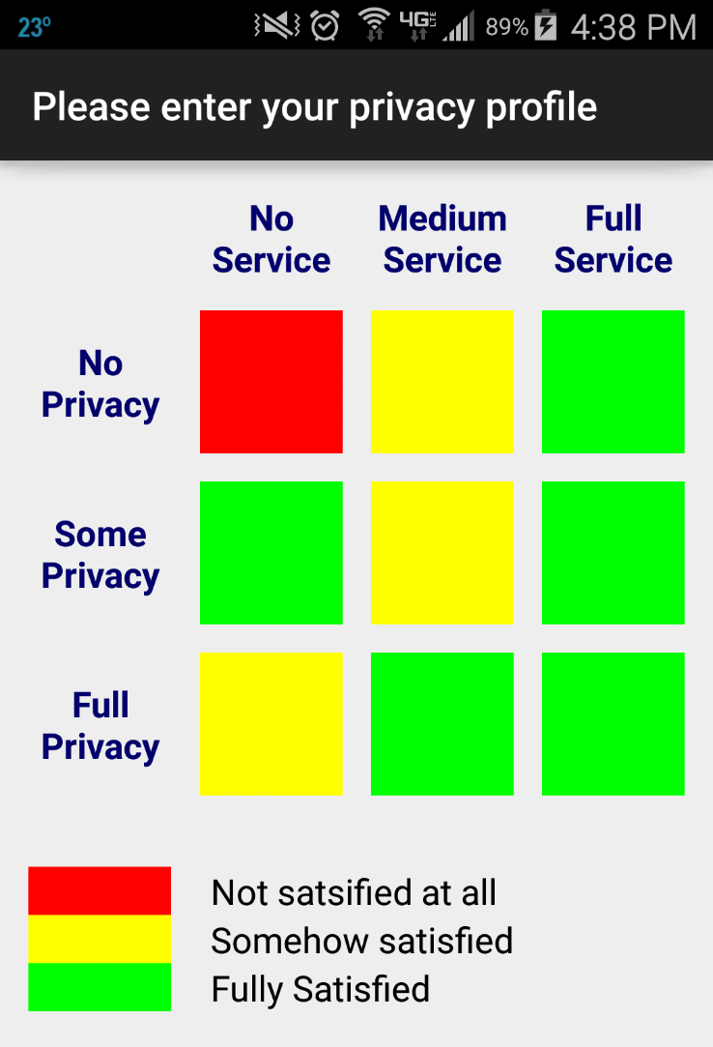
Implementation
Flow Diagram
User Interface
Instrumented Android to change content of BLE advertisement messages delivered to apps
Any location obfuscation method fits as an actuator
PR-LBS acts as a control knob for actuators

Slide 43
Trace-Based Evaluation - Datasets
Dataset | Location | Duration (days) | # zones | # users
HOPE 2008 | Hotel | 3 | 21 | 1273
HOPE 2010 | Hotel | 3 | 26 | 1119
State Fair | Fair | 5 | 32 | 19
Orlando | Theme Park | 61 | 44 | 41
NCSU | Campus | 80 | 49 | 35
KAIST | Campus | 78 | 44 | 92
Walmart | Retailer | - | 29 | 93
Nordstrom | Retailer | - | 34 | 76
CRAWDAD
Online survey

Slide 44
Privacy Protection
Privacy-Oriented Users
Service-Oriented Users
PR-LBS curbs location sharing even for service-oriented individuals to protect their privacy

Slide 45
Summary
Indoor localization technologies are gaining popularity
Users have privacy concerns
  Hindering the wide deployment of indoor location services
PR-LBS:
  Balances privacy and rewards in indoor environment
  Is easy to deploy and usable
Future work:
  a field study of PR-LBS’s device-based prototype

Slide 46
BLE-Guardian
cv
cv
Service Provider
Localization Infrastructure
Location
Location-aware apps
Service
RSSI
Location Access Controls
OS level
Android Location Services
Location-aware Apps
Indoor environment
Wearable IoT devices

Slide 47
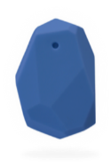
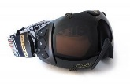
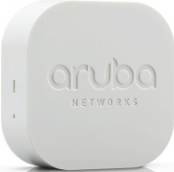
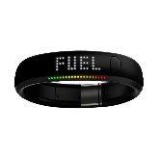
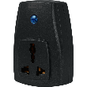
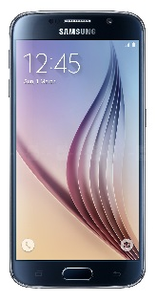
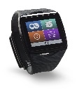
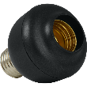
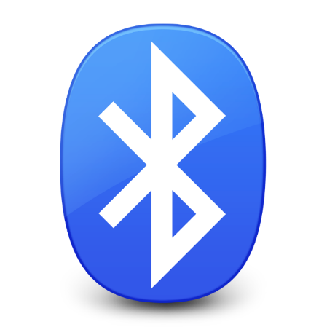
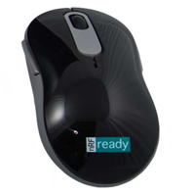
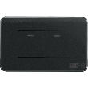

What is Bluetooth Low Energy?
Attractive communication technology
  Short range
  Low energy footprint
  Supported by most hosts
Currently:
  74K unique products with BLE support
2013:
  1.2 billion BLE products shipped
2020:
  2.7 billion BLE products expected

Slide 48
BLE Primer
Scanning
Standby: Low Power Mode. Receiver and transmitter switched ‘off’
Advertising: Used by low power ‘Server’. Only transmitter required.
Scanning: Used by ‘Client’. Receiver listens to advertising channels.
Initiating: ‘Server’ sends connection request
Connection: After scanning, ‘Client’ responds to ‘Server’ advertisement
Advertising
Standby
Initiating
Connection

Slide 49
BLE Security and Privacy
Pairing & bonding
  Prevent unauthorized access to device or secured services
Address randomization
  Prevent user tracking
Direct Advertisements
  Prevent user tracking and profiling

Slide 50
BLE Privacy & Security Effectiveness
Indirect Advertisements
  Detected 214 different unique types of devices
Address Randomization
Name | Description
ihere | key finder
DEXCOMRX | Glucose monitor
Frances’s Band ea:9d | smartband
Otbeat | heart rate monitor
JS00002074 | digital pen
Device | Days observed
One | 37
Flex | 37
Zip | 37
Forerunner 920 | 36
Basis Peak | 25
Address
00:17:E9:CB:F3:61
00:17:E9:CB:F5:01
Revealing Names
Consistent Addresses
Poor Randomization

Slide 51
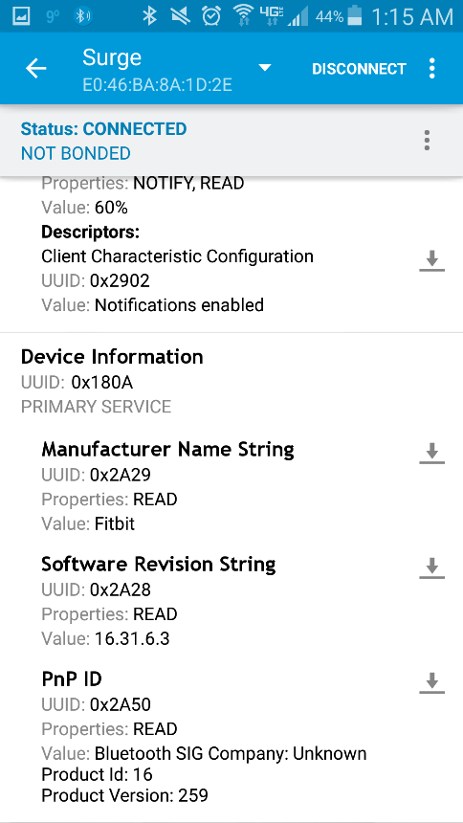
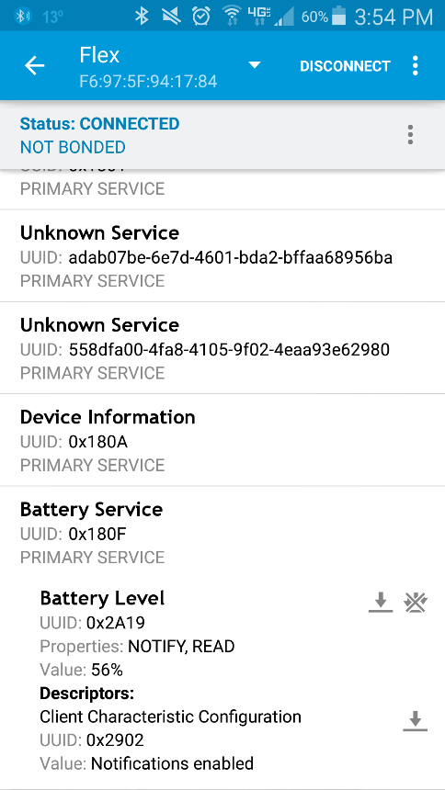
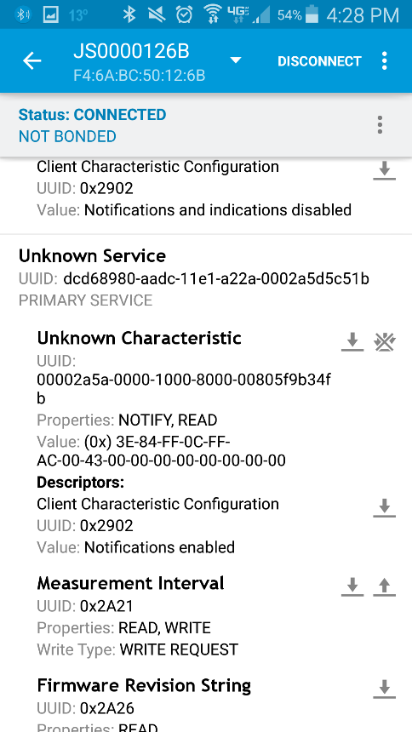
BLE Privacy & Security Effectiveness
Device Pairing
Advertise and accept connections
Battery level
Unique identifiers
Notes:
Screenshots obtained from Nordic app

Slide 52
It all starts with the advertisements…
Tracking User
Profiling User
Harming User
  Health situation, user’s lifestyle, behavior, preferences, and personal interests
  Fingerprinting of and unauthorized access for sensitive systems and devices
Consistent addresses, poor randomization, unique device names and identifiers

Slide 53
Research Questions
Can we effectively fend off the threats to BLE-equipped devices
  in a device-agnostic manner,
  (2) using COTS (Commercial-Off-The-Shelf) hardware only, and
  (3) with as little user intervention as possible?

Slide 54
BLE-Guardian
Adversary
Device Hiding
Access Control
BLE-equipped
Device
Authorized client
BLE-Guardian

Slide 55






Device Hiding
Jam BLE device advertisements to hide its existence
Need to learn device advertising Sequence
  Otherwise jamming will be ineffective or inefficient
Advertisement
Listen
$$…$$
$$r∈[0,10]$$
$$37$$
$$38$$
$$39$$
$$adv$$

Slide 56




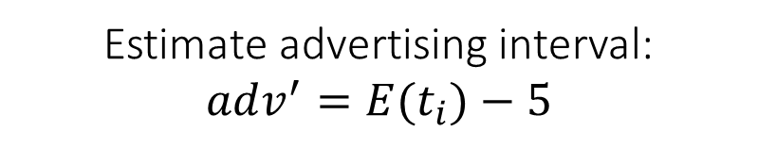
Device Hiding
Advertisement session
$$t_{1}$$
$$t_{2}$$
$$t_{3}$$
$$t_{4}$$
Estimate advertising interval:
$$adv^{′}=E(t_{i})−5$$

Slide 57
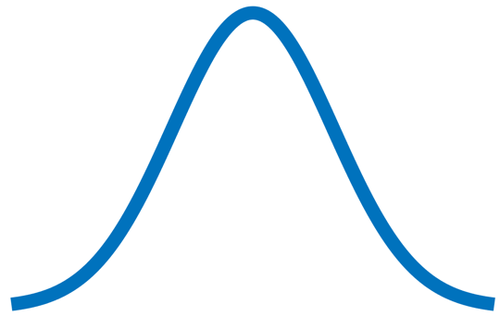




Device Hiding
$$T_{N}$$
$$T_{N}+adv’$$
Max delay
Monitoring interval
$$T_{N}+adv^{′}−e$$
$$T_{N}+adv^{′}+e+10$$

Slide 58
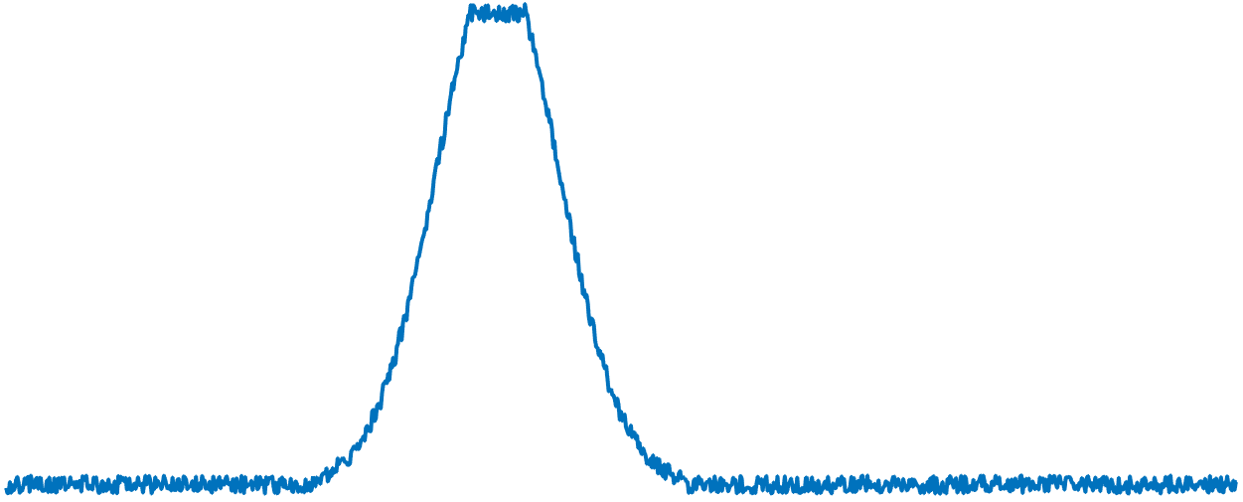
Device Hiding
jamming
Monitoring interval
Detect RSSI (received signal strength indication) increase
Apply jamming and follow advertising sequence

Slide 59
At this point, the target BLE device is hidden.
  How to enable access to it?

Slide 60
Access Control
Connection Enabling:
Bluetooth classic as an OOB channel.
Connection parameters to distinguish legitimate connection request.
Connection
parameters
jamming
adv
Reduced Adv.
Connection request
Legitimate connection
jamming
adv
data
data

Slide 61
Implementation
Ubertooth One
  Programmable BT radio
  Open source firmware
  Rx/Tx on each BT channel
User-level app
  Control BLE-Guardian
  Update firmware seamlessly

Slide 62
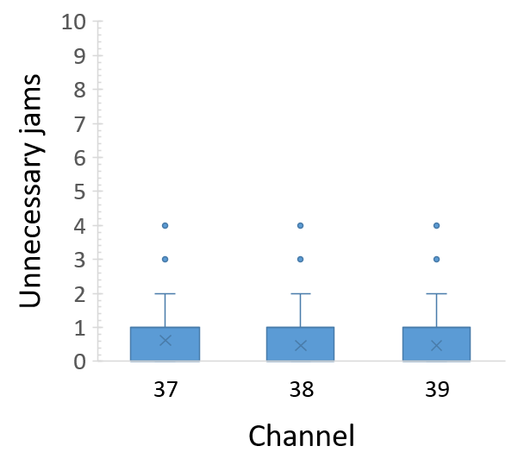
Evaluation
Cut-off distance
  Less than 1m
Impact on advertising channels
  Less than 1 unnecessary jam in 20 ms in worst-case scenario
Energy overhead
  Less than 16%

Slide 63
Summary
BLE-Guardian
  Privacy protection for BLE device users
  Device agnostic and relies on COTS hardware
  Low overhead on advertisement channels
Future work
  Explore other M2M protocols such Zigbee
  Implement without external hardware (need firmware access)

Slide 64
Conclusion & Future Work

Slide 65
Thesis Contributions
Location privacy threats are a reality in the mobile and IoT ecosystem
State-of-the-art fails to address these threats
Four systems to mitigate location privacy threats:
  Location-aware smartphone apps: LP-Guardian & LP-Doctor
  Indoor location-based services: PR-LBS
  IoT devices: BLE-Guardian
The proposed systems:
  Provide privacy guarantees
  Are Practical to employ
  Are Usable

Slide 66
Thank you!
kmfawaz@umich.edu
Kassemfawaz.com

