Slide 1
RT-OPEX: Flexible Scheduling for Cloud-RAN Processing
Krishna C. Garikipati, Kassem Fawaz, Kang G. Shin
University Of Michigan

Slide 2

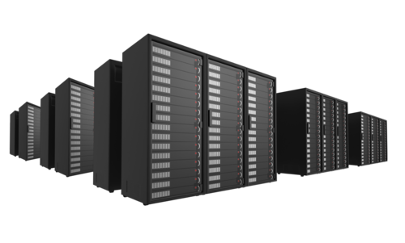
What is Cloud-RAN*?
Virtualization in Radio Access Network (RAN)
Benefits
  Lower energy consumption (compute, HVAC)
  Less site visits
  faster upgrade and replacement cycles
  Advanced signal processing
fronthaulnetwork
* C-RAN

Slide 3
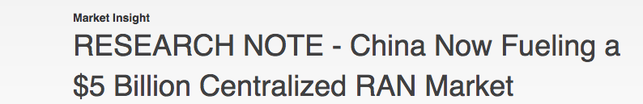
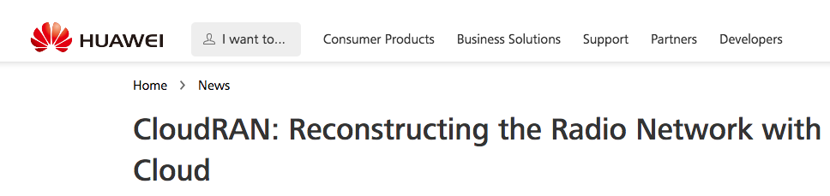

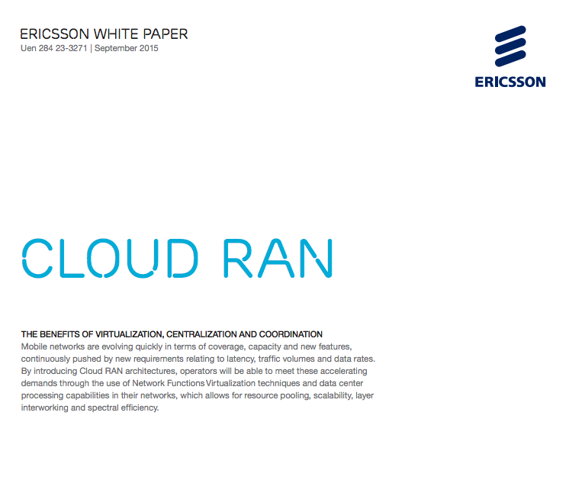
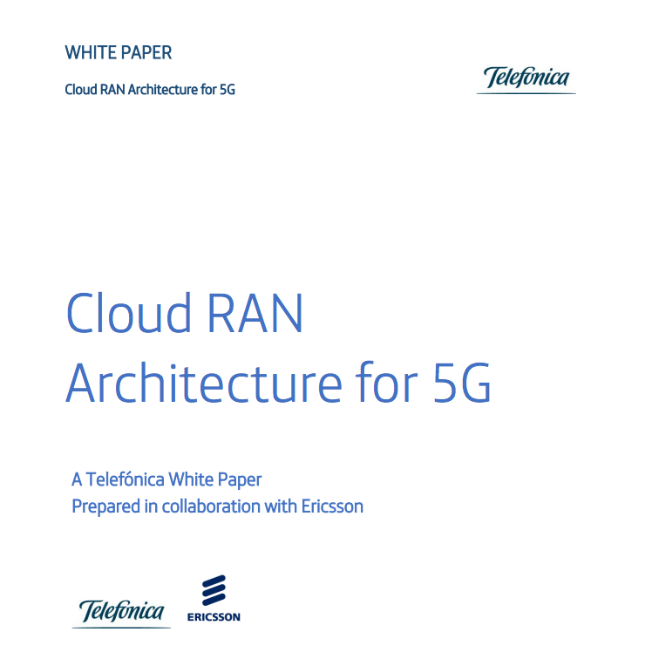
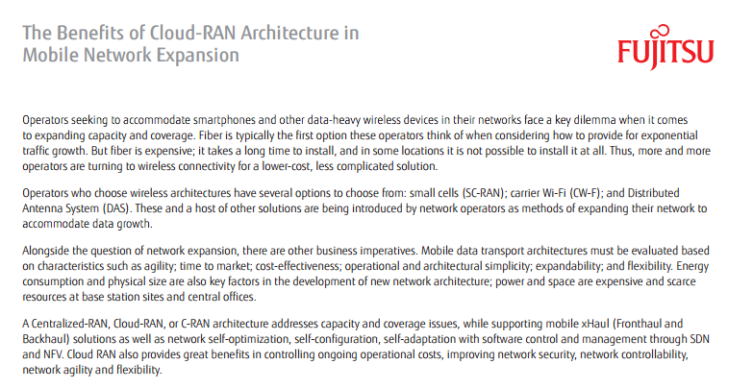
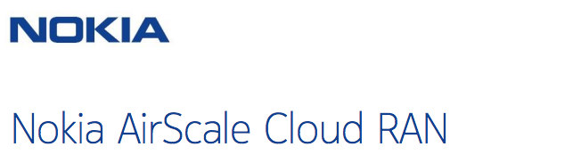
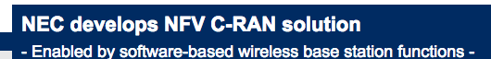
C-RAN in Practice

Slide 4



Deadlines
Periodic (sub)frames every 1 ms
Hard deadline of 3ms
  Transport, decode and respond to LTE uplink frame
Requires real-time scheduling
fronthaulnetwork
ACK
ACK
ACK

Slide 5



C-RAN Scheduling
BS 0 – subframe 0
BS 0 – subframe 1
BS 1 – subframe 0
BS 1 – subframe 1
BS 0
Core network
Per-node scheduler
BS 0
BS 1
scheduler
core 0
core 1
core 2
BS 1
.
.
.
core N
Assign basestations to computing nodes
Assign subframes to cores

Slide 6
State-of-the-Art
Partitioned
CloudIQ
Global
PRAN
Parallelism
WiBench
Bigstation
Assumes fixed processing time
High runtime overhead
Scheduler-agnostic
Scheduling
Architecture

Slide 7
Real-world Traffic
Band 17
Max load
Band 13
Two scheduling options:
  Design for WCET → overprovision resources
  Design for average case → deadline misses

Slide 8
RT-OPEX
Offers flexible scheduling for C-RAN
Combines offline partitioned scheduling with runtime parallelism (work stealing)
Achieves resource pooling at finer time scale
Avoids over-provisioning of resources

Slide 9
E2E model
Uplink processing
Scheduling
Leverage model for processing time
Implementation
Parallelism
Deadline misses
RT-OPEX design
Evaluation Platform
Overhead
Performance gains

Slide 10
End to End Model

Slide 11
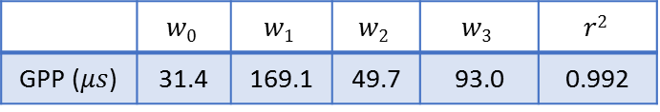
Uplink Processing
Model
LTE processing in software
N = # antennas
K = modulation order
D = bits per carrier (load)
L = decoding iterations
Dominating terms
FFT, Equalization, Turbo decoding
Error term
Platform variations
(kernel tasks/interrupt handling)
Comparable to benchmark stress test
FFT, Equalization
Turbo-decoding
Error
De-mapping, De-matching
 | $$w0$$ | $$w1$$ | $$w2$$ | $$w3$$ | $$r2$$
GPP ($μs$) | 31.4 | 169.1 | 49.7 | 93.0 | 0.992

Slide 12
Parallelism
Decoder Block
FFT
Independent w.r.t code blocks
Independent w.r.t antenna and OFDM symbols

Slide 13
Parallelism
Task Model
Divide tasks into parallel and independent subtasks
Parallel processing
Precedence constraints

Slide 14
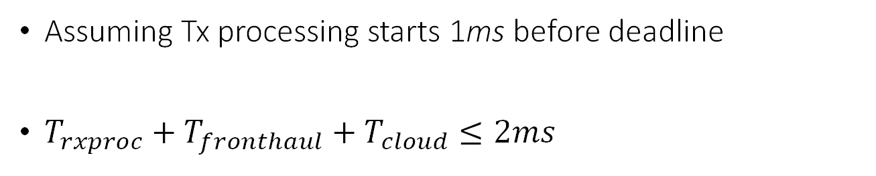

End-to-End Model
Tx processing starts
$$T_{rxproc}$$
RTT/2
RTT/2
Assuming Tx processing starts 1ms before deadline
$T_{rxproc}+T_{fronthaul}+T_{cloud}≤2ms$
RTT/2

Slide 15
Scheduling

Slide 16

Conventional Approaches
Static
Global
Deterministic, offline
Offers real-time guarantees
Deadline miss: $T_{rxproc}≥T_{max}$
Single-queue of subframes
FIFO (or EDF) de-queuing
Non-deterministic, flexible
No real-time guarantees

Slide 17
Scheduling Gaps
WCET design + non-optimal design
→ gaps in execution

Slide 18
RT-OPEX
Exploit the gaps dynamically at runtime
core is idle
core is idle

Slide 19
RT-OPEX Migration
Start migration
Subtasks migrated to cores with enough slack time
Local processing does not wait for migrated task
  Ensures no performance degradation
  Otherwise perform recovery
Core 0
Local FFT
decode
Local FFT
Core 1
Core 2
Core 3
Core 4

Slide 20

Implementation
& evaluation

Slide 21
RT-OPEX Implementation
OpenAirInterface (LTE Rel 10)
  Modularize the tasks
  Abstraction of FFT, Demod, Decode
Utilize pthread library
Migration
  Data references from shared memory
Open-source
  Enables different configurations
  https://github.com/gkchai/RT-OPEX

Slide 22
Evaluation Platform
GPP
  32-core Intel Xeon E5, 128 GB RAM, 15 MB L3 cache
  Ubuntu 14.0.4 low latency kernel
LTE data collection
  USRP to collect load of 4 cellular towers
  30000 subframes
  Replay load from each BS trace
4 BS, 2 Antennas, 10MHz LTE FDD
1 UE per BS, 100% PRB utilization
Simulated transport delay (RTT/2)

Slide 23
Performance Evaluation
Performance Comparison
Large gaps
Narrower gaps

Slide 24


Migration Overhead
FFT median overhead is 26$μs$
Decoding overhead is 20 $μs$
Overhead = cost of transfer OAI variables from shared memory to core
Account for overhead at migration

Slide 25
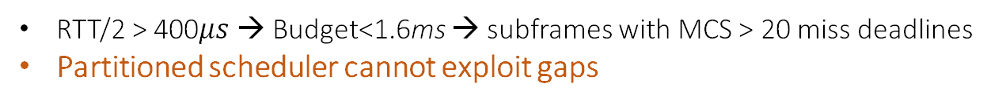
Partitioned Scheduler
RTT/2 > 400$μs$ → Budget<1.6ms → subframes with MCS > 20 miss deadlines
Partitioned scheduler cannot exploit gaps

Slide 26
Global Scheduler
Fails to deliver performance gains
Cache thrashing causes deadline performance to saturate beyond 8 cores
At MCS 27, processing time increases with more cores

Slide 27
Conclusion
RT-OPEX: Real-Time Opportunistic Execution
  Low overhead
    Migration on top of partitioned
  Flexible to resources
    Exploits added resources for migration
  Flexible to load
    Leverages load variations to improve deadline miss rate

Slide 28
Thank You!
Questions?

Slide 29
RT-OPEX Performance
Lower RTT → larger gaps
Larger RTT → narrower gaps
migrate decode tasks of high MCS → deadline miss goes to zero
migrate only FFT subtasks → deadline miss reduced

Slide 30

Transport Latency
Latency between and Radio
Fronthaul ($T_{fronthaul}$):
  Fixed latency (~20us/Km)
Cloud network latency ($T_{cloud}$):
  Switch, Ethernet and driver delay
Latency per packet
Average 0.15ms
1Gbps Ethernet to switch
1/10 Gbps Ethernet to GPP

Slide 31

Uplink Processing
Dynamic and depends on:
MCS selection
Number of antennas
SNR of channel
$$0.5ms$$
2.8x increase w.r.t MCS
0.5ms increase w.r.t L
50% increase w.r.t SNR
$200μs$ per antenna

Slide 32

RT-OPEX Performance
At miss rate threshold ≤ 0.01, RT-OPEX supports 4 Mbps of extra load
RTT/2 = 500$μs$

Slide 33
RT-OPEX
Challenges
What to migrate?
How to migrate?
When to migrate?

Slide 34
RT-OPEX

