Slide 1
Location Privacy Protection for Smartphone Users
Kassem Fawaz and Kang G. Shin
Computer Science & Engineering
The University of Michigan

Slide 2
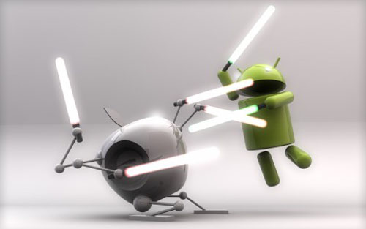
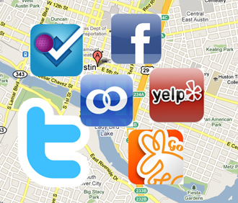
Location-aware Apps
Location-aware mobile devices
iPhone 6, Galaxy S5 …
Location-Based Services
All Adults
Cell phone owners (90%)
74% of smartphone users utilize location-based services
Smartphone owners (58%)
http://www.popsugar.com/tech/Which-Location-Based-Service-Do-You-Like-Best-7829817
Pew Research, 2014
Notes:
Pew research: http://www.pewinternet.org/fact-sheets/mobile-technology-fact-sheet/

Slide 3
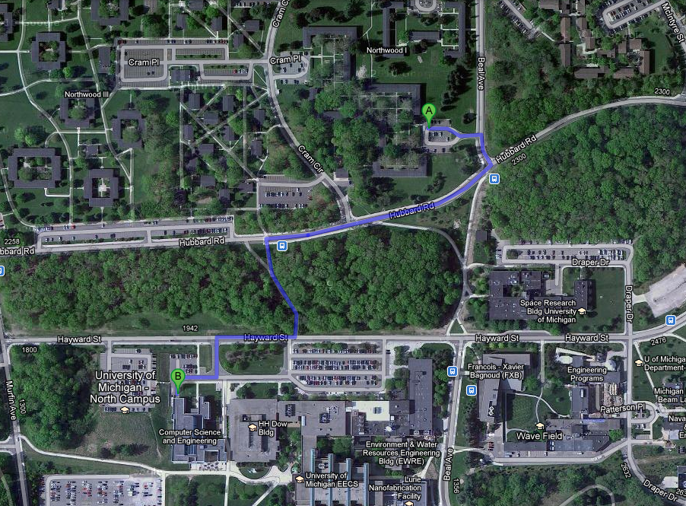
Location Privacy
User tracking:
Track user in real time
User profiling:
Infer user characteristics
Occupation (CS grad. Student)
User identification:
Infer user identity
Home: NW1
Work: CSE
home
t₁, l₁
t₂, l₂
t₃, l₃
t₄, l₄
work
t₅, l₅
North Campus, Ann Arbor, MI

Slide 4
Location Privacy
Mobile users are more aware of this risk
Concerned about location access
Need more location access control
Teen app users turned off location tracking feature
Location aware apps pose privacy threats
Feed apps inaccurate location

Slide 5
Existing Systems
More than a decade of research
Shortcomings of existing proposals:
Practicality:
Have not been implemented with real-world apps
Effectiveness:
Focus on tracking while ignoring profiling threat
Efficiency:
Do not balance between privacy and QoS

Slide 6
Our Solution
LP-Guardian:
A novel location privacy protection mechanism for Android
Practical:
Operates solely on the mobile device and is app-compatible
Effective:
Provides a theoretical location-privacy guarantee
Efficient:
Provides only the needed level of protection

Slide 7
Threat Model
What’s in?
Honest-but-curious adversaries
Parties with access to location traces
Service providers or Advertisement and Analytics (A&A) agencies
Access location only through apps
Can link location updates of the same user
What’s out?
Navigation apps
Operating systems and cellular operators
Users have no choice but to trust them
Security issues

Slide 8
Overview of LP-Guardian
App Requests Location
A&A library/background app requested location
Coarsen location to city-level
Core foreground app requested location
E.g., AccuWeather
Identity protection
Profiling protection
E.g., Yelp, facebook
Synthetic Route
E.g., Runkeeper
Hide
Coarsen location

Slide 9
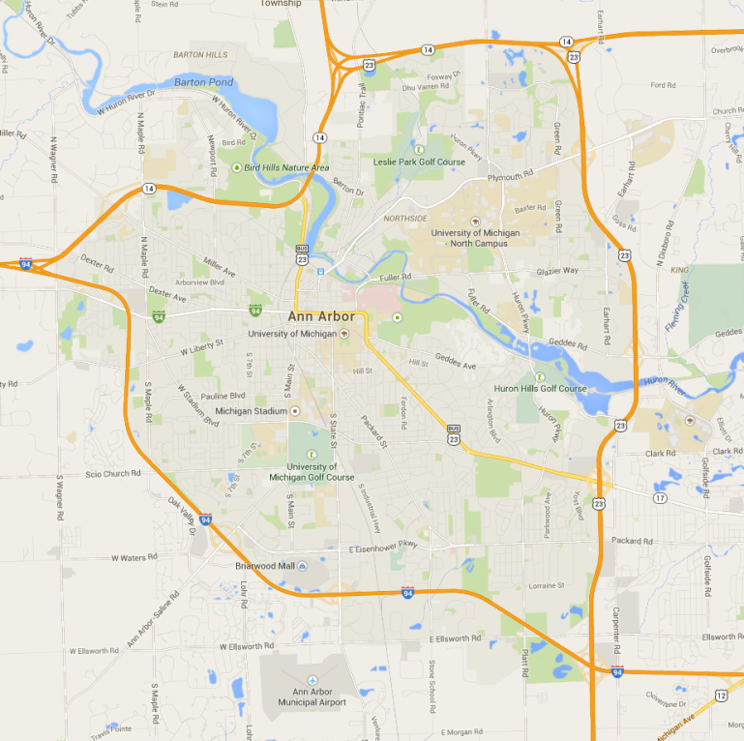
Identification Threat
App session maps to a place the user visited
Because app usage is sporadic
Short sessions (less time spent at a place)
Model app as a histogram
Map place to number of visits
92 visits
50 visits
92 visits
40 visits
25 visits

Slide 10
Identification Threat
Background information model
Adversary’s objective:
Map an app’s histogram to a source profile
Utilize the observation probability:
Can be given by a multinomial distribution
p_{app,x} = P(h_{app}|x) =
Profile ID | Place distribution
ID – 1 | p₁:50%, p₂:30%, p₃:20%
ID – 2 | p₁:0%, p₂:40%, p₃:60%

Slide 11
Indistinguishability Criterion
User’s privacy is protected if:
The adversary can’t associate the histogram with an individual
Regardless of background information
Rely on indisintguishability concept:
$∀ x,y:\text{P}\left(\text{h}\text{app} | x\right)≤ e^{ε}.\text{P}\left(\text{h}\text{app} | y\right)$
Apply logarithm to previous equation to get
Rewrite model: $\sum_{i=1}^{k}{N_{i}(\ln{p_{ix}}−\ln{p_{iy}})}≤ε$

Slide 12
Profiling Metric
Profiling metric p_{min}:
Minimum probability in every bin the profiles the adversary has to attain
The user is indistinguishable among a set of people, where everyone has a probability p_{min} of visiting the places the user visits
The lower p_{min,} the higher the privacy guarantees
A larger set of people will visit the places the user visits, with low probability

Slide 13
Indistinguishability Mechanism
New app session from place i
Assess the change of privacy budget
Budget exhausted
Budget not exhausted
Disclose anonymized location
Profiling protection
Budget consumed for the app: $ε_{app}$
$$ε_{exp.}=ε_{app}+(\ln{p_{ix}}−\ln{p_{min})}$$
$$ε_{exp.}≥0.1$$
$$ε_{exp.}<0.1$$

Slide 14
Profiling Protection
User is the best judge of the place sensitivity
Apply Laplacian noise to the location to hide exact location but keep inexact whereabouts

Slide 15
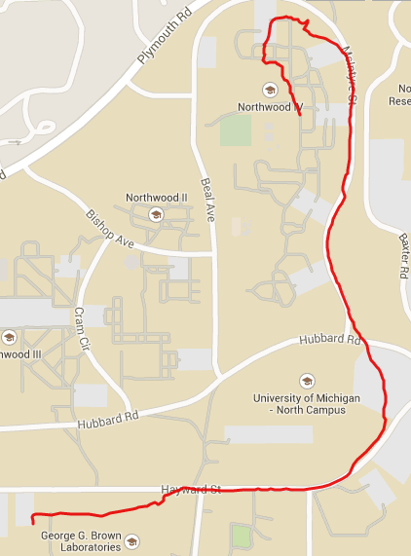
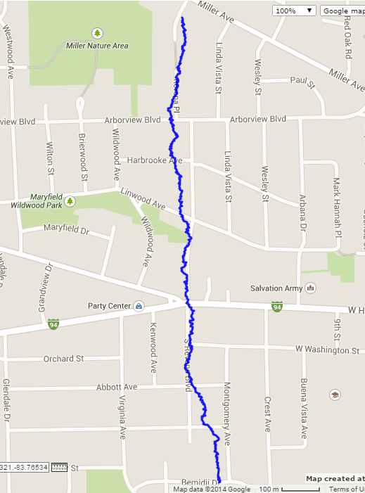
Synthetic Route Generation
For apps interested in distance traveled
E.g., sports tracking apps (Endomondo, Runkeeper)
Distort path but keep distance/speed intact
Actual Path
l’₂ after d(l₁,l₂)
New session
l₂ after d(l₁,l₂)
Reported Path
Random location

Slide 16
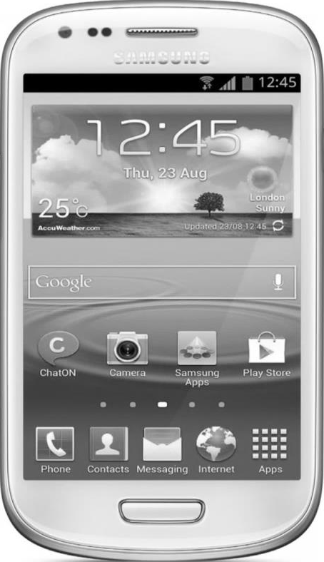
Implementation
Rely on a platform-level instrumentation
Instrument the location object
Communicate with LP-Guardian through binder
User level
LP-Guardian
User level
User level
Location updates
4
2
3
New location
New location
Location updates
OS level
1
1
OS level
OS level
LMS
GMS
LMS
GMS
LMS
GMS

Slide 17
Evaluation
Privacy
Tracking
Identification
Performance
Measure effect on energy and real-time operation
Devices: Galaxy Nexus, Galaxy S3, and Galaxy S4
Running CM 10.2.1 based on Android 4.3.1
User study
Users’ perception on loss of QoS

Slide 18
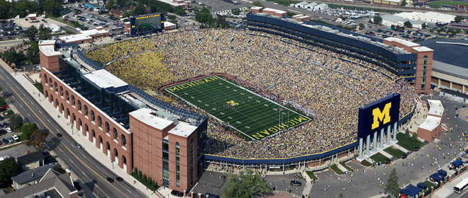
Privacy Evaluation
Dataset-based evaluation
List of app sessions:
Every data point: user-app combination
Three datasets:
com.whatsapp,1395247179636,America/New_York,75,placeID:1,placeID:1
 | RTCL | PhoneLab | LiveLab
Participants | 25 | 95 | 30
Period | 1 week - 10 months | 1 week - 4 months | 1 year
Location | Ann Arbor, MI | Buffalo, NY | Houston, TX

Slide 19
Privacy Evaluation
P_{min}= 0.05: relaxed scenario
P_{min} = 0.0005: constrained scenario
QoS: percentage of sessions where LP-Guardian releases actual location

Slide 20
Privacy Evaluation
Tracking threat: time tracked per day
90% of time, user is tracked less than 10 minutes a day

Slide 21
Performance Evaluation
Delay Overhead
Battery Life
Only incurred once every 750ms
Time for 85% battery depletion
Location load: 1 request every 5s

Slide 22
User Study
Recruited 180 participants from Amazon Mechanical Turk
Studied perception of loss of QoS
From home and work
For different apps:
Geo-search | Social networking | Chatting/messaging
Fitness tracking | Games | Weather

Slide 23
User Study
Are you comfortable with an inaccurate service while either at home or work?
Receiving PoIs that are not close
Geotag is a city instead of actual location
Share city instead of actual location

Slide 24
User Study
Would the service provided be any different if an inaccurate location is to be shared?
Care about actual path more than distance
Gaming Experience is different
Weather information is different within a city

Slide 25
Conclusion
Presented LP-Guardian that is:
Practical:
Implemented on Android 4.3 and compatible with Android apps
Effective:
Protects against the tracking, profiling, and identification threats
Efficient:
Loss in app functionality is tolerable
In future we will:
Explore deployment issues
Push all logic to the user level

