Slide 1
Addressing Security and Privacy Challenges in User-Device Interactions
Kassem Fawaz
University of Michigan
kassemfawaz.com

Slide 2
LOTS of Connected Devices by 2020
Notes:
http://spectrum.ieee.org/tech-talk/telecom/internet/popular-internet-of-things-forecast-of-50-billion-devices-by-2020-is-outdated

Slide 3
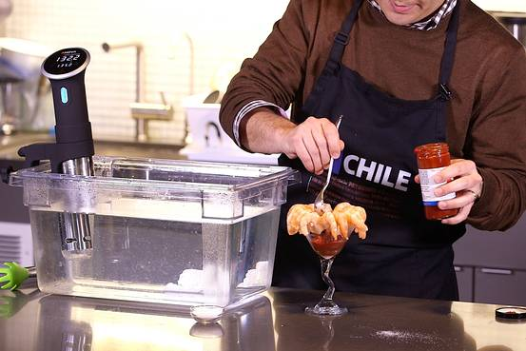
User-Device Interactions

Slide 4

Hands-Free User-Device Interactions
Direct
  User → device
  Voice-based Interaction
  30% of interactions through “conversations” with smart machines
Indirect
  User → hub → device
  Bluetooth Low Energy (BLE)
  75K unique products with BLE support
User
Hub/gateway
IoT
Device
Notes:
https://www.branded3.com/blog/ok-google-give-stats-voice-search/
https://www.gartner.com/doc/3021226/market-trends-voice-ui-consumer
Google I/O 2016

Slide 5
With great power comes great responsibility
(or more security and privacy issues)

Slide 6
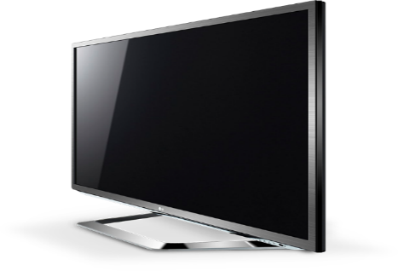
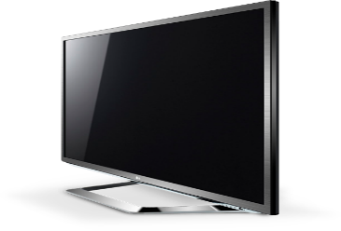




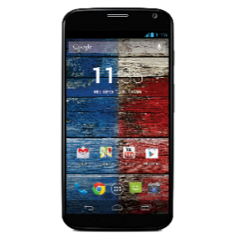
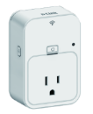
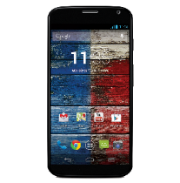
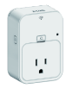

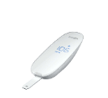




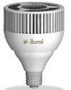
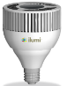
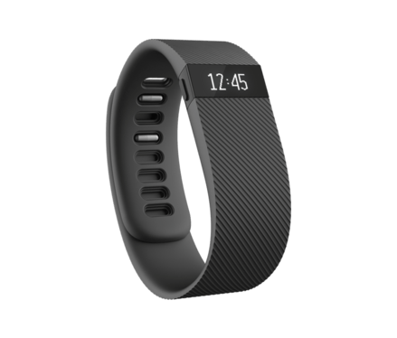
Security and Privacy of User-Device Interactions
Do you share my info with third parties?
Bluetooth Low Energy
Voice interactions
Hands-free interactions

Slide 7
BLE Security
Black Hat 2016 and DEF CON 2016
  “80 % of those BLE smart devices are vulnerable to MitM attacks.”
Reverse Engineering of BLE communications
…
Notes:
https://medium.com/@urish/reverse-engineering-a-bluetooth-lightbulb-56580fcb7546#.7e1kweb0w
https://www.blackhat.com/docs/us-16/materials/us-16-Jasek-GATTacking-Bluetooth-Smart-Devices-Introducing-a-New-BLE-Proxy-Tool-wp.pdf
https://threatpost.com/bluetooth-hack-leaves-many-smart-locks-iot-devices-vulnerable/119825/
https://github.com/Jeija/bluefluff
https://github.com/michael-yuji/BLE-Hacker

Slide 8
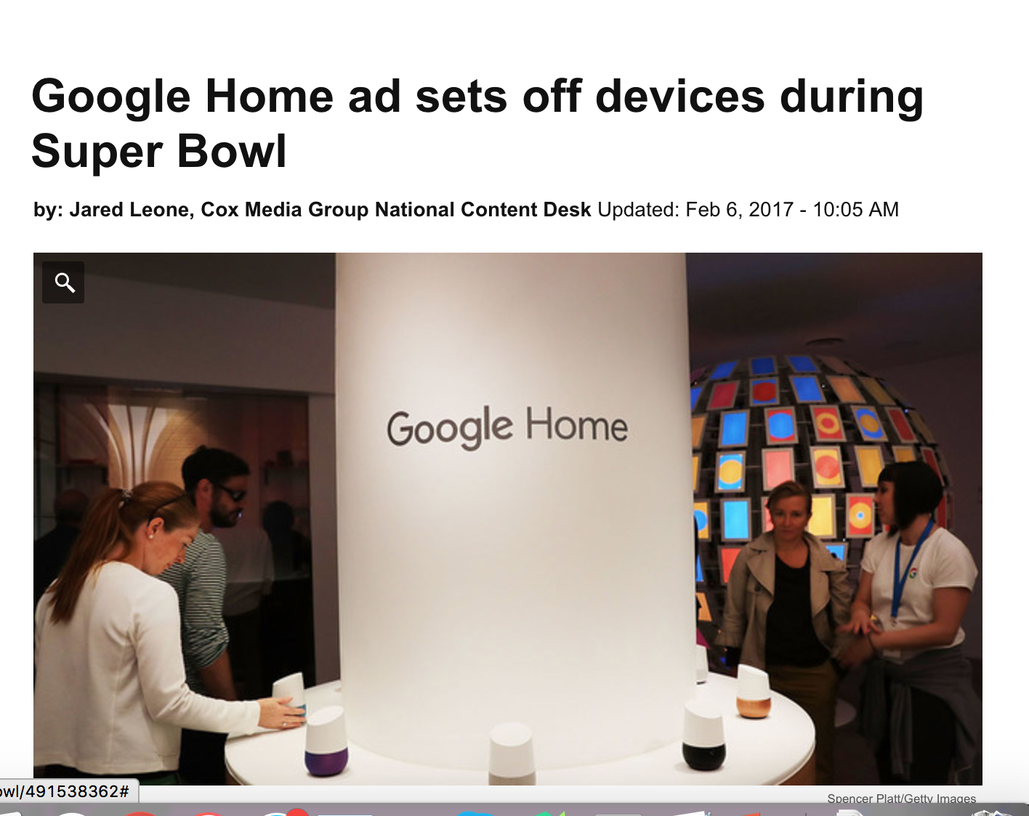
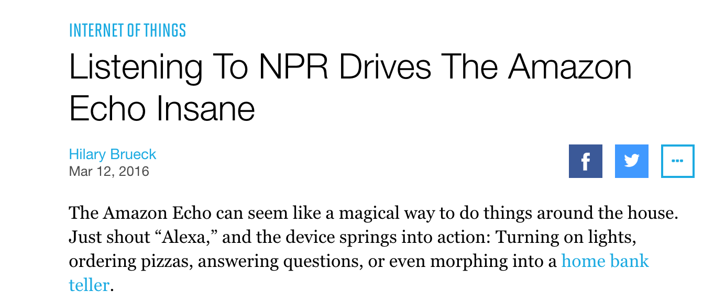
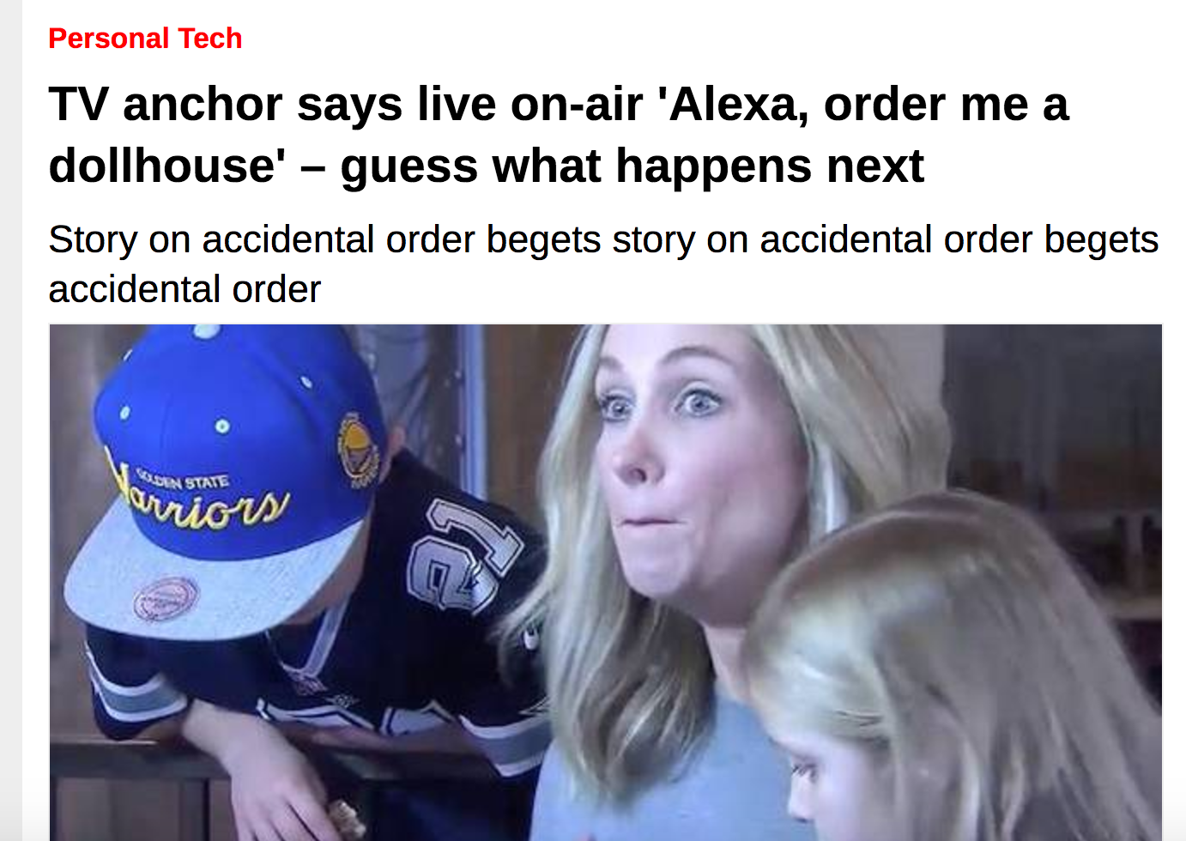
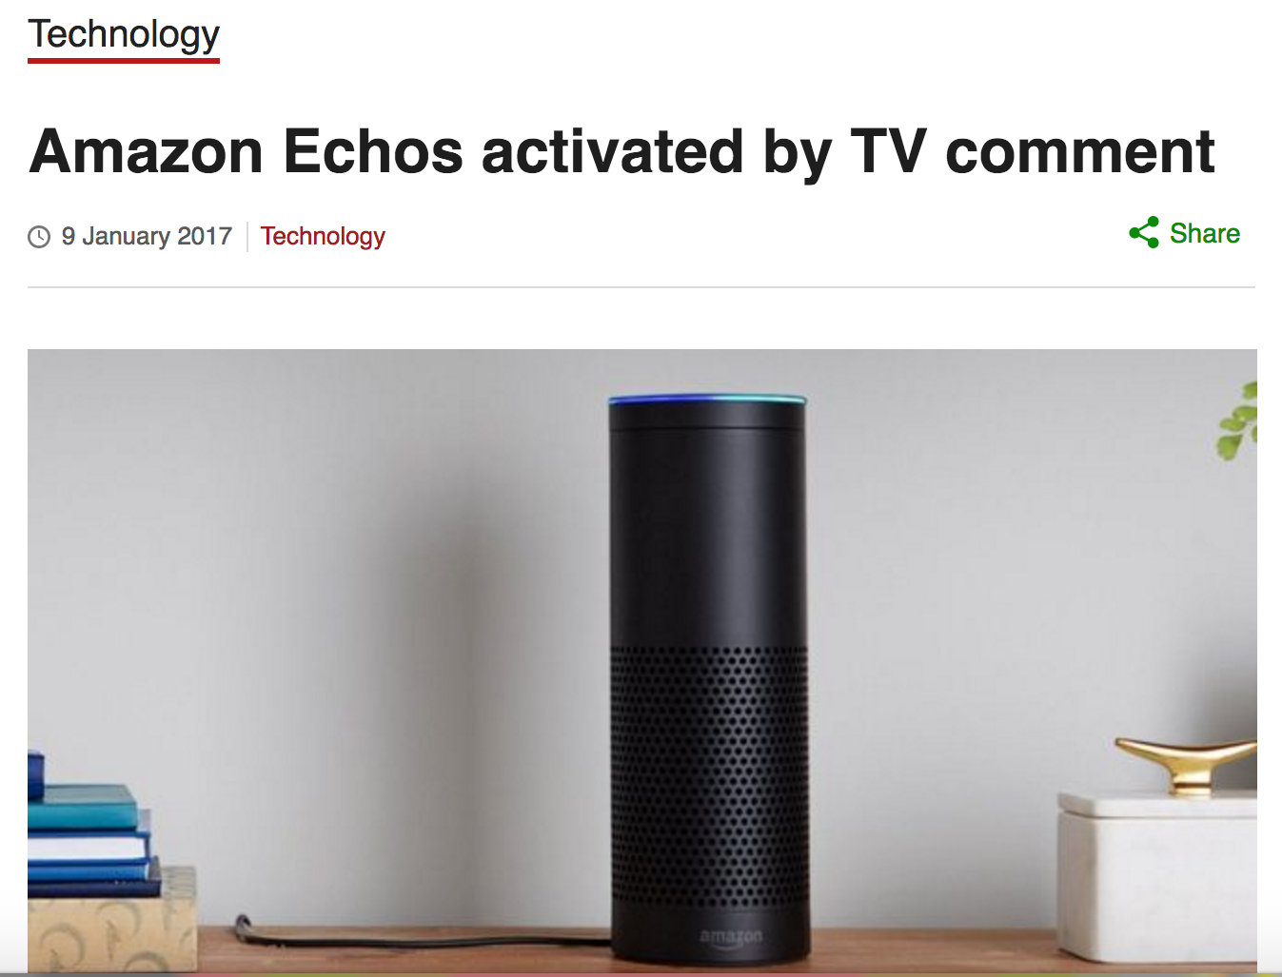
Voice-enabled Devices Listen to Everything

Slide 9
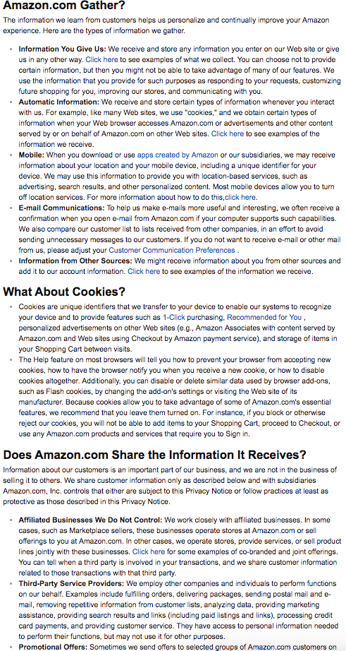
How Can We Deliver Privacy Notices?
Do you share my info with third parties?

Slide 10
This Talk:
Effectively and practically wrap an additional layer of security/privacy protection on top of user-device interactions.

Slide 11
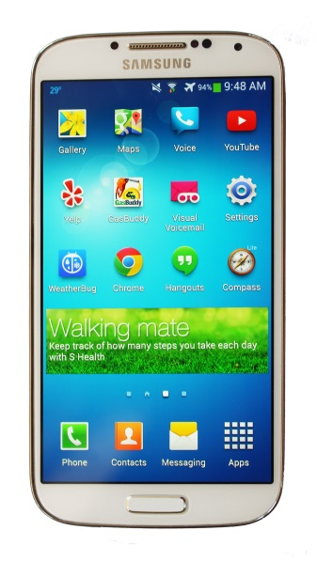









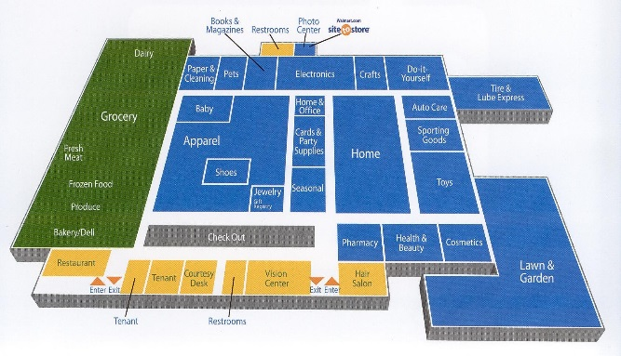

Research Contributions in Security & Privacy
Mobile Systems
Smartphone location privacy
  [USENIX Sec ’15a, CCS ‘14]
Indoor location privacy
  [PETS ‘16]
Mobile linkage privacy
  [USENIX Sec ‘15b]
IoT Interactions
BLE-Guardian
  [USENIX Sec ‘16]
VAuth
  [Under Review]
Pribot
  [WFPN-SOUPS ‘16, Under Review]
Service Provider
I
Localization Infrastructure
A
C
MAC Address
Location
Location-aware apps
H
B
Service
RSSI
D
Android ID
Phone Number
Intent IPC
Location Access Controls
G
E
F
OS level
Android Location Services

Slide 12
Security and Privacy of User-Device Interactions
BLE-Guardian
Access control layer to BLE-equipped devices
VAuth
Pribot
QA interface to deliver privacy notices through a conversation
Continuous authentication interface to voice-activated devices

Slide 13
BLE-Guardian
[USENIX Sec ’16]

Slide 14
BLE Primer
Standby: Low Power Mode. Receiver and transmitter switched ‘off’
Advertising: Used by low power ‘IoT Device’. Only transmitter required.
Scanning: Used by ‘gateway’. Receiver listens to advertising channels.
Initiating: ‘Gateway’ sends connection request
Connection: Communication over data channels.
Scanning
Advertising
Standby
Initiating
Connection

Slide 15
BLE Privacy & Security Effectiveness
Indirect Advertisements
  Detected 214 different unique types of devices
Address Randomization
Name | Description
ihere | key finder
DEXCOMRX | Glucose monitor
Frances’s Band ea:9d | smartband
Otbeat | heart rate monitor
JS00002074 | digital pen
Device | Days observed
One | 37
Flex | 37
Zip | 37
Forerunner 920 | 36
Basis Peak | 25
Address
00:17:E9:CB:F3:61
00:17:E9:CB:F5:01
Revealing Names
Consistent Addresses
Poor Randomization

Slide 16
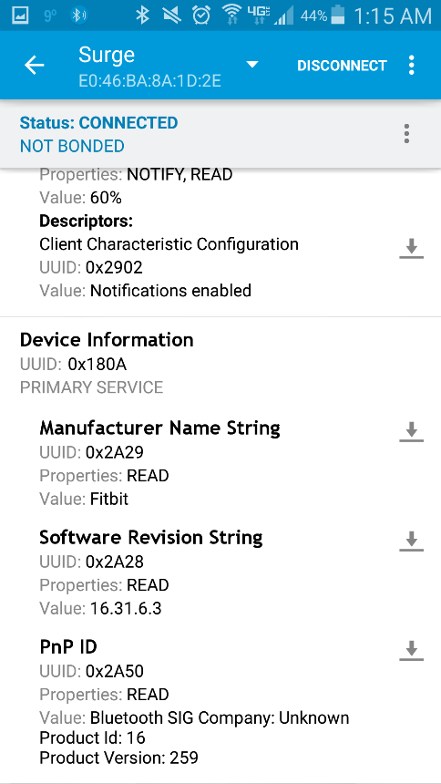
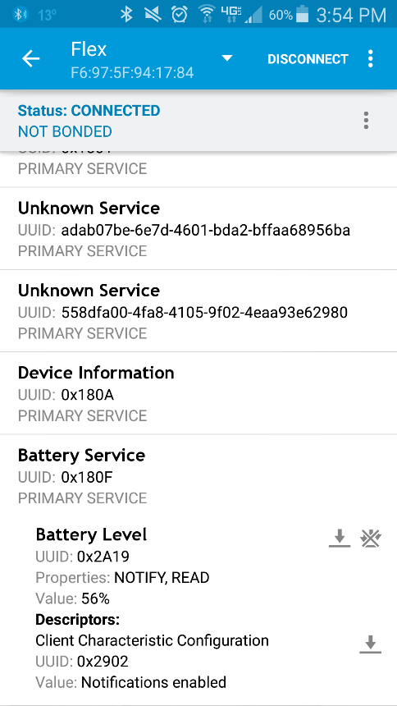
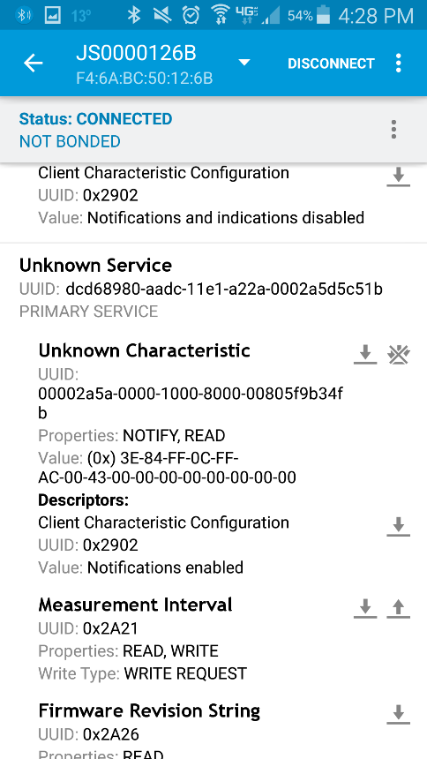
BLE Privacy & Security Effectiveness
Device Pairing
Advertise and accept connections
Battery level
Unique identifiers

Slide 17
It All Starts with the Advertisements…
Tracking User
Profiling User
Harming User
  Health situation, user’s lifestyle, behavior, preferences, and personal interests
  Fingerprinting of and unauthorized access for sensitive systems and devices
Consistent addresses, poor randomization, unique device names and identifiers

Slide 18
Can we effectively fend off the threats to BLE-equipped devices
  in a device-agnostic manner, and
  (2) using COTS (Commercial-Off-The-Shelf) hardware only?

Slide 19
BLE-Guardian
Adversary
Device Hiding
Access Control
BLE-equipped
Device
Authorized client
BLE-Guardian

Slide 20



Device Hiding
Jam BLE device advertisements to hide its existence
Need to learn device advertising Interval
  Otherwise jamming will be ineffective or inefficient
Advertisement
Listen
$$…$$
$$r∈[0,10]$$
$$adv$$

Slide 21

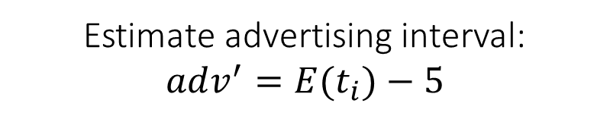



Device Hiding
Advertisement session
$$t_{1}$$
$$t_{2}$$
$$t_{3}$$
$$t_{4}$$
Estimate advertising interval:
$$adv^{′}=E(t_{i})−5$$

Slide 22
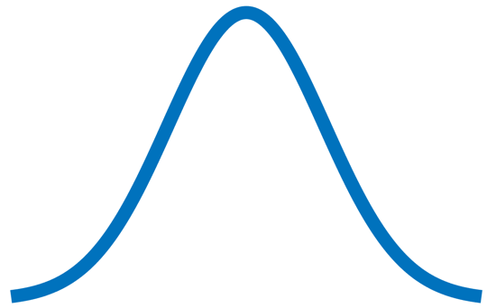




Device Hiding
$$T_{N}$$
$$T_{N}+adv’$$
Max delay
Monitoring interval
$$T_{N}+adv^{′}−e$$
$$T_{N}+adv^{′}+e+10$$

Slide 23
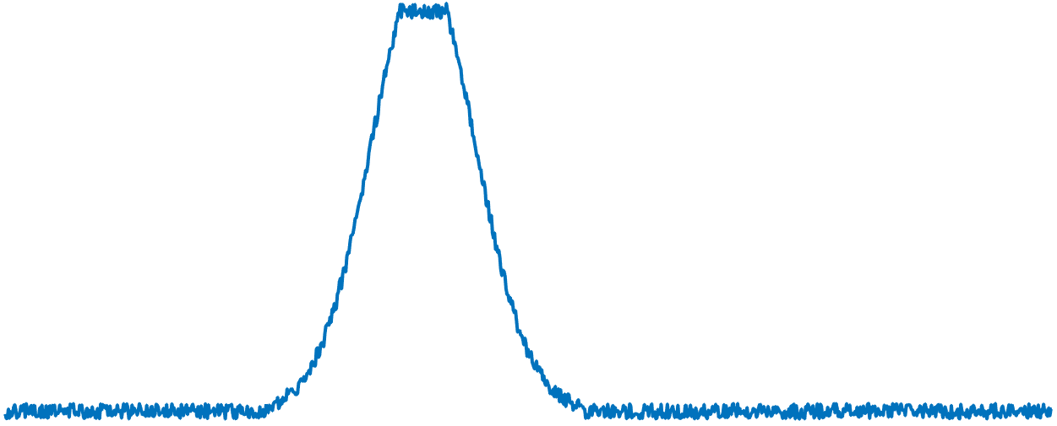
Device Hiding
jamming
Monitoring interval
Detect RSSI (received signal strength indication) increase
Apply jamming

Slide 24
At this point, the target BLE device is hidden.
  How to enable access to it?

Slide 25
Access Control
Bluetooth classic as an OOB channel.
Connection parameters to distinguish legitimate connection request.
Connection
parameters
jamming
adv
Reduced Adv.
Connection request
Legitimate connection
data
data

Slide 26
BLE-Guardian Prototype
External hardware
  Programmable BT radio
  Open source firmware
  Rx/Tx on each BT channel
User-level app
  Control BLE-Guardian
  Update firmware seamlessly

Slide 27
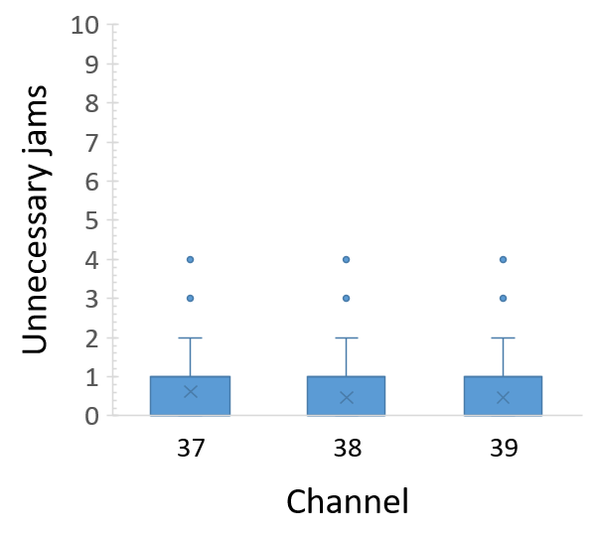
Evaluation
Cut-off distance
  Less than 1m
Impact on advertising channels
  Less than 1 unnecessary jam in 20 ms in worst-case scenario
Energy overhead
  Less than 16%

Slide 28
Summary
BLE-equipped devices enable:
  tracking, profiling and potential physical harm
Challenge: Cannot modify BLE devices post-production
Solution: BLE-Guardian
  Privacy protection for BLE device users
  Device agnostic and relies on COTS hardware
  Low overhead on advertisement channels

Slide 29
VAuth
[under submission]
Notes:
https://robertmcgrath.wordpress.com/tag/continuous-authentication-for-voice-assistants/

Slide 30
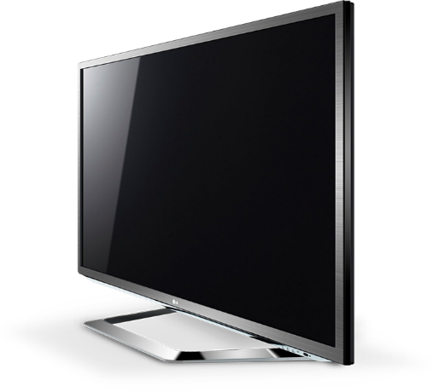
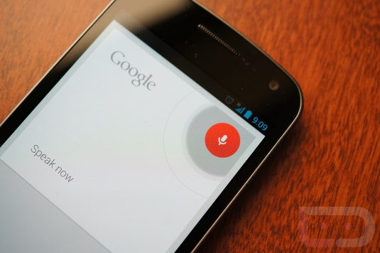
Voice – An Emerging Interaction
While driving, cooking, exercising …
Voice assistants and voice-activated devices

Slide 31
Voice Is an Open Channel
with repercussions …
Mangled voice attack
[Vaidya et al. ‘15, Carlini et al. ’16]
Malicious apps issuing voice commands
[ Ben Itzhak '14]
Command injection through wireless signals
[Kasmi et al. ’15]
Notes:
https://www.hackread.com/4-security-vulnerabilities-in-voice-recognition-technology/Ben-Itzhak

Slide 32

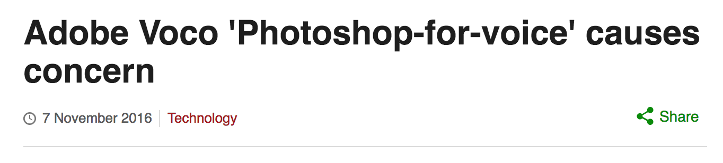
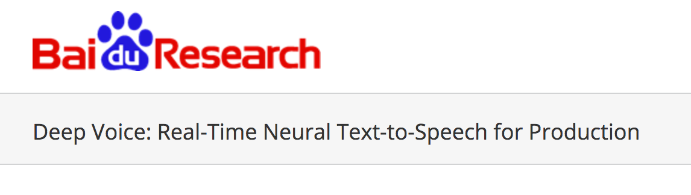
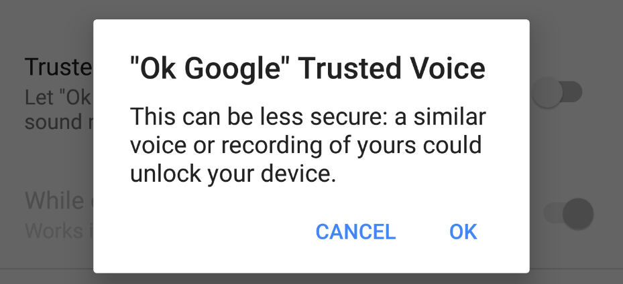
Why Not Voice Biometrics?
Notes:
http://research.baidu.com/deep-voice-production-quality-text-speech-system-constructed-entirely-deep-neural-networks/

Slide 33
VAuth – Continuous Voice Authentication
accelerometer
Real-time matching engine
Match
speech
Mismatch

Slide 34
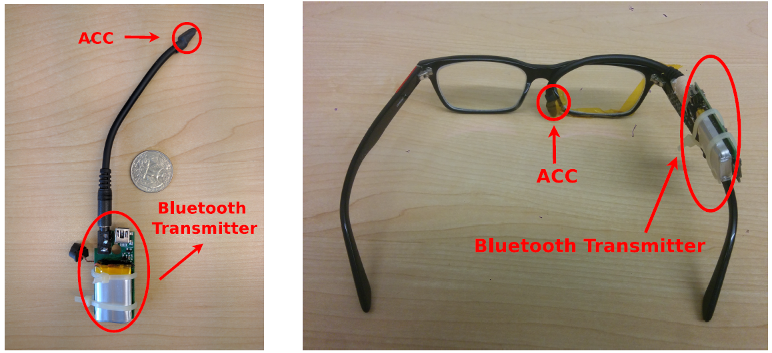
VAuth Prototype
  Smaller than a coin
  Sensitive (11k Hz)
  Analog-to-digital conversion
  Secure Bluetooth transmission
(a) Wireless
(b) Eyeglasses

Slide 35
Evaluation Results
Recruited 18 users issuing 30 commands
  Three positions: (eyeglasses, earbuds, necklace)
  Two mobility scenarios: (still and jogging)
  Five languages: (English, Korean, Arabic, Persian, Chinese)
Takeaways:
  Security: almost 0% false positive rate
  Accuracy: 97% matching rate
  Overhead: 0.35s matching delay, 1 week on 500 mAh battery
Notes:
Beyond 30 cm an attacker cannot use loud voice to inject vibrations on the accelerometer.

Slide 36
Summary
Voice is an open channel
  Unauthorized access to voice-activated devices
Challenge: Need continuous authentication mechanism for voice that does not rely on signature
Solution: VAuth
  Couple the voice channel with physical assurances from on-body vibrations
  Secure, real-time and continuous voice authentication

Slide 37
PriBot
Do you share my info with third parties?
[WFPN-SOUPS ’16, under submission]

Slide 38
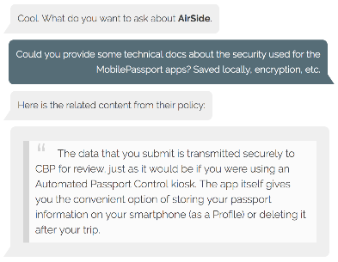
Pribot: Privacy QA System
Do you share my info with third parties?
Do you share my info with third parties?
Question
Answer
Information about our customers is an important part of our business, and we are not in the business of selling it to others. We share customer information only as described below and with subsidiaries Amazon.com, Inc. controls that either are subject to this Privacy Notice .
Pribot

Slide 39
Challenges
Language discrepancy between user’s question and privacy policy
Word embeddings and neural networks
Lack of privacy-related Question-Answering datasets
Repurpose existing privacy policies datasets

Slide 40
QA Approaches
Inputs:
  Q: User Question
  S: Policy Segment
Output:
  Ranked policy segments
  User-friendly summaries
Approaches:
  Semantic Vector
  Hierarchical Classifier
q₁
q₂
…
Embeddings Layer
Neural Network(s)
Vector
Q
Similarity
Measure
a₁
a₂
…
Embeddings Layer
Neural Network(s)
S
Vector
Pribot engine

Slide 41
Online Privacy Policies Dataset
[Wilson et al. ’16]
115 annotated policies
23K annotations
1st Party Collection
Collection Mode
Purpose
3rd Party Collection
Action
Information Type
Purpose
Choice, Control
Choice Type
Choice Scope
...
Do Not Track
Policy Change
Do Not Track Policy
Notification Type
Information Type
Audience group
Specific Audiences
Security Measure
Data Security

Slide 42
Semantic Vector Approach
Embeddings:
  Match question-answer vocabulary
Classification Task:
Embeddings
Layer
CNN
+
Max-Pooling
Dense 1
Max-
Pooling
+
ReLU
Dense 2
Softmax
w₁
w₂
…
segment
class
Phrase | Label
If we believe in good faith that the law requires such disclosure. | Purpose : legal-requirement
… | …
Segment Representation

Slide 43
Need Privacy Taxonomy
Third party collection
  “third-party application providers may automatically collect real-time geographic location information or other location-based information about you and your device . . .”
First party collection
  “we automatically collect and store certain information (. . . ) including: (. . . ) your mobile device’s geographic location (specific geographic location if you’ve enabled collection of that information…”

Slide 44



Hierarchical Classifier
Category-level Classifier
P=0.5
1st Party Collection
3rd Party Collection
…
$$\text{Value}\text{−}\text{level} \text{Classifiers}$$
Info Type
Purpose
Collection Mode
…
P=0.3
Financial
Location
…
Marketing
Legal
…
On-website
From 3rd party
…
$$\text{Distribution} \text{of}\text{: }\text{P}\text{(}\text{category}\text{)}\text{x}\text{P}\text{(}\text{value}\text{)}$$
…
…
…
$$\text{Distribution} \text{vector}$$
0.15
0.06
…
0.11
…
0.13
0.06
…

Slide 45
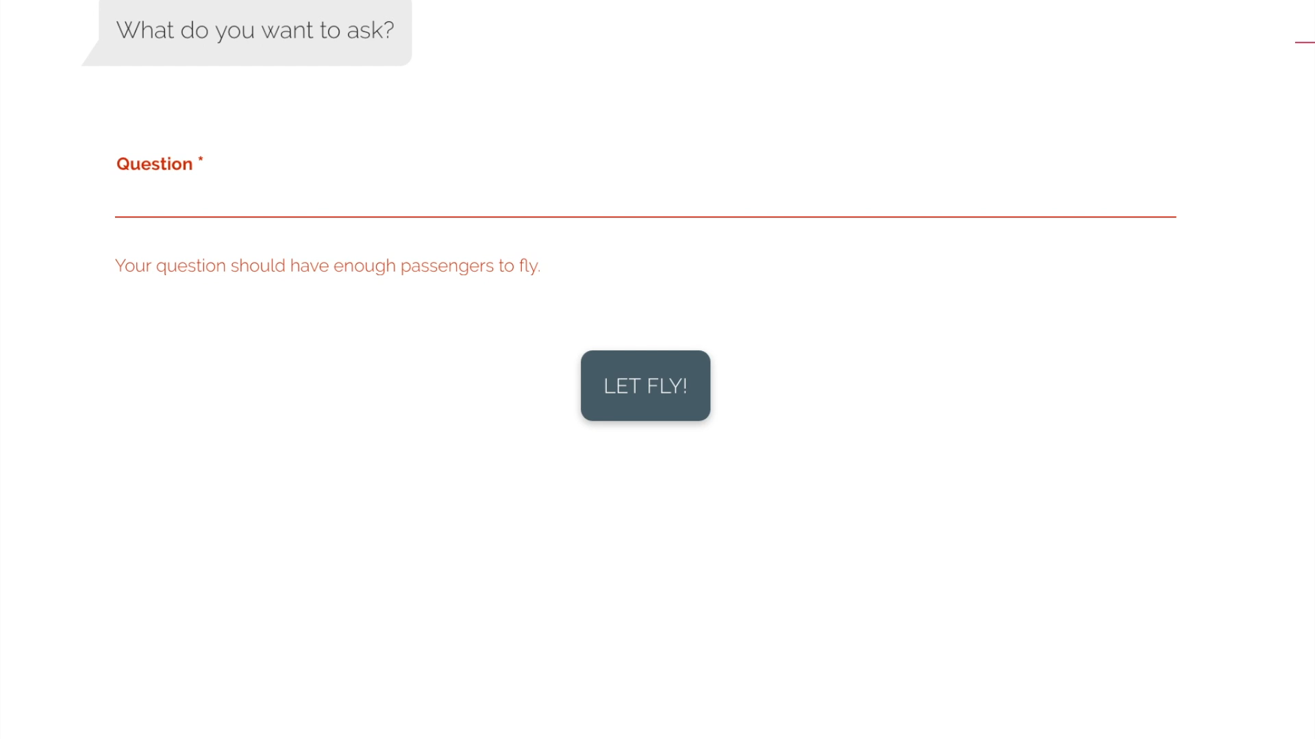

Slide 46
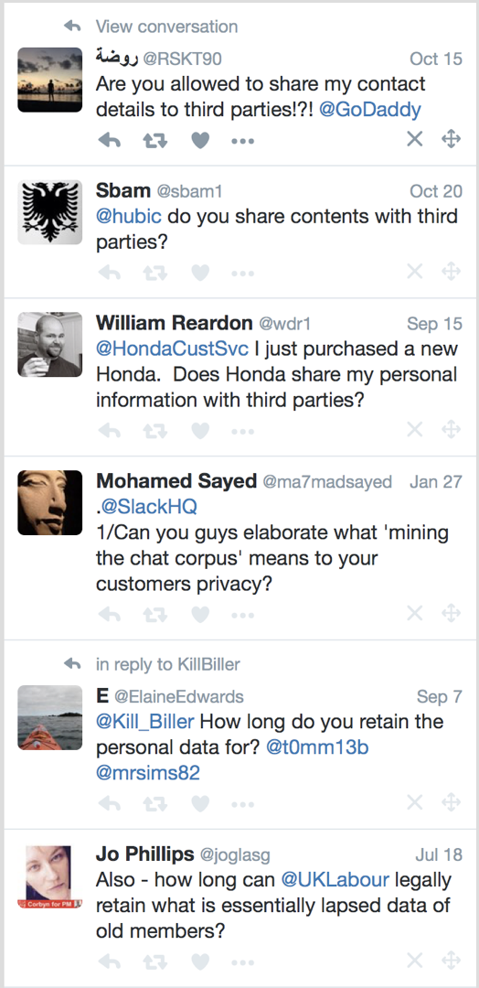
Twitter Dataset
Backtrack company replies to questions
120 questions about 102 companies
Real-world testing dataset
  Real user-company interactions

Slide 47
Relevance Evaluation
Methodology
  Between subject study
  1186 respondents on MTurk
Results
  Hierarchical: 91% relevance @3
Notes:
Example of relevant but not accurate:
thanks. Do you pass on customer addresses to 3rd parties? Got interiors catalogue addressed to me here. How did they know
Retrieval returns the following relevant but inaccurate answer:
To supply our customers with our services we need to use information about you, and some of that may be personal or private. For example we may need to know your name and address”.
The answer, which contains multiple matching terms, describes a first-party collection practice not a third-party one.

Slide 48
Accuracy Evaluation
Methodology
  Two independent annotators
  Consolidate the annotations
  Hierarchical:
  70% of questions had accurate answers in top 3
  Highest agreement between relevance and accuracy

Slide 49
Summary
Limited-UI devices and hands-free interactions
  Traditional privacy notice delivery methods do not apply
Solution: Pribot
  Answers, automatically, user free-form question from policies
  Provides answers that have high accuracy and relevance in real-time
Deployment:
  Integrate with IoT gateways for indirect hands-free interactions
  Incorporate within voice assistants for direct hands-free interactions

Slide 50
Conclusion
The security/privacy problems of IoT are multi-faceted
This talk addresses the interactions’ aspects:
  BLE-Guardian: BLE-equipped device
  VAuth: voice-activated devices
  Pribot: UI-limited devices
More work needed on system, users, device and policy levels

Slide 51
Future Work
IoT Security from a Distance
A Network View to IoT Security
Usable Security & Privacy
IoT Data Privacy

Slide 52
Thank You.
kmfawaz@umich.edu
kassemfawaz.com

